Slide 1
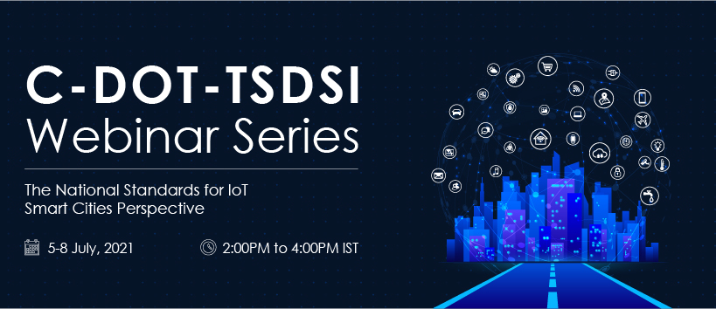

Slide 2

Inaugural Session
The Global Context of oneM2M
Enrico Scarrone
Technology Communicaton & Standardization
oneM2M Steering Committee Chairman
ETSI TC smartM2M Chairman

Slide 3
IoT: what is about!
IoT
Vertical business
Ecosystems
Humans
Better services
Sharing informations
Things
New services
Machines
Edges
Edges
Cloud
Connectivity
protocols
API
platforms
Edges

Slide 4

IOT: From Connectivity to Information sharing
Semantic support
Information
Service Enablement
Service Enablement
Data
Data
Management
Services
Management
Services
Management
Services
Connectivity
Connectivity
Connectivity
Connectivity
Devices
Devices
Devices
Devices
Connectivity
Deployment
Data sharing
Information sharing

Slide 5












oneM2M Partnership Project
founded¹ July, 24th 2012
More than 200 member organizations in oneM2M
Based on ETSI M2M Rel 1 and Rel 2 standards)
Join forces
=> reduce fragmentation
=> Integrate existing solutions
=> Merge Ecosystem
Partner transpositions
De jure Standard
“collaborate on standard”
focus on interoperability
“compete in implementation”
“do not re-invent the wheel”
=> Reuse e.g.
HGI
Release 2 transposition
ITU-T SG20 Y.4500.x
www.oneM2M.org
All documents and specifications are publically available

Slide 6

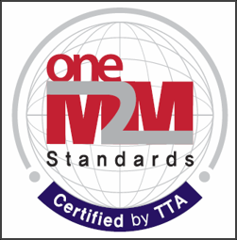
oneM2M
Standard – Testing – Certification Programs
Energy
Enterprise
Healthcare
Public Services
Residential
Other
Transportation
Industry
Interoperability
Test Events
REQUIREMENTS
TS-0002
TECHNICAL REPORTS
TECHNICAL SPECS
Certification Program
TECHNICAL REPORTS
TECHNICAL SPECS
TECHNICAL REPORTS
TECHNICAL SPECS
Transposed to Partner Specifications Regional Standards

Slide 7
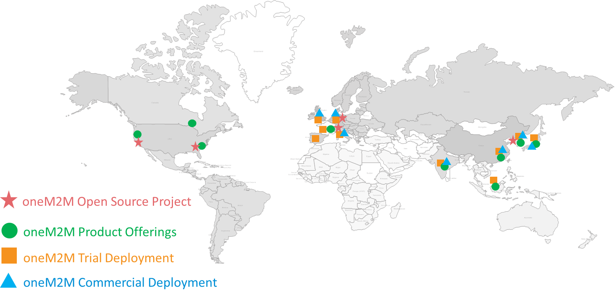
oneM2M Adoption is Global

Slide 8
www.oneM2M.org – All freely accessible
Benefits of oneM2M https://www.onem2m.org/using-onem2m/what-is-onem2m
The IoT Standard for Interoperable and Scalable Systems https://www.onem2m.org/using-onem2m/what-is-onem2m#standard
oneM2M’s Value Proposition https://www.onem2m.org/using-onem2m/what-is-onem2m#value
oneM2M Technical Specifications https://www.onem2m.org/technical/published-specifications
OneM2M opensource resources https://www.onem2m.org/using-onem2m/devices-examples/onem2m-device-and-platform-software-resources
oneM2M Adoption and User Experiences https://www.onem2m.org/using-onem2m/what-is-onem2m#adoption
oneM2M Implementation Guidance https://www.onem2m.org/using-onem2m/what-is-onem2m#implementation
Develop with oneM2M https://www.onem2m.org/using-onem2m/developers
Deploy with oneM2M https://www.onem2m.org/using-onem2m/devices-examples
Some useful links
on the oneM2M webpages

Slide 9
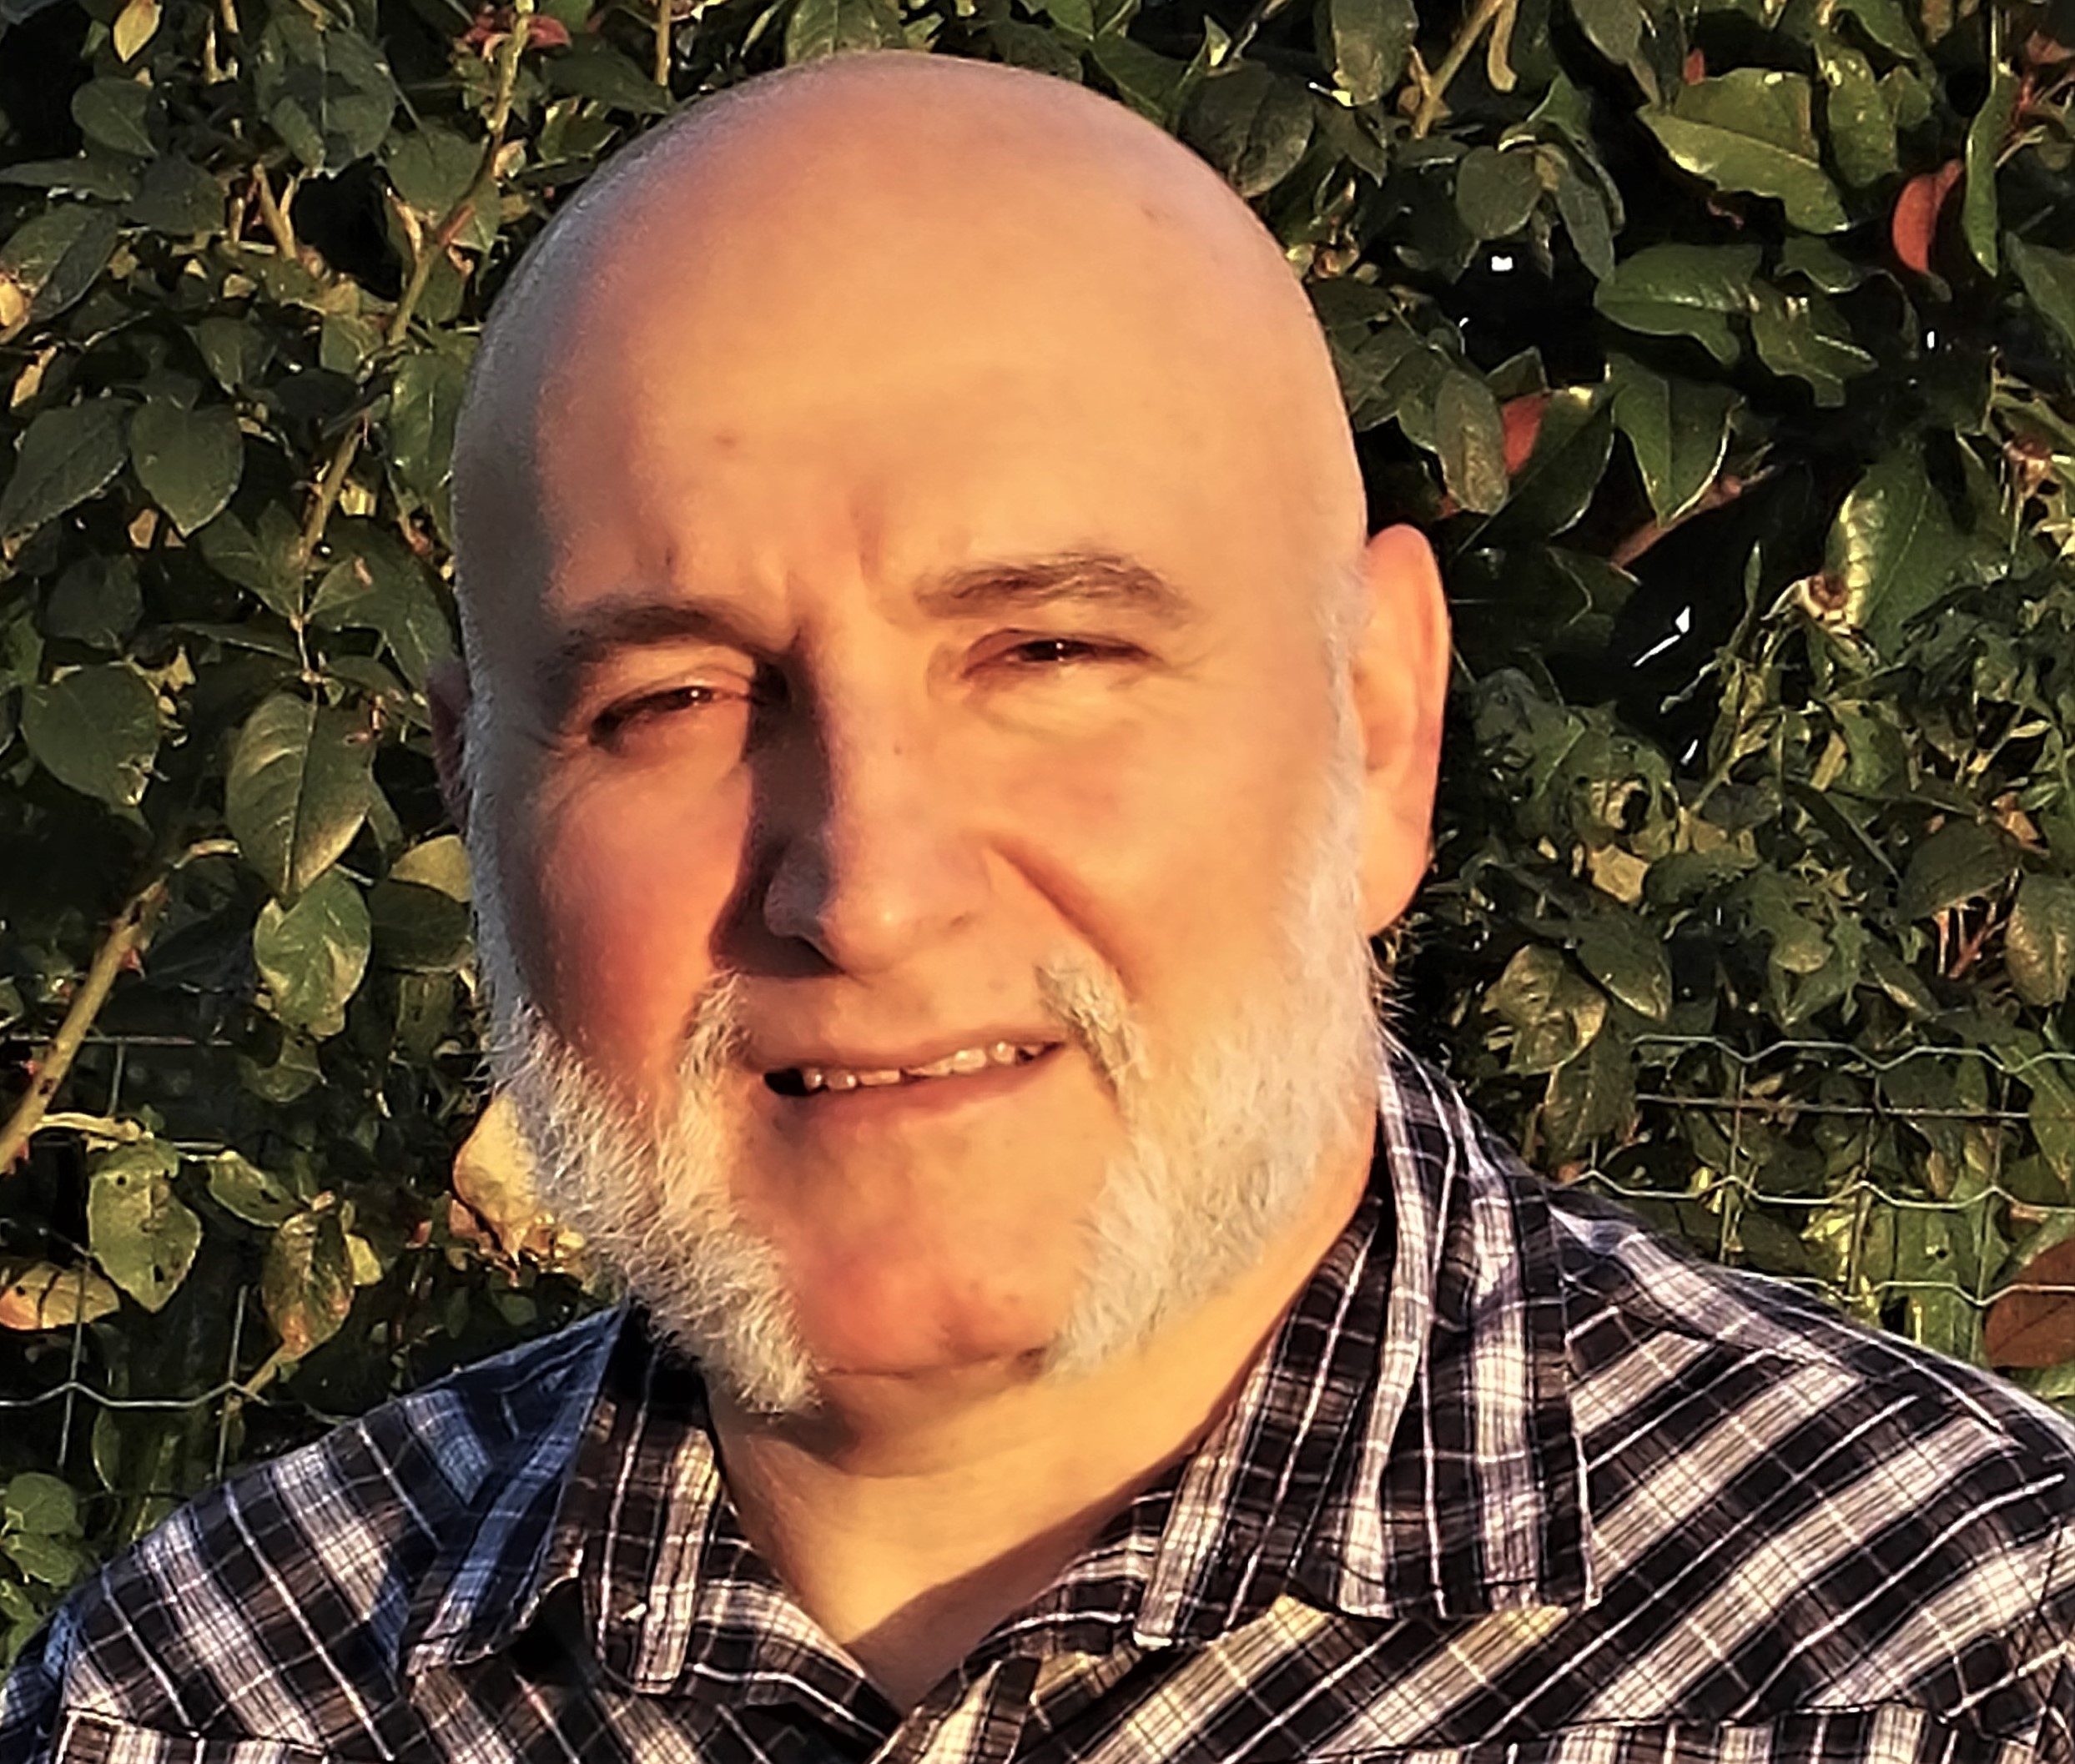

Contact details
Dr. Enrico Scarrone
ETSI TC smartM2M Chairman,
oneM2M Steering Committee Chairman
M2M/IoT Standardization Manager
TIM | CTIO | Technology Communication & Standardization
enrico.scarrone@telecomitalia.it
IOT:
It is NOT about selecting a protocol… or a platform…or a cloud….
IoT is sharing the information and its meaning
between different systems, different applications,
different business sectors !
Thank you!

