Slide 1
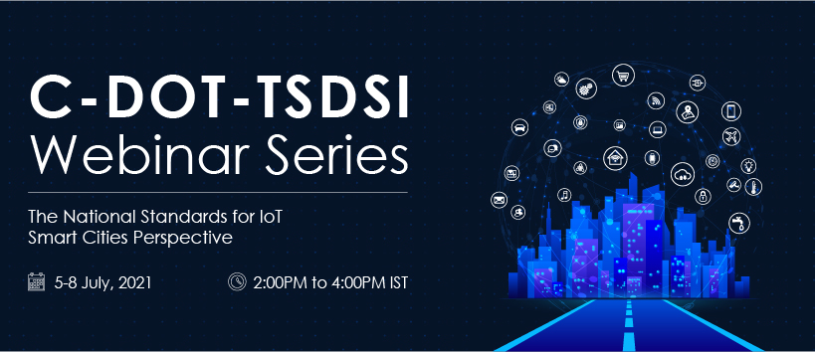

Slide 2
IoT Standards and Smart Cities: Security, Privacy and Trust
Security, Privacy and Trust in IoT Ecosystem : The oneM2M way
Rana Kamill
Security Consultant, BT
oneM2M
C-DOT TSDI Webinar Series- Security, Privacy and Trust in IoT Ecosystems: The oneM2M way

Slide 3
IoT Threat Assessment
Internet of Computers:
Attended by human « owners »
Comfortable, controlled environment
Relatively fixed location
Low latency broadband connection
Few chipsets and OSs to secure
Few Apps largely deployed
Rather uniform lifetime
Relatively powerful resources (computing, memory, energy supply)
Internet as entry point
Frequent software security patches
Ever decreasing cost of attacks
« Virtual world » impact (information)
Internet of Things:
Largely unattended by owners
Harsh conditions, or physical exposure
Potentially highly mobile
Sporadic/constrained throughput/latency
Diversity of embedded hard and soft
Multitude of small deployments
Lifetime from months to decades
Constrained power, memory, processing
More, weaker entry points
Weaker, possibly unmaintained software
Available and accessible
Real world impact (physical safety)

Slide 4
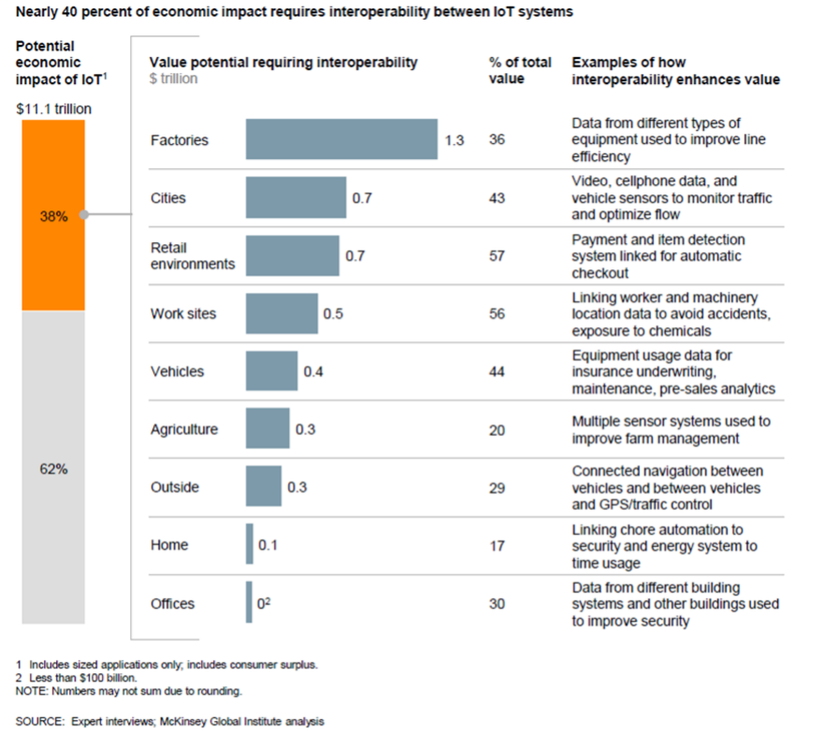
40% of economic impact of IoT requires interoperability between IoT systems
Source: McKinsey

Slide 5
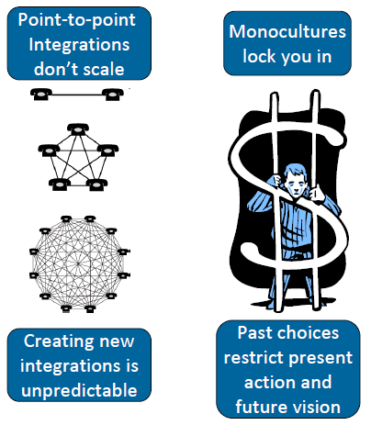
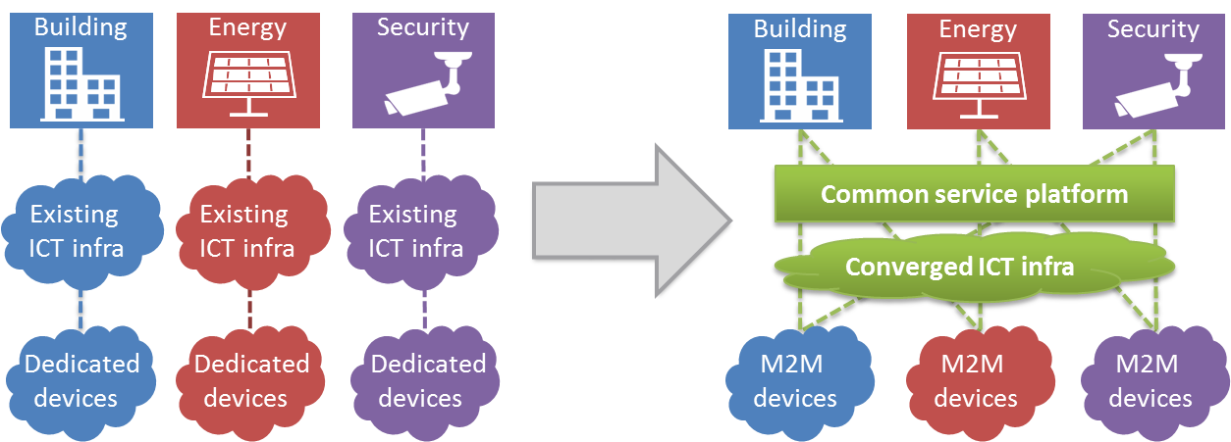
An integrated solution is needed
Highly fragmented market with small vendor-specific or sector-specific solutions.
Reinventing the wheel: Same services developed again and again-
Limited communication and high integration costs

Slide 6
Why use oneM2M?
THE ONLY STANDARD “DE JURE” DEDICATED TO ENABLE HORIZONTAL IOT INTEGRATION
DATA MANAGEMENT - DATA HISTORIZATION - INFORMATION SHARING
VERY DYNAMIC PRIVACY AND ACCESS CONTROL
SECURE: MULTIPLE SECURITY LEVELS
STORAGE AND EXPOSURE FOR
  Historical data
  Data search and aggregation
  Context information
  Dynamic data
  Real time control and actuation
  Field device management
  Network technologies independence
EASY DB AND CLOUD INTEGRATION
NATIVE DEVICE MANAGEMENT (DM; TR 069)
FLEXIBLE IN THE DEPLOYMENT to adapt to the requirements of the various domains
SCALABLE ARCHITECTURE
INTER-PROVIDER NATIVE SUPPORT
DESIGNED BE AN INTERWORKING FRAMEWORK FOR
  Legacy field and core server technologies
  Other technologies
  Proprietary solution
  -> Not an additional solution, but a standard to integrate the different solutions
SEMANTIC ENABLED TO SHARE INFORMATION
INTERNET FRIENDLY FOR HUMAN INTERACTION
SIMPLE if you use the core functions and know your deployment architecture

Slide 7
Opportunities and problems
Diversity is the richness that allows evolution and innovation: combination of services is the biggest opportunity for the future
But fragmentation of solutions and technologies is the enemy that is delaying and blocking the developments
Simplify the environment, remove the unnecessary duplicated solutions (economy of scale), preserve the necessary/opportune solution specialization by interworking.

Slide 8

Opportunities and problems
Support the developers community accelerating the development of IoT.
Transfer the competition from integration and platforms to services unlocking the market
Reduce the cost due to the silos approach and its management
Enable Inter-technology and inter-domain data sharing generating new services and new business opportunity
Reduce platform development and integration costs,
enlarge the market,
enable real competition on services

Slide 9
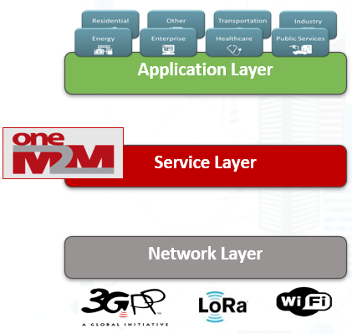
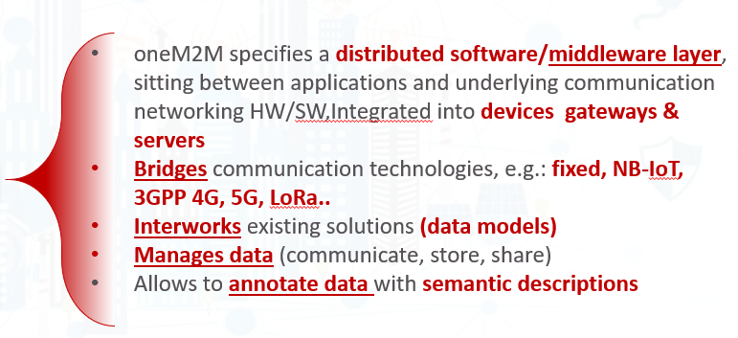

oneM2M
…and most importantly: is a Global Standard – not controlled by a single private company!

Slide 10
OneM2M
Service Enablement
Data
Management
Services
Management
Services
Connectivity
Connectivity
Connectivity
Devices
Devices
Devices
Connectivity
Deployment
Integration
oneM2M standard is based on a “Store and Share” resource REST based paradigm.
The data may be made available in the platform to the other applications, interested application are notified by means of subscription
Privacy is ensured by a strict Access Control Management, which relies on underlying network security, providing a secure light solution
oneM2M is heavily reusing underlying network functionalities, including TR069 and OMA DM management, LCS, subscription management, QoS, Charging, etc.
oneM2M is an interworking framewort designed to connect the different IoT technologies

Slide 11
oneM2M integrates the vertical silos!

Slide 12
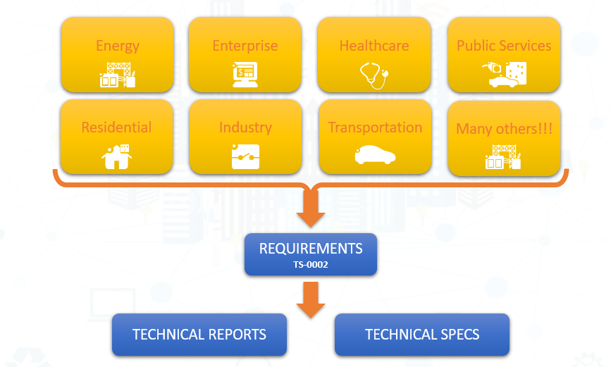
Work flow

Slide 13
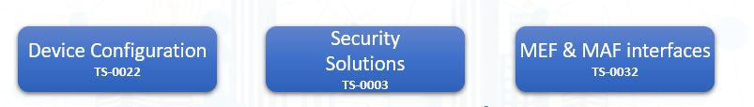
Security in oneM2M Release 2- Release 4
Enrolment services (RSPF / MEF)
Credentials Provisioning/Security Configuration of the M2M System
Secure communications services (SAEF / MAF)
Methods for Securing Information (PSK/PKI/Trusted Party)
Point-to-point and end-to-end solutions (TLS / DTLS)
Access Control & Authorization services
Requester Authentication
Information access Authorization(ACL based)
Static and Dynamic solutions
Privacy Policy Management

Slide 14
oneM2M Secure Environment and security levels
« Secure Environment » concept abstracts the security implementation
  Expose common services to applications, depending on implementation
  Provide common interface for remote security administration, if needed
oneM2M supported implementations distinguish 4 security levels
  No additional security
    devices otherwise protected from attackers, i.e. on trusted networks
  Software only security (obfuscation, White box crypto etc.)
    Always vulnerable to sufficiently motivated attacker
    Acceptable when compromise is not critical
  « Trusted Execution Environment » (TEE) relying on main CPU hardware features
    Good barrier against software based attacks
    Sufficient for remotely accessible, but not physically exposed devices
  Tamper resistant hardware embedded Secure Element (eSE)
    Required to protect secrets within devices physically exposed to attackers (SPA / DPA etc.)
    E.g. to protect unattended devices against cloning

Slide 15
Summary of Release 2- Release 4 Features
Industrial Domain Enablement
  Time series data management
  Atomic Transactions
  Action Triggering
  Optimized Group Operations
Home Domain Enablement
  Home Appliance Information Models & SDT
  Mapping to existing standards (OCF, ECHONET, GoTAPI...)
Smart City & Automotive Enablement
  Service Continuity
  Cross resource subscriptions
Management
  M2M Application & Field Domain
  Component Configuration
Market Adoption
  Developer Guides
  oneM2M Conformance Test
  Feature Catalogues
  Product Profiles
oneM2M
Rel-2/3
Features
Semantics
  Semantic Description/Annotation
  Semantic Querying
  Semantic Mashups
  oneM2M Base Ontology
oneM2M as generic interworking framework
  3GPP SCEF
  OMA LWM2M
  DDS
  OPC-UA
  Modbus
  AllJoyn/OCF
  OSGi
  W3C WoT
Security
  Dynamic Authorization
  End to End Security
  Enrollment & Authentication APIs
  Distributed Authorization
  Decentralized Authentication
  Interoperable Privacy Profiles
  Secure Environment Abstraction

Slide 16

oneM2M Security Framework
Registration
Service Layer
Authorization
Dynamic Authorization
oneM2M provides a common set of security capabilities to secure IoT devices and applications and prevent/ mitigate attacks
oneM2M exposes an abstracted set of security related APIs to help simplify security for IoT devices and applications
Message Security
Privacy Policy Manager
Enrollment & Provisioning
End-to-End Security
Registration
Discovery
Security
Group Management
Communication Management
Data Management & Repository
Subscription & Notification
Device Management
Application & Service Management
Network Service Exposure
Location
Service Charging & Accounting
Semantics
Transaction Management

Slide 17
Security in oneM2M Release 2-Release 4
Main security functions supported:
  Identification and Authentication
    Identification: checking if the identity of the request originator provided for authentication is valid
    Authentication: validating if the identity supplied in the identification step is associated with a trustworthy credential
  Security Association Establishment
    Establishment of a security context between communicating entities to provide confidentiality (encryption) and integrity
    Range of authentication options supported
  Authorization (Access Control)
    Authorizing services and data access to authenticated entities
  Remote Provisioning

Slide 18
Security in oneM2M Release 2-Release 4
Additional security functions:
  Identity protection
    Capability to use pseudonyms to protect anonymity of transactions
  Sensitive data handling
    Capability to protect sensitive data (e.g. local credentials) and functions (e.g. data encryption/decryption) in a Secure Environment (e.g. Smart Card or Virtual Smart Cart)
  Security administration (related to device management)
    Creates and administers dedicated Secure Environments and post-provisioning of master credentials

Slide 19
Enrollment & Provisioning (Onboarding)
Onboarding is the procedure of bringing IoT Field Devices into operation in an IoT network
Procedures must cope with large variety of field devices types and Service Provider‘s business models
oneM2M has specified an “M2M Enrolment Function“ (MEF) which enables stakeholders to setup their preferred onboarding and enrollment mechanisms in an interoperable way

Slide 20
Enrollment & Provisioning (Onboarding)
M2M Enrollment Function can trigger the Field Device to execute a variety of procedures, including
  Configuration of Field devices with registration parameters (e.g. oneM2M identifiers and contact information)
  Provisioning of symmetric keys
  Provisioning of certificates
  Keys and Certificates can be provisioned for securing oneM2M communication across a single communication “hop” or across multiple hops in an end-to-end fashion (see following slides).
M2M Enrollment Function is operated by M2M Service Provider or trusted 3rd party (device manufacturer, underlying network operator, etc.)

Slide 21
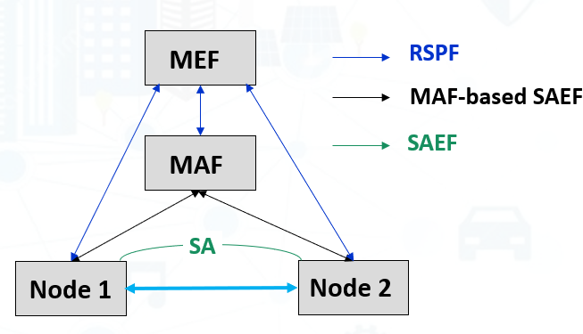
M2M Enrolment Function (MEF)
M2M Enrolment Function allows 3 types of Remote Security Provisioning Frameworks (RSPF)
  Symmetric key authenticated RSPF
  Certificate authenticated RSPF
  GBA-authenticated RSPF; in this case the MEF is the Bootstrapping Server Function (BSF) of 3GPP Generic Bootstrapping Architecture (GBA)
MEF can trigger the Field Device to execute a variety of procedures, including
  Configuration of Field devices with registration parameters and authentication profiles applicable to the operational Security Frameworks (see next slide)
  Provisioning of symmetric key credentials
  Provisioning of certificates (certificate (re-)enrolment using EST and SCEP specified by IETF recommendations)
MEF is operated by M2M Service Provider or trusted 3rd party (device manufacturer, underlying network operator)

Slide 22
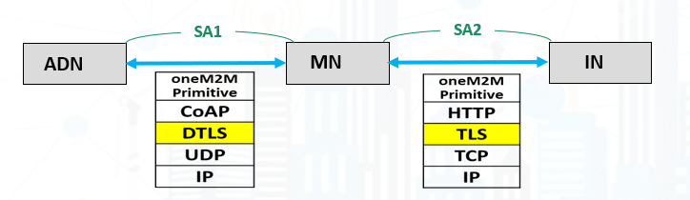
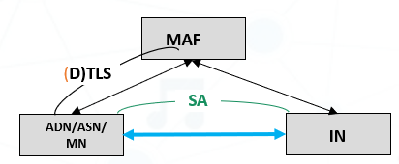
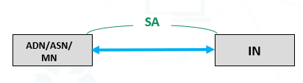
Message Security between adjacent Entities:
The operational security framework
Message Security between adjacent Entities:
The operational security framework
Uses (Datagram) Transport Layer Security Protocols, TLS/DTLS Version 1.2
Several Security Association Establishment Frameworks are supported:
  Authentication and session key establishment using symmetric keys shared by devices
  Authentication and session key establishment using Certificates provisioned to devices
  Authentication facilitated by an M2M Authentication Function (MAF) hosted by M2M-SP or third-party
    The MAF authenticates the end-points (PSK or certificates) and facilitates establishing a symmetric key

Slide 23
Authorization / Access Controls
oneM2M is based on a RESTful architecture
  API is based on requests to perform an operation on a resource
  Operations are Create, Retrieve, Update, Delete
oneM2M Service Layer supports configurable access control policies that define clear rules dictating, for each resource
  WHO is authorized to access,
  WHAT operations are allowed, and under
  WHICH conditions (e.g. time, location of entity)

Slide 24
Authorization / Access Controls
Resource access is authorized based upon satisfying at least on Access Control Policy (ACP) rule in one of the linked ACPs

Slide 25
Dynamic Authorization
Dynamic Authorization: Originator or Hosting CSE requesting authorization of Originator – provided by a Dynamic Authorization System (DAS) Server
  Direct Dynamic Authorisation: Hosting CSE submits request to DAS, Originator not communicating with DAS Server
  Indirect Dynamic Authorisation: Originator submits request to DAS Server using info provided by Hosting CSE. Similar to Open Authentication (OAuth) mechanism
  DAS has multiple options for authorizing: Issue/update access control rules, assign Role(s) to the Originator, issue JSON Web Tokens (JWT)
Direct Dynamic Authorisation
1. Request
Hosting
CSE
4. Response (‘success’)
Originator
(AE or CSE)
3. Response
(with Token or dynamicACPInfo)
3. Request
(with parameters from step 1)
DAS
Server

Slide 26
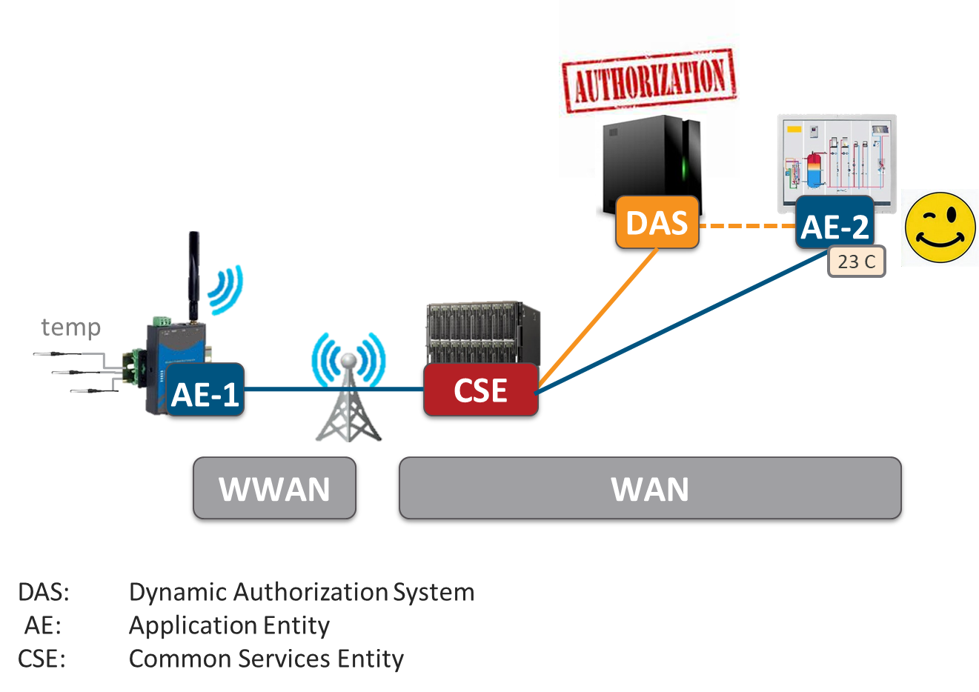
Privacy Policy Manager

Slide 27
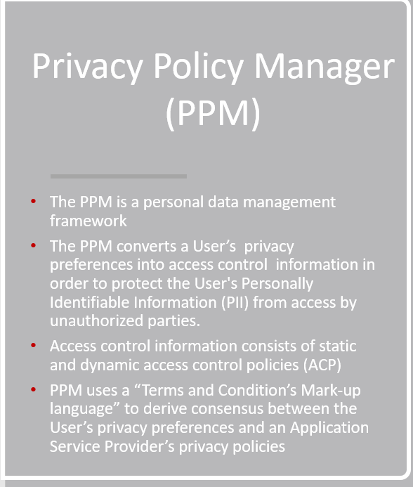
Privacy Policy Manager (PPM)
The PPM is a personal data management framework
The PPM converts a User’s privacy preferences into access control information in order to protect the User's Personally Identifiable Information (PII) from access by unauthorized parties.
Access control information consists of static and dynamic access control policies (ACP)
PPM uses a “Terms and Condition’s Mark-up language” to derive consensus between the User’s privacy preferences and an Application Service Provider’s privacy policies

Slide 28
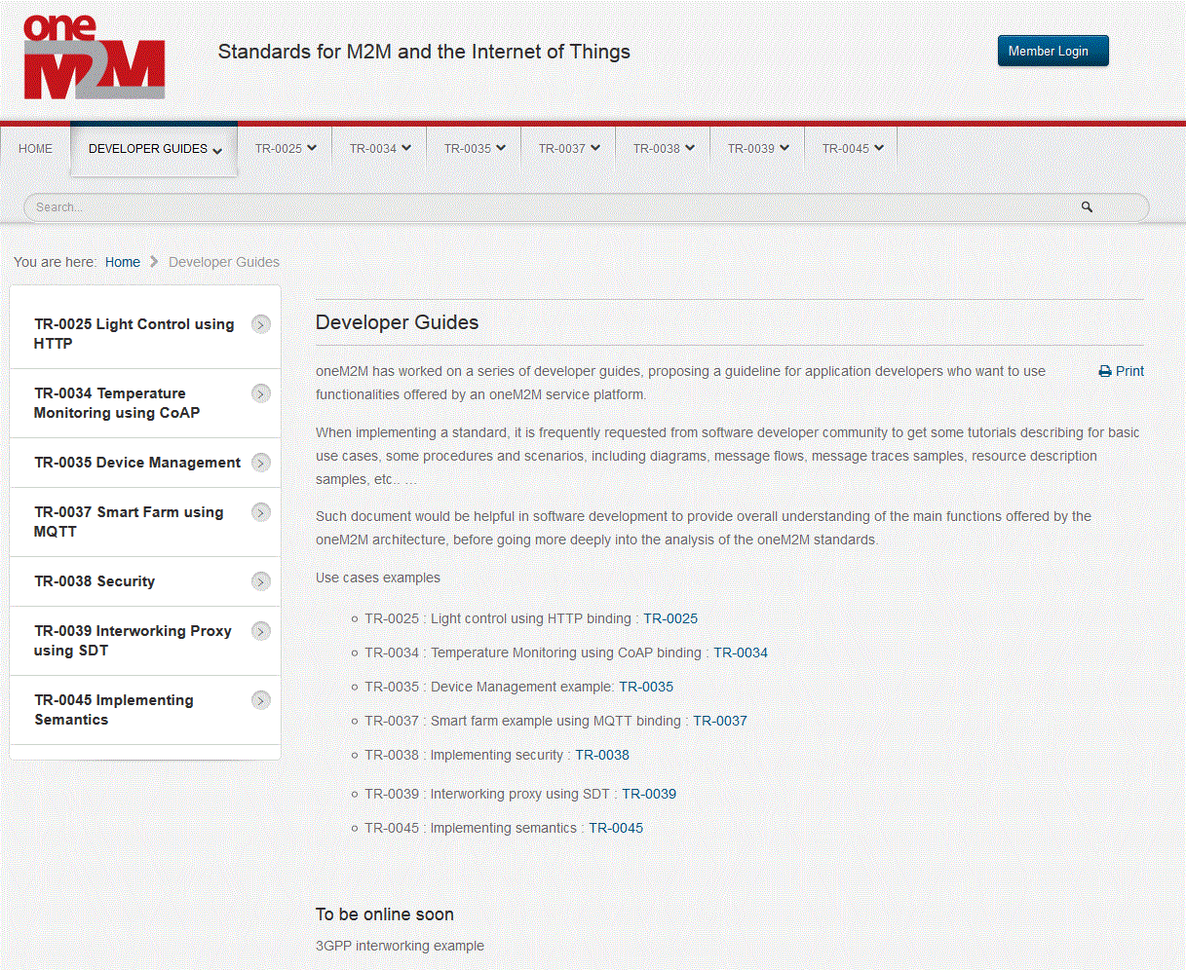
Publicly Accessible Links
Developer Guides
are now accessible via the public link:
http://www.onem2m.org/developer-guides

Slide 29
Publicly Accessible Links:
Webinars
  http://www.onem2m.org/technical/webinars
YouTube Channel
  https://www.youtube.com/c/onem2morg
Events
  http://www.onem2m.org/news-events/events
Web Site
  http://www.oneM2M.org
Developer Guides
  http://www.onem2m.org/developer-guides
Technical Questions
  http://www.onem2m.org/technical/technical-questions
Published Specifications
  http://www.onem2m.org/technical/published-documents
Documents developed in oneM2M
http://www.onem2m.org/technical/latest-drafts

Slide 30
Thank You!
For any questions, please email rana.kamill@bt.com
Notes:
30

