Slide 1
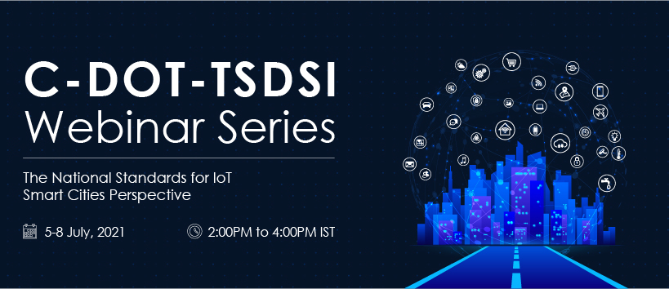

Slide 2
IoT Standards and Smart Cities : India Perspective
Overview of oneM2M: The National Standard for IoT
Aurindam Bhattacharya
C-DOT

Slide 3
M2M/IoT: Surge of connected things
Interconnected devices
forecast
8.74 Billion (in 2020)
to
25.4 Billion(in 2030)
Transforming industries with innovative services and useful information
Connected Home
Automotive
Smart Cities
Retail
Education
Healthcare
Industrial
3
1 Source: Statista

Slide 4
IoT and M2M framework
Things
representations
Linked things and digital
representations
Applications
Applications
Communications network
Communications network
Field area network
Blood pressure
GW
Smart phone serving as an M2M device
A
A
Device
Pulse oximeter
A
A
Device
Device
Device
Things
Smart bandage
Pedometer

Slide 5
Present IoT/M2M Deployment Architecture
Pipe (vertical):
1 Application, 1 NW,
1 (or few) type of Device
Business
Application
Business platform
Communication Network (mobile, fixed, Powerline ..)
Gateway
Local N/W
Device
A
A
Application Entity

Slide 6
Present IoT/M2M Deployment Architecture
Pipe (vertical):
For Transport
Pipe (vertical):
For Health
Pipe (vertical):
For Health
Transport
Application
Health
Application
Metering
Application
Transport platform
Health platform
Metering platform
Communication Network (mobile, fixed, Powerline ..)
Communication Network (mobile, fixed, Powerline ..)
Communication Network (mobile, fixed, Powerline ..)
Other domains/ verticals
Gateway
Gateway
Gateway
Local N/W
Local N/W
Local N/W
Device
Device
Device
A
A
A
Each Domain/Vertical : A separate Silo

Slide 7
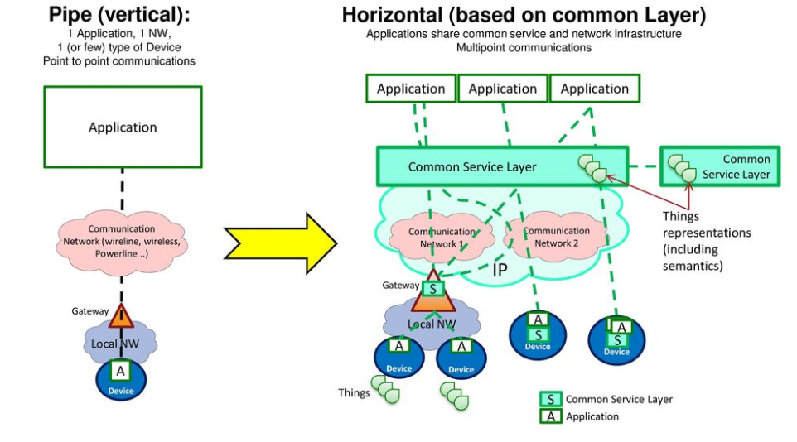
OneM2M Architecture Approach

Slide 8
Today each vertical develops the whole technology stack, leading to silos and cross vertical interoperability issues
A global interoperable Standard, enables a
cross-vertical IoT Eco-System
Data presentation
Data Analytics
Supply Chain / Industrial IoT
Utilities
Healthcare / Fittnes
Smart Cities
Automotive / Connected Car
Connected Home
Data storage
IoT Applications
IoT Service Enablement Functions
Connectivity

Slide 9





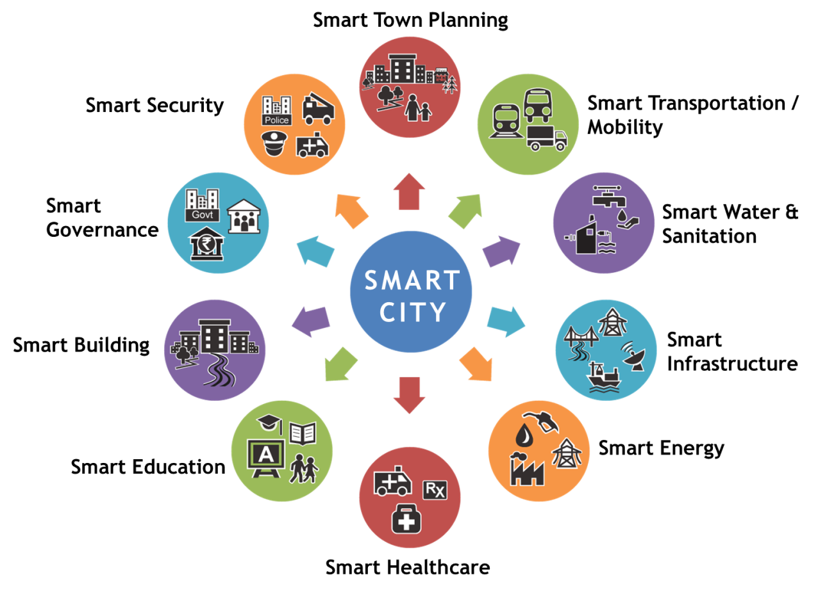



oneM2M Breaks Down the Silos
Horizontal
Information Flow
Smart
Health
Smart
Transportation
Smart
Metering
Smart
Health
Smart
Transportation
Smart
Metering
…
Vertical
Information Flow
Vertical
Information Flow
Vertical
Information Flow
Service Layer
…
…
9

Slide 10
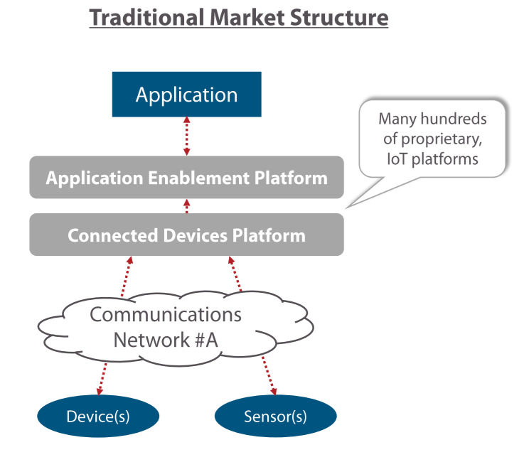
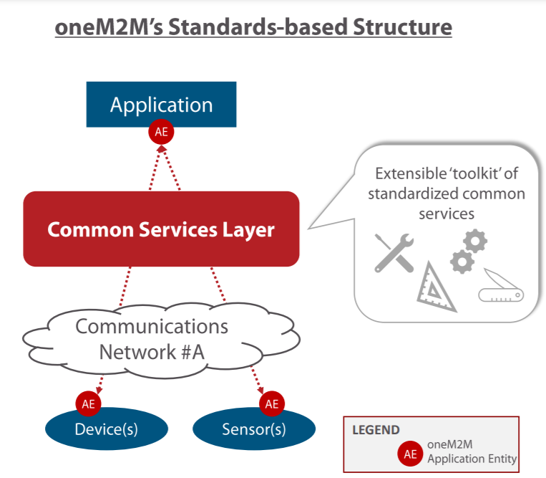
Present Landscape of IoT Applications
In Smart Cities

Slide 11
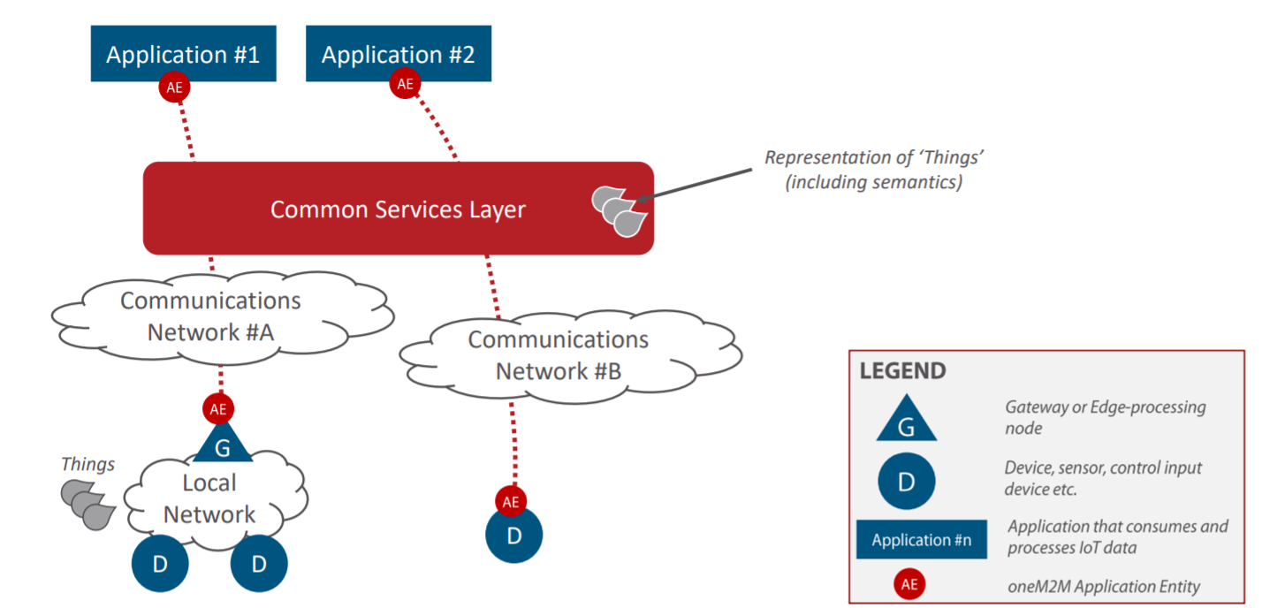
Deployment Scenarios: Multi User, Shared

Slide 12
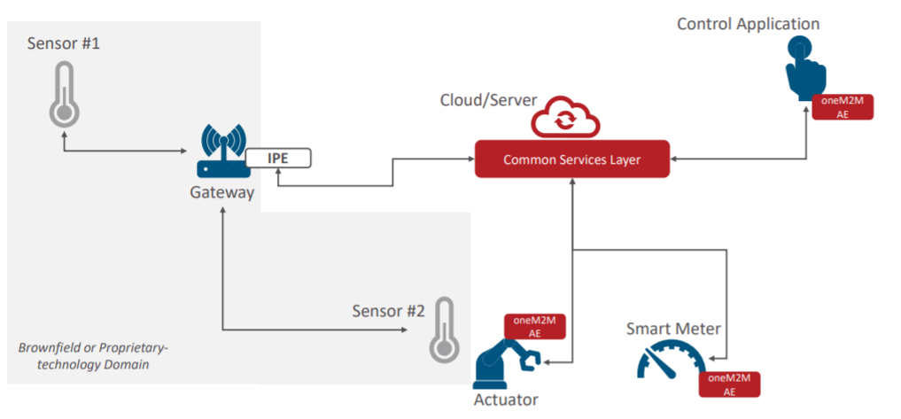
Deployment Scenarios: Brownfield + Greenfield

Slide 13








A framework for developers!
Similar to the modularity of smart Phones -
Governance:
  Applications access the Connectivity Layer and built-in sensors, via API’s provided by the Operating System
  Operating System collects connectivity requests from applications, buffers messages, optimizes & controls device’s network use
  Connectivity Layer provides device access to the Internet via the 3GPP mobile network, Wi-Fi, etc..
Applications
Operating System
Connectivity
Apply the concept of an Operating System to IoT Devices and Application Developers

Slide 14
Scope of and purpose of IoT technology Layers
IoT Field Device(s)
IoT Infrastructure
IoT Application
Measuring of Physical Parameters
Execution of commands
UI / Presentation of Device Data
Data Analytics etc.
Storing of data in case of lack of connectivity
Security, Authentication & Authorization
Device Management & Firmware update mechanism
Connectivity Management
Developer API
Developer API to control:
  Data Management
  Security
  Device Management
  Connectivity Management
Service Layer
Connectivity Layer
Reliable & efficient data transport
Reliable & efficient data transport

Slide 15
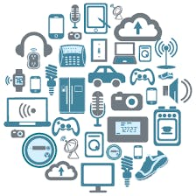

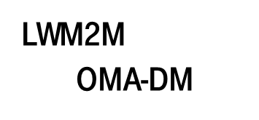












Individual technologies / Protocols used today
IoT Field Device(s)
IoT Infrastructure
IoT Application
Service Layer
Standards
Connectivity Layer
Standards

Slide 16
Bundling of individual service Layer technologies by oneM2M
IoT Field Device(s)
IoT Infrastructure
IoT Application
Service Layer
Standards
Connectivity Layer
Standard

Slide 17


Functions provided by oneM2M
IoT Field Device(s)
IoT Infrastructure
IoT Application
oneM2M Common Service Layer
Application developers can leverage
Common Service Functions (CSF’s) provided by oneM2M
Registration
Service Layer
Registration
Discovery
Security
Group Management
Communication Management
Data Management & Repository
Subscription & Notification
Device Management
Application & Service Management
Network Service Exposure
New Addition in oneM2M Release 4
Time Management
Location
Service Charging & Accounting
Semantics
Transaction Management

Slide 18
The Common Service Functions in oneM2M Architecture
Registration
Discovery
Security
Group Management
HTTP(S)
Devices/ Sensors
Data Management & Repository
Subscription & Notification
Device Management
Application & Service Management
CoAP
MQTT
Communication Management and Delivery Handling
Network Service Exposure
Location
Service Charging & Accounting
Applications in the Cloud
WebSocket
Time Management
Transaction Management
Semantics
CSE

Slide 19
Details of the Common Service Functions (CSFs)
Registration
Registers the Applications with the CSE
Discovery
Discovery of the resources within the CSE
Security
Ensures security of the data as well as communication
Group Management
Grouping the devices/sensors and taking common action
Data Management & Repository
Managing Storage of Data within CSE
Subscription & Notification
Notifying Applications about Data arrival or Events
Device Management
Management of Devices
Application & Service Management
Management of Applications and Service Subscriptions
Location
Location data management
Network Service Exposure
Choosing optimal network for application & Device Triggering,
Communication Management and Delivery Handling
When and How often communication should happen
Service Charging & Accounting
Providing Charging Data (Records for Billing)
Transaction Management
Scheduling of a transaction, locking and unlocking of resources targeted by a transaction
Semantics
Enable applications to manage semantic information and provide functionalities based on this information

Slide 20
Industry collaboration around oneM2M

Slide 21

oneM2M Application Developers Interface
IoT Field Device(s)
IoT Infrastructure
IoT Application
Developer-Interface
Service Layer
Standards
oneM2M Common Service Layer
Connectivity Layer
Standards
Connectivity Layer
IP Communication

Slide 22
Topology
AE: Application Entity
CSE: Common Services Entity
AE
AE
AE
Infrastructure Node
CSE
Middle Node
Middle Node
CSE
CSE
Middle Node
Application
Dedicated
Node
CSE
AE
AE
Application
Dedicated
Node
Application
Service
Node
AE
AE
Application
Dedicated
Node
CSE
AE
CSE

Slide 23
RESTful Style & Access Control
AE
AE
AE
Infrastructure Node
CSE
Resources
= State Information
Middle Node
Middle Node
CSE
CSE
Middle Node
Application
Dedicated
Node
CSE
AE
AE
Application
Dedicated
Node
Application
Service
Node
AE
AE
Application
Dedicated
Node
CSE
AE
CSE
Door Lock

Slide 24


IoT Application Deployment in a multi Service Provider scenario
Smart Parking
Smart Street Light
Smart Metering
Intelligent Transport
IN-CSE (M2MSP-1)
IN-CSE (M2MSP-2)
MN
MN
MN
MN
ADN
ADN
ADN
ADN
MN-Middle Node :oneM2M Gateway Device (Contains CSE and optionally applications)
ADN-Application Dedicated Node :The oneM2M Device that contains applications which interface with sensors/actuators
24

Slide 25




Functional Roles in the M2M/IoT Ecosystem
  Functional Role Description
The User (individual or company) fulfils all of the following criteria:
    Uses an M2M solution.
The Application Service Provider fulfils all of the following criteria:
    Provides an M2M Application Service.
    Operates M2M Applications.
The M2M Service Provider fulfils all of the following criteria:
    Provides M2M Services to Application Service Providers.
    Operates M2M Common Services.
The Network Service Provider fulfils all of the following criteria:
    Provides Connectivity and related services for M2M Service Providers.
    Operates an Underlying Network. Such an Underlying Network could e.g. be a telecom network.
USERS
IoT/M2M Application Provider
IoT/M2M Applications
COMMON SERVICE LAYER
IoT/M2M platform/Service Provider
UNDERLYING NETWORK
Underlying Network Service Provider
Any of the above functional roles may coincide with any of the other roles.
These functional roles do not imply business roles or architectural assumptions.

Slide 26
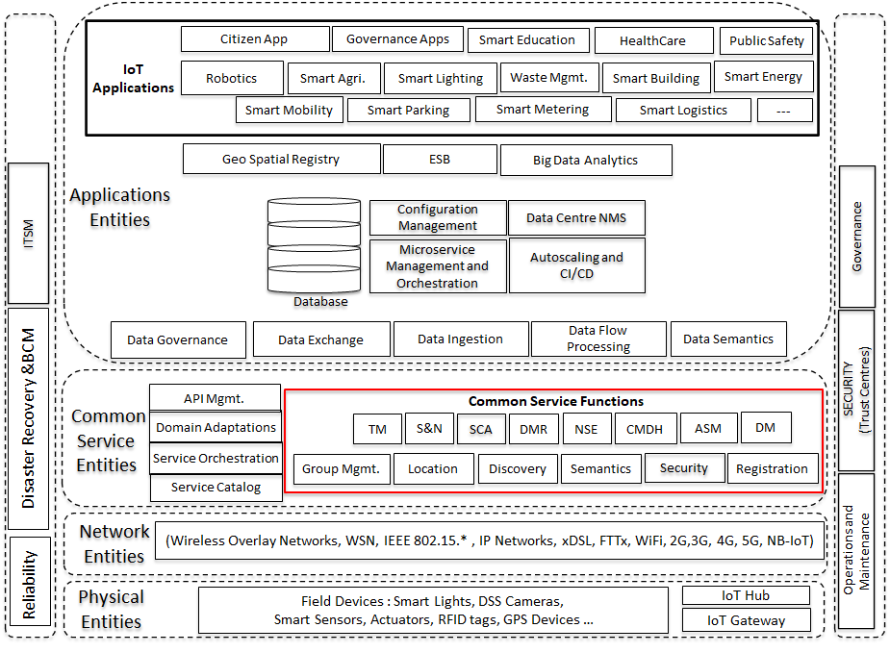
IoT System Deployment View

Slide 27
The Smart City ICT Reference Architecture for India
Public/
Developer
Application Layer
Governance, Operations, Security
Citizen App
IUO
Smart Governance (CCSG)
ICCC
Smart Lighting, Smart Parking, Smart Home…..
Data Layer
Urban Services
(API Mgmt, Service Catalog,
Data Semantics and Ontologies
Urban Context
(Geo Spatial Registries, Asset Registries etc.)
(NGSI-LD +)
Data Exchange
(IUDX)
Application Layer
(IoT)
IUDX Connector/ Adaptors
IPE
(Adapter)
Standards compliant IoT Platform
(Common Service Functions)
Proprietary IoT Platform
Common Service Layer
(IoT)
Network Layer(LMCP and WAN)
(WiFi, 2G/3G/4G/5G, 802.15.x,LoRa, Sigfox, FTTx etc.)
Network Layer
(IoT)
Sensing & Actuation(IoT)
Non IoT
City Infrastructure
(Fibre, Sewage, Waste Mgmt., Electricity ….)
Sensor Layer
(IoT)
Non IoT Data
Smart City ICT architecture
oneM2M Layered architecture

Slide 28
Thank You
Aurindam Bhattacharya
aurindam@cdot.in
Notes:
28

