Slide 2
IoT Standards and Smart Cities: India Perspective – Technical Session
Overview of oneM2M IoT Sustainability Initiative
Girish Ramachandran
Member of oneM2M Sustainability Sub-Committee (SSC)
President Asia-Pacific Business for TATA Consultancy Services (TCS)
Dale Seed
Convener oneM2M SSC Convenor and TP Vice Chair
Principal Engineer, InterDigital / Convida Wireless

Slide 3
Outline
Overview of oneM2M Sustainability Initiative - Dale
Some real-life examples of how IoT has helped companies achieve their sustainability goals - Girish

Slide 4
Sustainability has a strong influence on government policy and business strategy across the world
UN Sustainable Development Goals
Boston Consulting Group on Sustainability Strategy
National Sustainability Initiatives

Slide 5
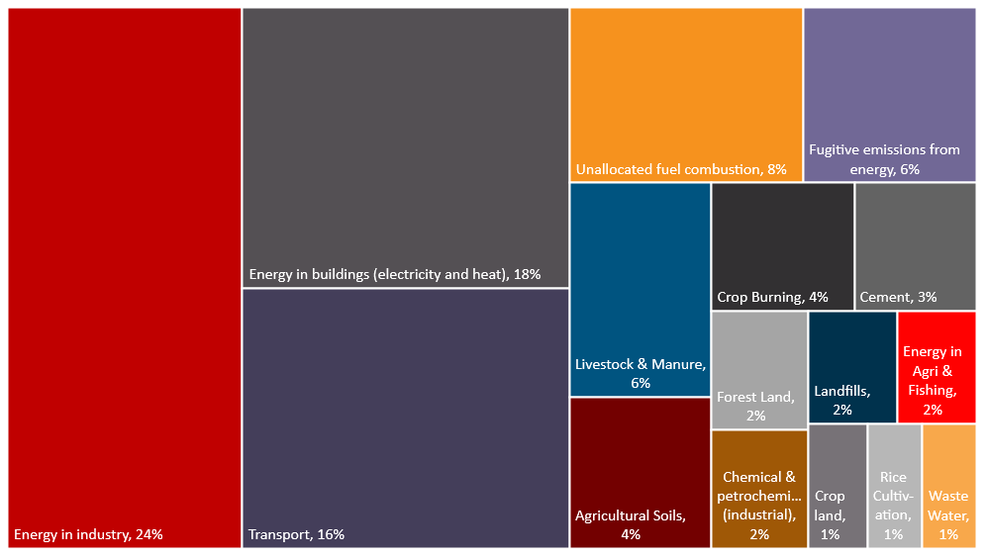
GHG emissions highlight key sectors to improve sustainability
Global Greenhouse Gas (GHG) Emissions
by Sector
"Industry, buildings & transport represent over 70% of GHG emissions"
Source: Our World in Data
Where do global greenhouse gases come from?
Note: Grassland category (not shown) accounts for <1%

Slide 6
The recent action plan for the EU's Green Deal identifies six priorities to address sustainability challenges
Investing in environmentally friendly technologies
Supporting industry to innovate
Rolling out cleaner, cheaper and healthier forms of private and public transport
Decarbonising the energy sector
Ensuring buildings are more energy efficient
Working with international partners to improve global environmental standards
SOURCE: A European Green Deal

Slide 7
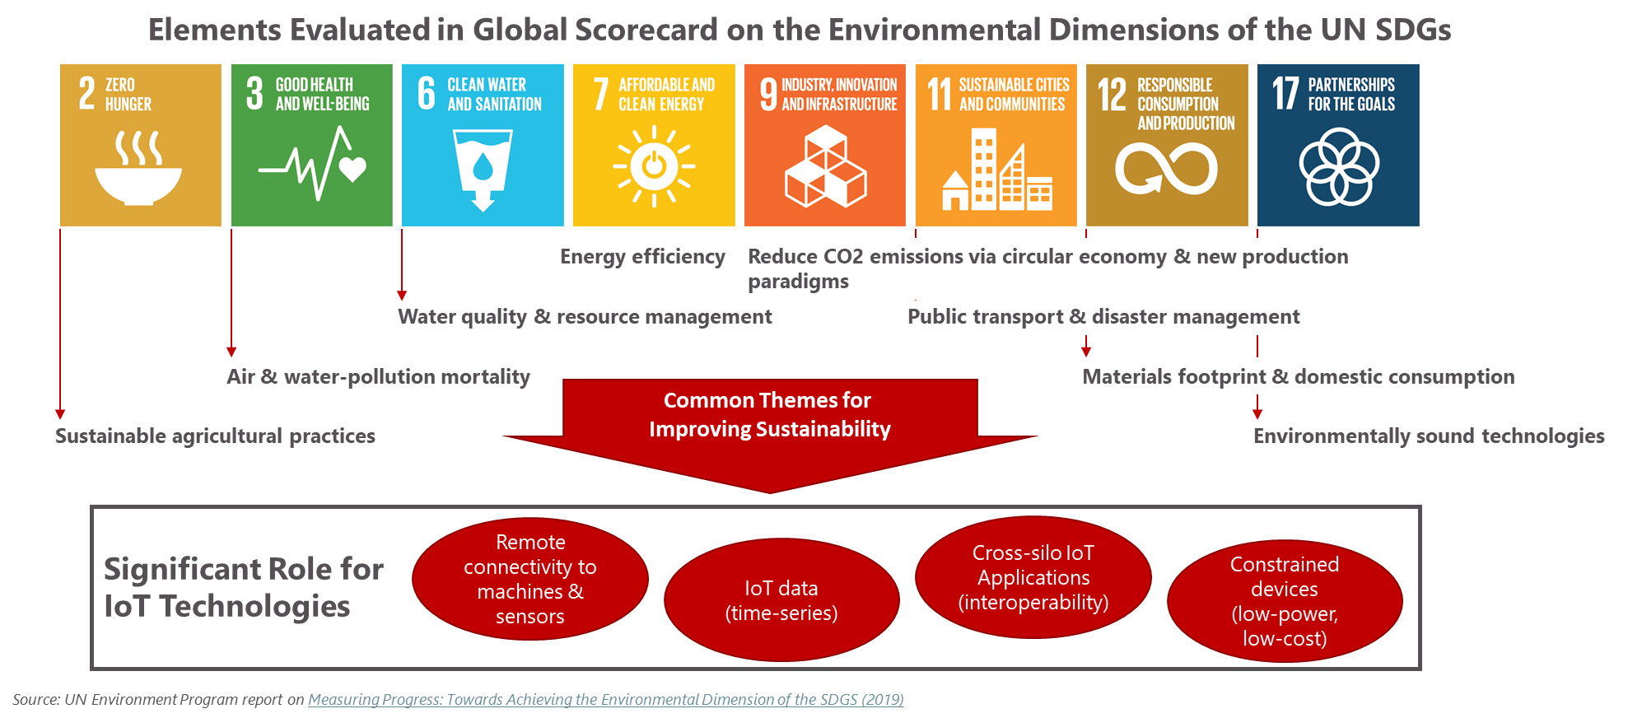
Improvements depend on remote sensing, resource management and environmentally sound technologies

Slide 8
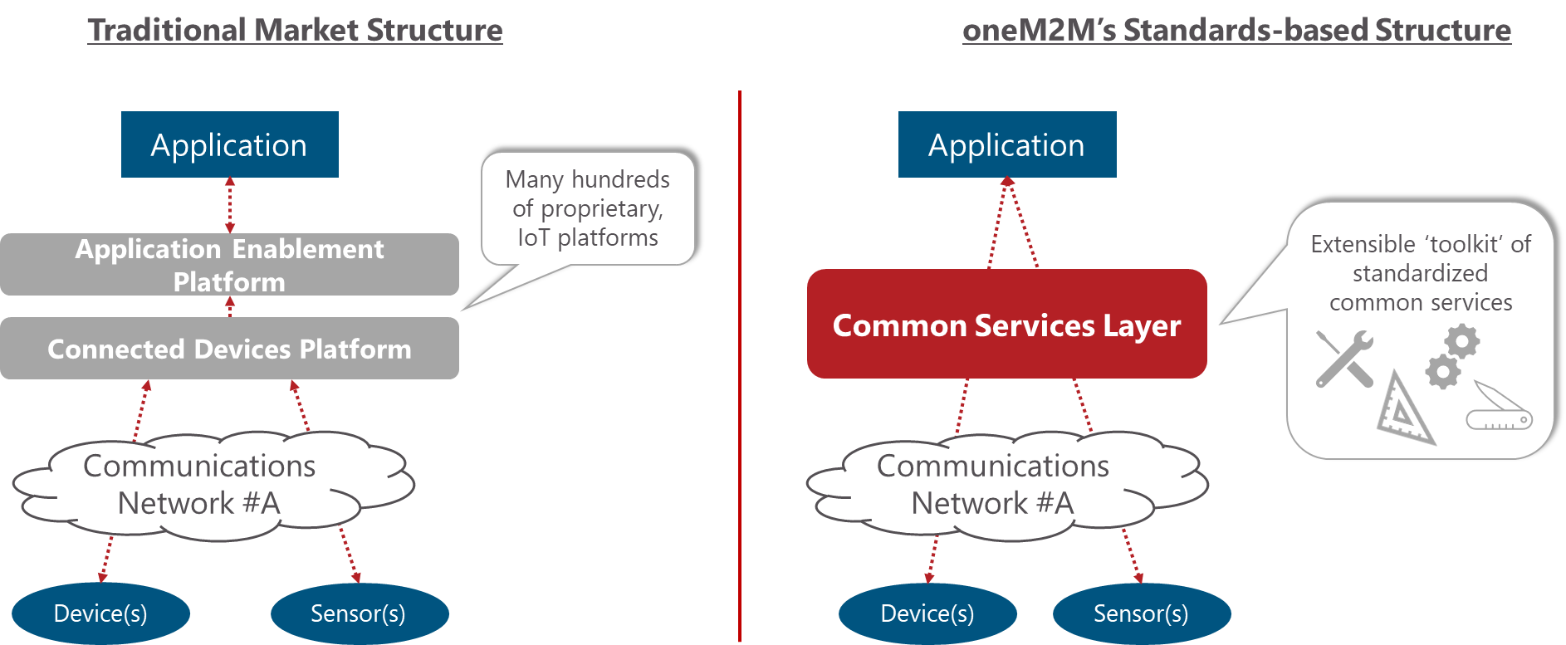
Common services, as defined in oneM2M standards, help developers build repeatable and scalable IoT systems

Slide 9
How oneM2M enables sustainability
Shareable, horizontal architecture – ‘build once, apply many times’
Toolkit of common services for developers to build IoT systems, repeatably
Open standard for vendor, technology and data interoperability
Ability to re-use legacy systems in ‘brownfield + greenfield’ scenarios via a cross-domain, interworking capability
Avoid re-invention by reusing established industry standards and enhancing them with new capabilities

Slide 10
oneM2M plays an important role as a standard and for its enabling technology
oneM2M is integral in several sustainability usage scenarios
Early deployments in street lighting, intelligent transport, smart city and waste management applications
oneM2M standards align with the core principles of sustainability
Interoperability, scalability, modularity and re-use
Existing functionality in oneM2M enables sustainable IoT deployments
Energy Efficiency: enable devices to power down and conserve energy without impacting users / applications.
Reuse of legacy systems: oneM2M’s information model enables interworking with non-oneM2M components, enabling a transition from installed assets as more sustainable systems are deployed

Slide 11
oneM2M’s Sustainability Initiative
Objectives
Advocate the role that IoT and the oneM2M standard have with respect to sustainability
Create a market-responsive forum to promote the oneM2M standard externally
Recruit new participants to oneM2M activities, going beyond standardization experts
Identify requirements that may feed into oneM2M working group activities
Approach
Demonstrate a strategic commitment to sustainability via a dedicated oneM2M sub-committee
Sub-committee will generate various content (webinars, articles, blogs, tweets, videos, etc.):
the role of IoT in enabling sustainability, leveraging oneM2M deployment examples
oneM2M capabilities that enable sustainability (network resource management, messaging scheduling for efficient communications etc.)

Slide 12
oneM2M’s Sustainability Sub-Committee Workplan
 | Apr | May | Jun | Jul | Aug | Sep | Oct | Nov | Dec
oneM2M SSC Meetings | 4/20 SSC Kick-off Meeting | 5/20 - SSC Monthly Meeting | 6/23 - SSC Monthly Meeting | 7/22 - SSC Monthly Meeting | 8/19 - SSC Monthly Meeting | 9/23 - SSC Monthly Meeting | 10/21 - SSC Monthly Meeting | 11/28 - SSC Monthly Meeting | 12/16 - SSC Monthly Meeting
Recruiting Phase
Quarterly Report (to SC, MARCOM, TP) |  |  | SSC Quarterly Report |  |  | SSC Quarterly Report |  |  | SSC Quarterly Report
Speaking Events | 6GWorld web event | Peggy Smedley Show (podcast) |  |  |  | AIOTI event – IoT/Edge and UN SDGs |  | IoT Tech Expo
Liaison Activities (AIOTI, ATIS, ETSI, GSMA, others) |  | Liaison initiated with AIOTI Digital for Green
Webinars (e.g., industry experts) |  |  |  | Low-code/zero energy devices
Position Papers |  |  |  |  | IoT for Sustainability White Paper |  |  | IoT and supply-chain reporting obligations (TBD)
Executive Viewpoint Articles | Dale Seed (Convida) | Girish Ramachandran (TCS) | Klaus Grobe (ADVA) | D van Gorp, (Nyenrode Business Universiteit) | TBD | TBD | TBD | TBD | TBD
Short Articles on IoT Sustainability​ | ​ | ​ | Architecture & Governance magazine​​ | ETSI Enjoy! article​ | ​ | ​ | ​ | ​ | ​
Case Studies (Planned)
Guest Speaker Series (Planned)
Ad hoc initially, leading to sub-groups/deliverables as contributors and areas of common interest emerge

Slide 13
Outline
Overview of oneM2M Sustainability Initiative - Dale
Some real-life examples of how IoT has helped companies achieve their sustainability goals - Girish

Slide 14
Market drivers and what that means for IoT and sustainability
Forces at Work in Industry 4.0 world
Driving sustainability in business
Digital ubiquity is the norm
Transparency, trust and loyalty critical to sustain
Customers becoming socially, environmentally conscious
Regulatory & investor pressure for sustainability & transparency in supply chain
Sustainability will be non-negotiable
Sensor-based Remote Care Models
Unobtrusive monitoring of seniors living in isolation
Connected Vessel Platform
Mapping and reducing environmental footprint
Digital Twin as Sustainability
Measuring carbon footprint across business processes
Farm-to-Fork Solution
Tracking freshness along supply chain to reduce wastage
Smart Energy Management Solution
Reducing carbon emissions to reach net zero goals
Digital Farming Initiatives
Driving food security and sustainable agriculture
Renewable Energy Certificate Marketplace
Enabling customer journey towards decarbonization
Technology is at the center of sustainable business transformations and IoT is a key enabler.
Notes:
It is important to think in terms of the fourth industrial revolution which brings the physical, digital, and biological worlds together. Through this cycle of change, industries and business models are being reshaped, at an unprecedented rate of change, even if you make allowance for the pressures caused by the pandemic.
In terms of how change is taking hold, the first thing to say is that digital ubiquity is the norm. That is one reason why we see “digital twin” technologies taking over from physical-asset management. Convenience is also becoming more important, and consumers are going beyond omni-channel systems to omni-presence ones. That means service providers need to build transparency, trust, and loyalty into their business models. And, finally, I would make the case that sustainability is non-negotiable, and organizations need to design their operations accordingly.
Technology is at the centre of these transformations and IoT is a key enabler for smart cities, smart citizens, and smart workplaces.

Slide 15
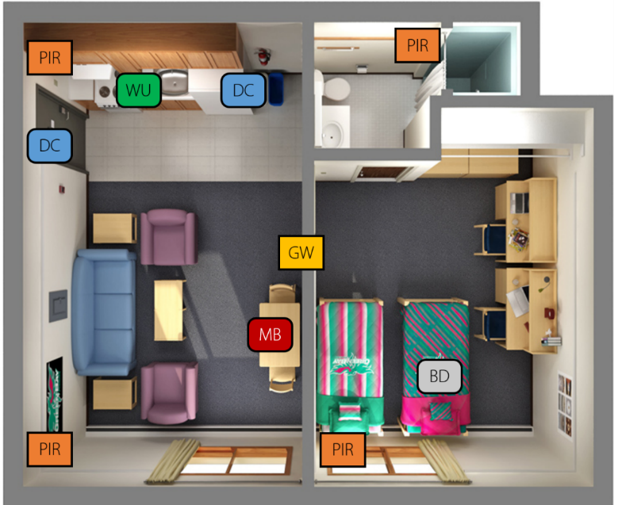
Drive digitally connected ecosystem to enable sensor-based remote care models.
TCS SHINESeniors, an integrated eldercare platform using IoT and data analytics, enabling timely care that involves emergency alert, inactivity alert has reached 170 elderly beneficiaries in Singapore.
Ecosystem
PIR
Ecosystem
WU
31 million
Data points processed
DC
SIX
Care Partners
Caregiver
Government
TCS ASSISTED
LIVING PLATFORM
Machine Learning
90%
Alert Accuracy
Emergency Services
IoT,, loud
Tech Innovators
THREE
Government Partners
Open API Architecture
Hospitals
GW
Gateway
BD
Bed
WU
Water Usage
Appliances Mfrs.
PIR
Passive Infra-Red
DC
Door Contact
MB
Medication Box
Notes:
Combines sensor-based internet of things (IoT) technology with data analytics (leveraging TCS Assisted Living Platform) for unobtrusive monitoring of seniors living in isolation through inactivity and preventive alerts to caregivers.
Uses a community caregiver ecosystem, thereby reducing dependence on healthcare infrastructure and associated costs.

Slide 16
Driving new business models and connected ecosystems to contribute to a more sustainable future.
Damen Shipping developed Triton, a remote monitoring and operational insight system that aims to enable value creation from operational data in the maritime environment, in the areas of safety, sustainability and efficiency.
A platform for collaboration and the stimulation of maritime sustainability
Integrated IoT based connected vessel platform to reposition Damen as a digital maritime solution provider, assuming a leading role in an ecosystem of multiple sector suppliers.
Analyze data from 10-15,000 sensors on board its vessels, offering predictive maintenance, remote services access, savings in fuel consumption and reducing environmental footprint.
Collaborate and share knowledge (as-a-service) with wider maritime eco-system.

Slide 17
Deploy intelligent systems to drive core business processes and enable sustainable business outcomes.
Leading Japanese conglomerate leveraged IoT and AI powered digital twin technology for production optimization and emission reduction.
Combustion Tuning
Over 150 people work for 14 days.
120K tons of carbon burnt leading to significant NOX emissions.
Digital Twin
2,500 sensors, 250 parameters, 45 AI rules monitored in real-time.
Over 10,000 Ai-based scenarios to tune boiler for maximum efficiency.
2 days
reduction in boiler commissioning time
$3M
savings in commissioning cost
50%
reduction in NOX emissions

Slide 18
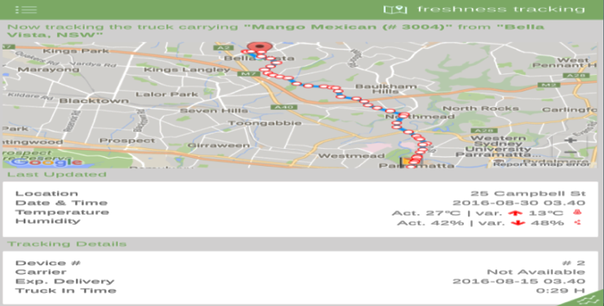
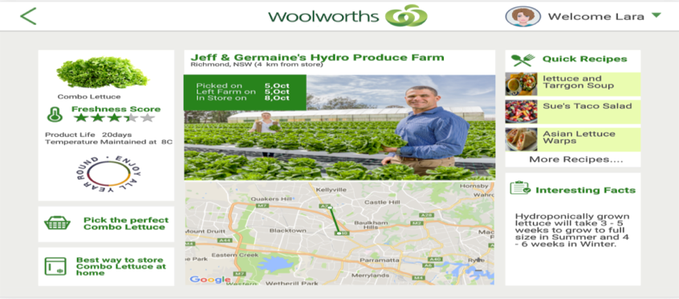
Drive digitally connected enterprise for improved organizational performance through a resilient supply chain.
Leading retailer in Australia built a unique IoT based “Farm to Fork” solution for strawberries and lettuce. Sensors monitor temperature, humidity, location, and other parameters to track food freshness and reduce food waste.
POC Solution Built by TCS
Tracking Temperature, Humidity, Light, Bumps and Location
Fresh Insights – Logistics Tracking
Fresh Insights – Customer Interface
Food freshness for strawberry and lettuce
Pilot Conducted with 20 Lx IOT devices
Metrics Tracking and Pilot Validation

Slide 19
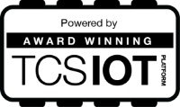
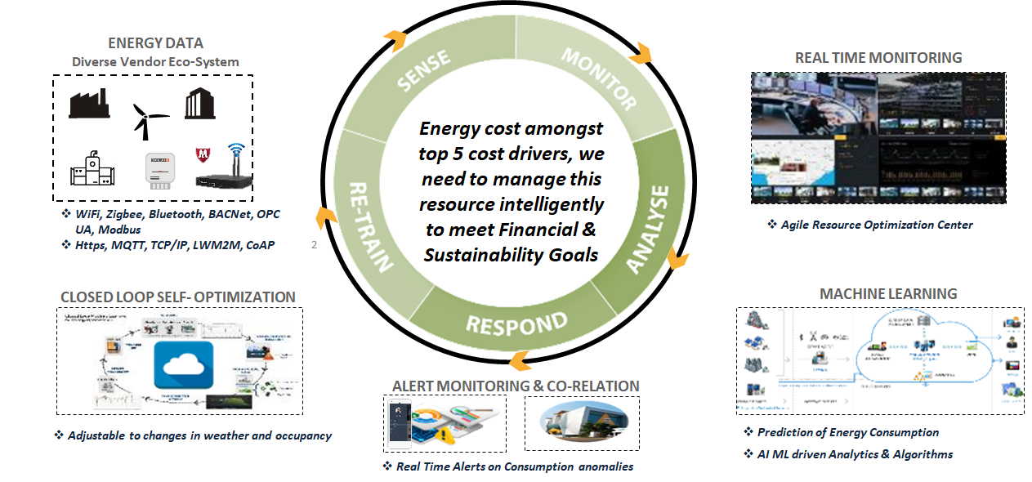
Move towards sustainable business through automated & cognitive systems driven transformations.
Leading Middle East retailer leveraged TCS Clever Energy™ to progress towards clean energy goals and meet the Group’s sustainability targets.
TCS Clever Energy™ Solution
“Firstly, congratulations to TCS on winning the 2020 IoT Global Awards. The TCS Clever Energy leverages the power of cognitive technologies like IoT, Edge & Artificial Intelligence to improve energy efficiency and reduce carbon footprint. We have implemented this solution across our retail stores, warehouses, offices and malls and have started realizing the energy savings. This step goes a long way in meeting our Group’s sustainability targets and expanding our clean energy goals, which in turn helps us become more cost-competitive and innovative as a business.”
Rajesh Garg, Group Chief Finance Officer, Landmark Group
Notes:
https://www.tcs.com/tcs-launches-iot-powered-clever-energy-solution-to-help-enterprises-accelerate-shift-towards-net-zero-emission

Slide 20
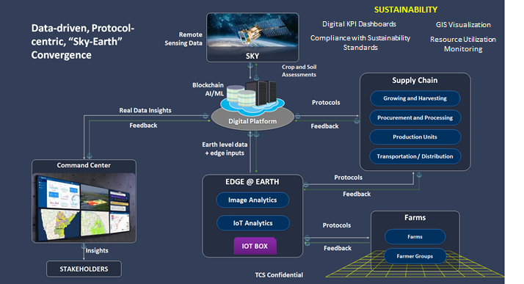
Drive food security and sustainable business practices through digital farming initiatives.
Leading global beverage company deployed IoT and smart sensing-based solution to improve soil health while driving increased profitability.
Customer: Top 5 Global Beverages Company
Challenge: Improve soil health through reduction of chemical and water use; increase profitability
Solution:
Farm management and event reporting
Digital farm advisory
Satellite based hotspot identification
Pesticide Residue Detection
IoT based disease/pest forecasts, soil moisture monitoring
10%
reduction in water use
420 tons
reduction in chemical use
20%
increase in profitability

Slide 21
Enable green energy solutions to drive decarbonization journey of customers.
Leading integrated energy company in South-East Asia to implement a Blockchain and IoT based platform for trading of Renewable Energy Certificates.
Platform for Lifecycle management of REC; creation to retirement.
Installation of IoT meters at point of renewable energy production
Solution developed on Hyperledger Fabric Blockchain and accelerated by TCS Quartz Gateway.
Generators and Buyers - Trade RECs using platform.
Application components are hosted in Cloud.
National Grid
The Grid receives Electricity from Fossil and Green sources (commoditized electricity) and distributes to Buyers
IoT Meters
Records the production of renewable energy before feeding into the National Grid and sends the record to the Blockchain to create a REC
Renewable Energy Sellers
Producers which generate renewable energy and wish to sell these energy to Buyers
Renewable Energy Buyers
Companies wanting buy renewable energy put in their demand to be matched automatically with sellers

Slide 22
How to get involved
Get in touch
Follow our work
ONEM2M_SSC@LIST.ONEM2M.ORG
oneM2M press release on sustainability initiative
Viewpoint article on sustainability, Dale Seed of Convida Wireless
IoT standardization and sustainability, Girish Ramachandran of TCS
Using IoT to Promote Sustainability, Ken Figueredo representing oneM2M

Slide 23
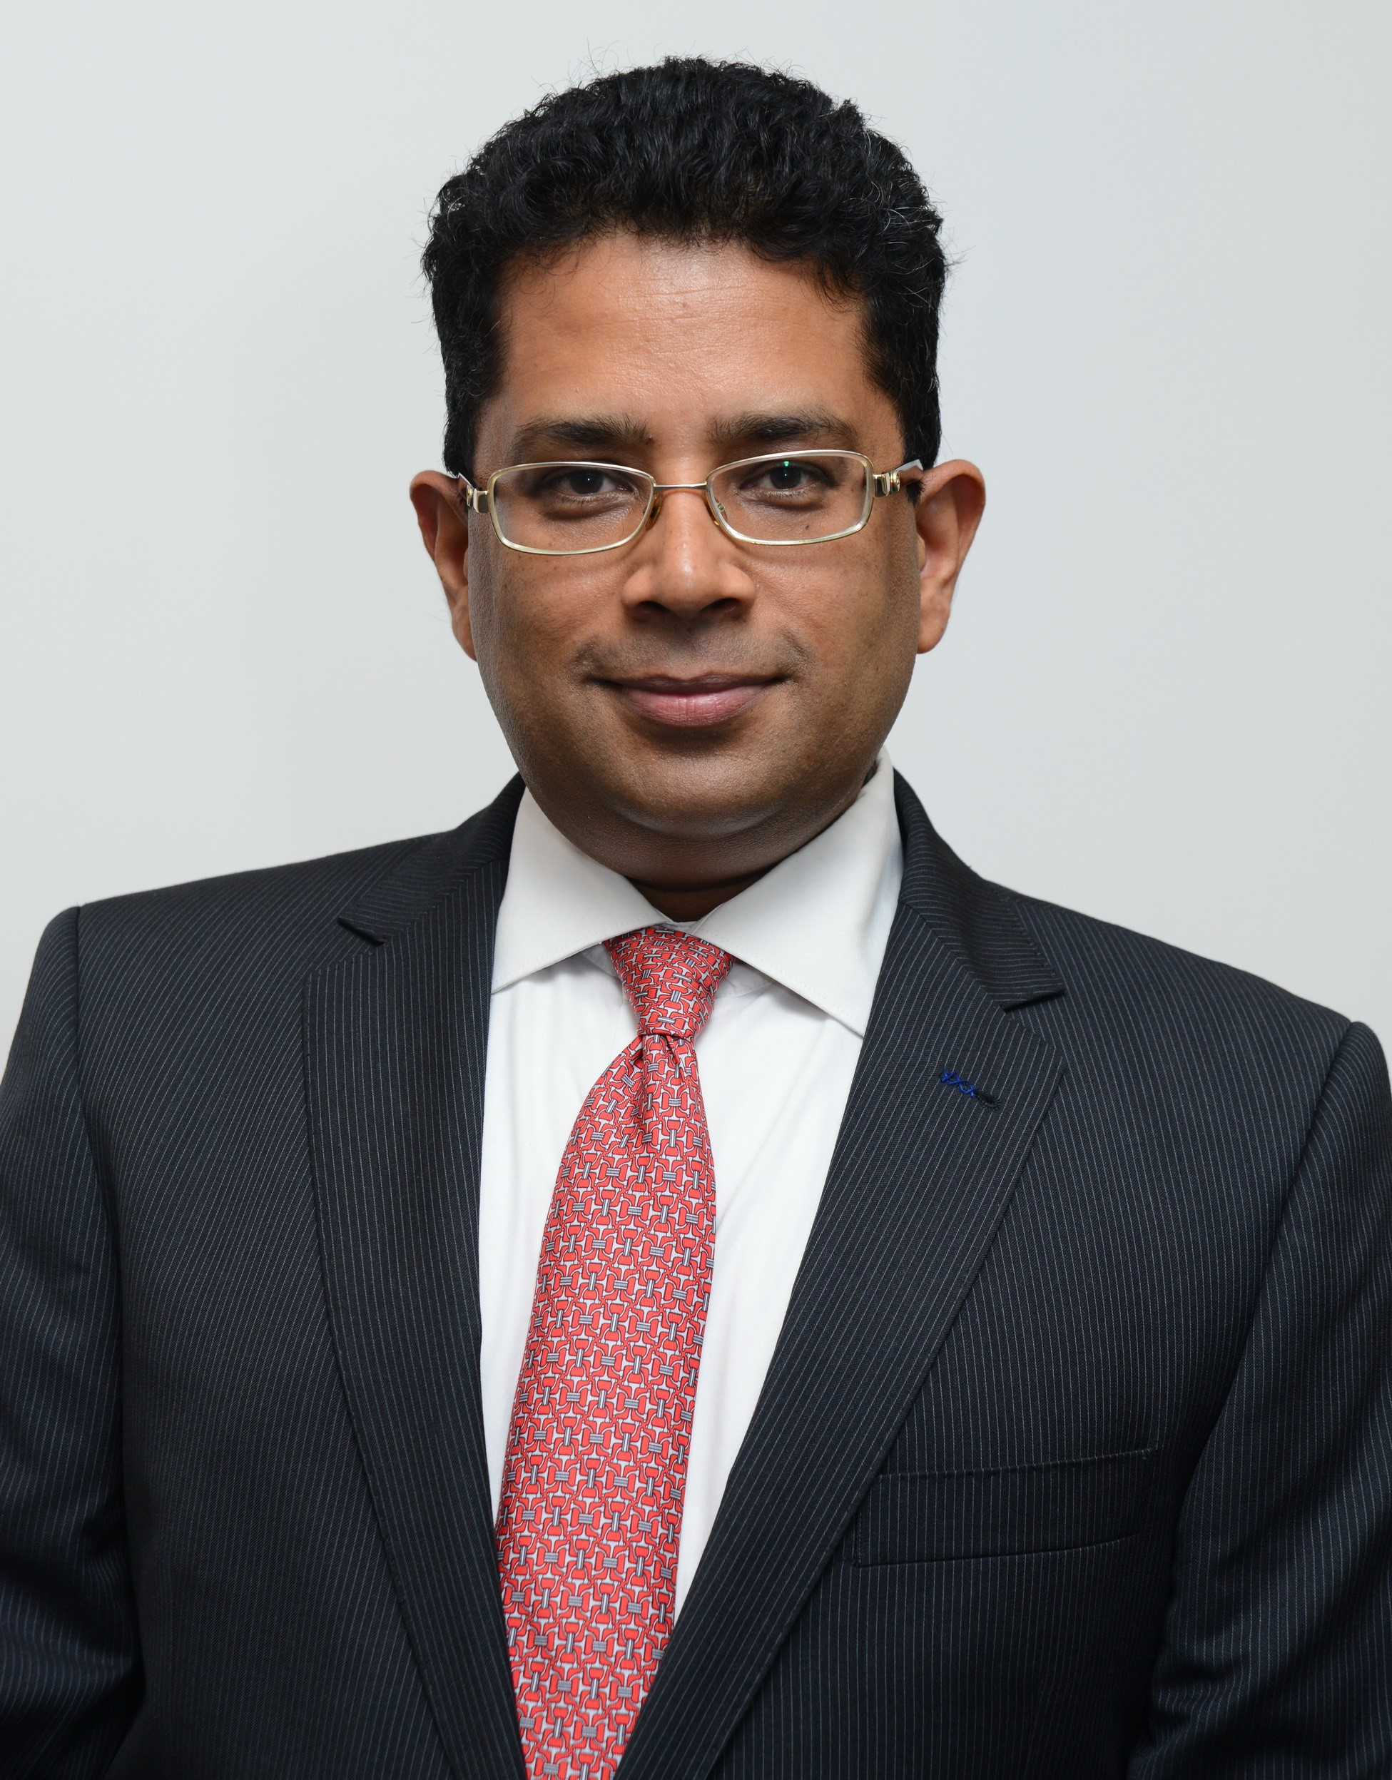
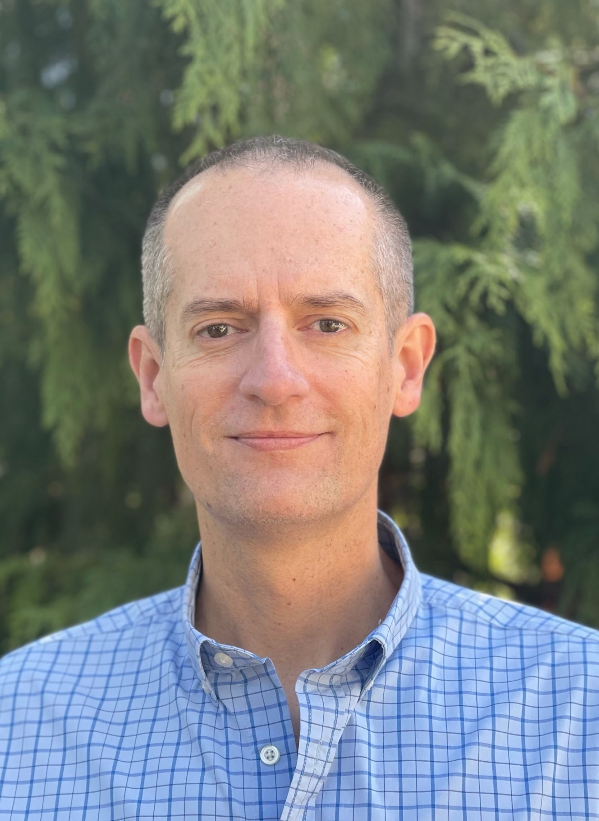
Thank You
Girish Ramachandran
Member of oneM2M Sustainability Sub-Committee (SSC)
President Asia-Pacific Business for TATA Consultancy Services (TCS)
girish.ramachandran@tcs.com
Dale Seed
Convener oneM2M SSC Convenor and TP Vice Chair
Principal Engineer, InterDigital / Convida Wireless
dale.seed@interdigital.com
Notes:
‹#›

