Slide 2
IoT Standards and Smart Cities : Global Perspective
Standardized IoT Use Cases in Smart City
By
Rama NS
ELCITA
Electronics City Industrial Township Authority

Slide 3
Smart City @ Electronics City Background
self-governance, participative citizens and exposure to latest technology and vision to be a model SMART City
Was not part of smart city list but focus was to work towards affordable smart city relevant to citizens
Partnered with IISc, Wipro, Tejas Networks, Bosch…..
Started with a basic platform and IoT devices were added progressively
Infrastructures like LED lighting, cameras, Optical network, signaling… were also implemented as part of smart city

Slide 4
Smart City @ Electronics City Smart city approach
e-Governance, Smart lighting , Smart water/waste, management, Smart parking, Smart surveillance, Traffic management, Waste management, Complaints management through citizen App, Town planning
Combination of IoT devices with Apps from vendors and locally developed Apps for specific data as required
Both cases it was not a straightforward plug and play
Need for adapters and understanding the device protocols, APIs
In the case of using data from devices we had to integrate the data from different vendors
Platform was supporting over 100 protocols so that any IoT vendor can be connected

Slide 5
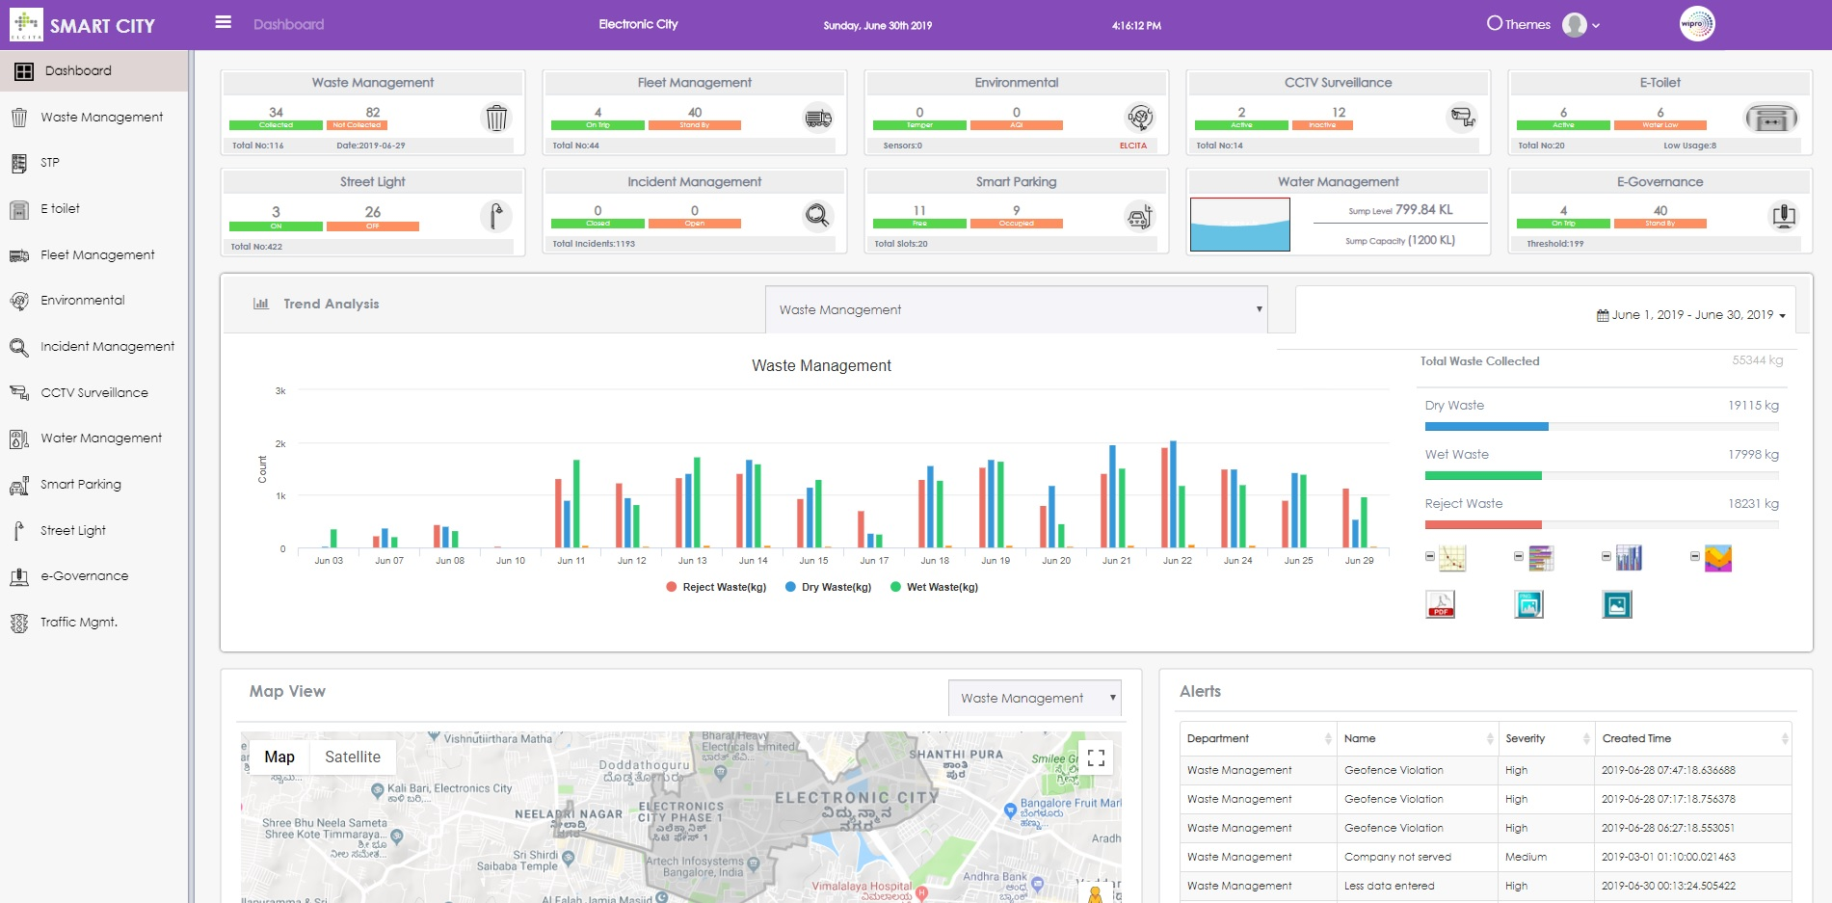

Slide 6
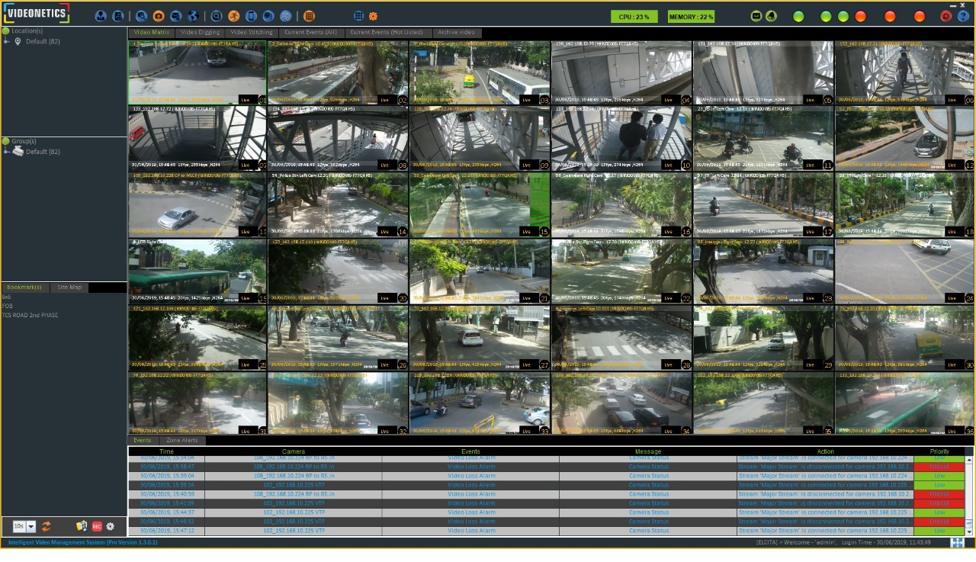

Slide 7
Smart City @ Electronics City Standards
“There is need for standardization for both Infrastructure and ICT in India” is an understatement
Smart city spreads across many disciplines of engineering
Communication, optical network elements, traffic signal and data to signals
Cameras, video analytics, Video management software
Street lighting – LED luminance, spread,
Water management – plumbing, electronics, electrical combination is an issue
Civil, mechanical and environmental engineering are involved

Slide 8
Smart City @ Electronics City Standards
Pavements, cabling for power, optical fibre network, traffic lights, junctions, parking also need to be specified
Server requirement, security with access controls
Protocols for data exchange with other entities and data aggregation at state level, national level
Paperless office, online financial transactions, internal approvals
Work management, project management, people management

Slide 9
Smart City @ Electronics City Way forward
There is a lot of work being done by organizations world over for creating standards for smart cities
Number of components are very high and each engineering discipline has varying level of standardization, standardisation will take time
ELCITA is working with IISc to pilot IUDX which will help in exchanging data to and from other smart cities and possibly IoT devices
Many small manufacturers have already developed their products . And may not want to change unless they have enough business and are mandated by the market/standards bodies.

Slide 10
Smart City @ Electronics City Way forward
Big players in India and world over have their own platforms and proprietary protocols for implementing smart cities
Implementation of Standards will be challenging for already developed platforms and related business impact and delays will be an issue
Hence we at electronics city believe integrating smart cities using IUDX built on open source can be the first step
Standardisation for say Communication, video analytics and management, e-Governance, resource management can be the next step based on standards emerging across the globe.
Priority can be for generic solutions which are used by many cities and customised solutions for specific needs of city may come later

Slide 11
Thank You
< Presenter Co-ordinates >
Notes:
11

