Slide 1
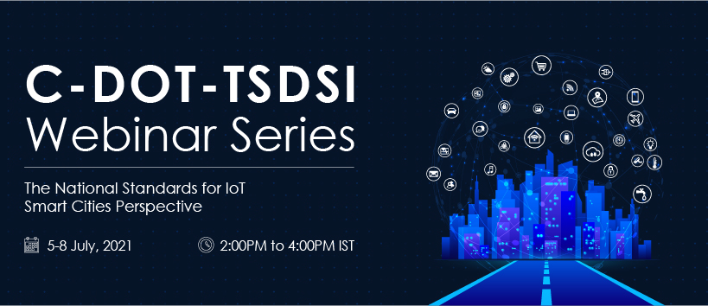

Slide 2

IoT Standards and Smart Cities: Global Perspective
Semantic Interoperability using oneM2M
Enrico Scarrone
Technology Communication & Standardization
oneM2M Steering Committee Chairman
ETSI TC smartM2M Chairman

Slide 3


































In IoT, NOBODY can do it alone
  Collaboration is important to reach common understanding, limit overlaps and build interoperable IoT ecosystems globally.
P2413
MIoT
Certification
ref. arch, OHTP
JTC1 WG10
SCP, SmartM2M
OCF
SCEF/CIoT
SG20
OSGi/DAL
WG3
WoT
HTTP/ CoAP/ (D)TLS/ WebSocket
AllJoyn
OMA DM/ LWM2M
DDS
OPC-UA
TR-069/ TR-181
MQTT

Slide 4

IOT and OneM2M
Semantic support
Information
Service Enablement
Service Enablement
Data
Data
Management
Services
Management
Services
Management
Services
Connectivity
Connectivity
Connectivity
Connectivity
Devices
Devices
Devices
Devices
Connectivity
Deployment
Data sharing
Information sharing
oneM2M is an interworking framework designed to connect the different IoT technologies
oneM2M standard is based on a “Store and Share” resource REST based paradigm. The data may be made available in the platform to the other applications, interested application are notified by means of subscription
Data management is a key element in a REST based solution (historization, time series etc.)
oneM2M support semantics in various forms , from annotation to dedicated interworking, templates, generic interworking

Slide 5





Example: Make it (inter)work together
Native OCF Application
OCF Data Models
Bridge / IPE
Which semantic?
Native
Application
COAP
COAP
COAP
COAP
DTLS
DTLS
DTLS
DTLS
UDP
UDP
UDP
UDP
Security/ Commissioning
Security/ Commissioning
IP Routing
IP Routing
IP Routing
IP Routing
6LoWPAN
6LoWPAN
IPv4/IPv6
IPv4/IPv6
IEEE 802.15.4 MAC
IEEE 802.15.4 MAC
IEEE 802.3 MAC
IEEE 802.3 MAC
IEEE 802.15.4 PHY
IEEE 802.15.4 PHY
IEEE 802.3 PHY
IEEE 802.3 PHY
Might be BT-LE or other short range at some point

Slide 6
Evolution of semantic in oneM2M
<AE>
1
Release-1: Resource Names (Text) can be defined by the client and so have some meaning. E.g. « Temperature-AE »
App-ID
SDT -Smart Device Template
Modular Description of objects allow representation by reusable modules of any devices in a unified data model and a fully generic abstraction
From Release-3
further expanded in
Release-4
0..1
appName
0..n
Release-1: A set of labels (keywords) can be defined for each resoruce. E.g. « temperature », « luminosity »
label
Attribtues
0..1
ontologyRef
..
Release-1: Each resource can be linked to an ontology reference (description). E.g. « http://ontology.tno.nl/saref#Device »
…
0..n
<container>
Child Resources
0..n
<semanticDescriptor>
Release-2: A complete semantic description can be added to a resource
(Ontology). E.g.<RDF>…</RDF>
..
<…>
SAREF Support included from Release-1

Slide 7


Interworking using semantic
Non oneM2M devices are described using the oneM2M base ontology + domain specific extensions.
The Interworking Proxy Entity translates the ontology instance to resources on the CSE based on pre-defined instantiation rules.
Vertical
Domain
Ontology
oneM2M
Base
Ontology
Interworking Proxy Entity
MN-CSE
Resource Repository
Non oneM2M devices in Area Network
Proxied devices in oneM2M system

Slide 8
Work on Semantics
oneM2M allows to annotate application specific resources (M2M data) with semantic description.
  Uses a specialized resource type <semanticDescriptor>
  Can contain proprietary semantics or
  Semantics according to a published ontology
The oneM2M base ontology is a top-level ontology that allows to create sub-classes (or equivalence classes) for application-level ontologies
  Aligned to Smart Application Reference Ontology (SAREF)
Ontologies can be used in oneM2M to describe the application specific data model of an external system for the purpose of interworking.
  oneM2M Generic Interworking uses such an ontology to enable interworking of oneM2M entities with devices of the external system

Slide 9
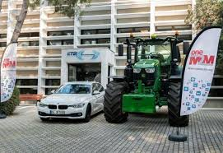

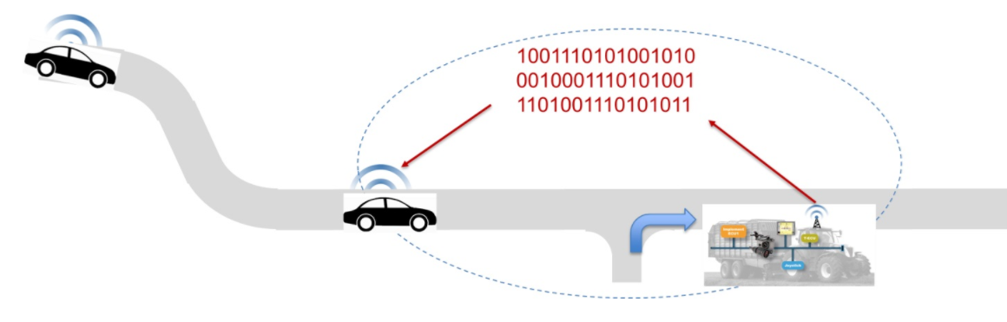

Example: oneM2M Interoperability with Agricultural Machines
ETSI TC smartM2M performed a PoC for the use of oneM2M as standard interworking framework between cars and agricultural machines – TR 103 545 Pilot test definition and guidelines for testing cooperation between oneM2M and Agricultural equipment
OneM2M is playing the role of
  communication enabler and interworking enabler for the AEF ISOBUS standards toward the automotive standards (such as the ETSI ITS ones like ETSI EN 302 637-3 (Decentralized Environmental Notification Basic Service) or ETSI EN 302 637-2 (Cooperative Awareness Basic Service)
    AEF - the Agricultural Industry Electronics Foundation (http://www.aef-online.org/home.html)
CERTIFIED!!!!

Slide 10
oneM2M base ontology model
Thing
AreaNetwork
hasThingProperty
subclassOf
consistsOf
Value
isPartOf
Device
concerns
hasService
Aspect
Service
hasFunctionality
isExposedBy
refersTo
hasOperation
Functionality
Operation
hasMethod
hasTarget
subclassOf
Method
Target
Controlling
subclassOf
hasInput
hasOutput
Input
Output
Measuring

Slide 11
oneM2M base ontology instance
Device
#1234AB
isPartOf
hasThingProperty
Value
#17
AreaNetwork
#WIFI-1
hasService
concerns
Service
#TempServ
hasFunctionality
Aspect
#Temperature
hasOperation
isExposedBy
refersTo
Measuring
#TempFunction
Operation
#RetrieveTempOp
hasMethod
hasTarget
Method
#Retreive
hasOutput
Target
#/MN-CSE/AE-123/CNT-TEMP
describes
Output
#Temp

Slide 12
Smart Applications REFerence ontology
SAREF specifications are currently developed and maintained in ETSI TC SmartM2M and are dependent of oneM2M - the interworking framework used by SAREF -, under stimulus and support of the EU DG Connect.
The specific ontologies to be integrated in SAREF are developed by the industry stakeholders - by companies, associations, and other SDOs.

Slide 13

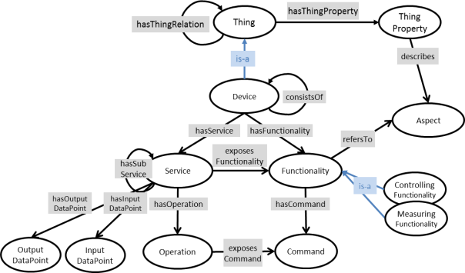

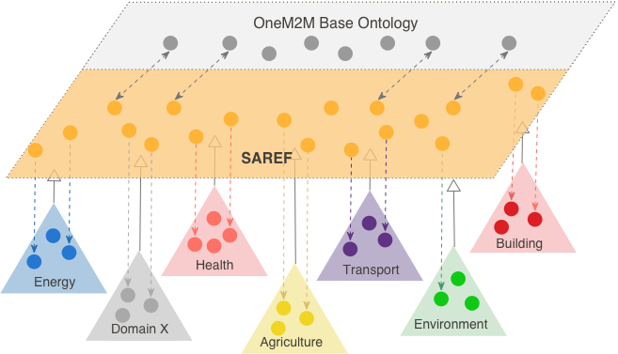
Universal semantic interoperability SAREF/oneM2M
Specific Abstraction
Models, grouped around a core common ontology
General base
Ontology
OneM2M resources
Semantic annotation of data
1) Vertical ontologies
support
SAREF and its extensions
IoT base ontology +
Data annnotation
2) Semantic Support
3) Communication
Framework
IoT Data sharing

Slide 14







SAREF and its extensions
Semantic interoperability
SAREF Core
Energy
Environment
Building
Smart Cities
Industry & Manufacturing
Automotive
Smart Agriculture
E-Health/
Aging Well
Smart Lifts
Smart Water
Wearables
01/2017
Q3/2019
Q2/2020
H12021

Slide 15
How to contribute to Smart Applications REFerence ontology
Ontologies are dynamic structures constantly evolving with the technologies and the products, so direct contributions from stakeholders are needed to sustain SAREF evolution.
ETSI has development of an open portal to gather direct contribution to SAREF, a sort of “open source” project dealing with ontologies instead of source code.
The stakeholders’ data model inputs will be then reflected in the SAREF.
The Open Portal is now operative
Stakeholder 1 input
SAREF/oneM2M core and Extensions
ETSI Smart M2M/
oneM2M
Stakeholder input
Stakeholder input
Open SAREF Portal
Stakeholder input
Stakeholder input
Stakeholder input
Stakeholder input
Stakeholder n input

Slide 16
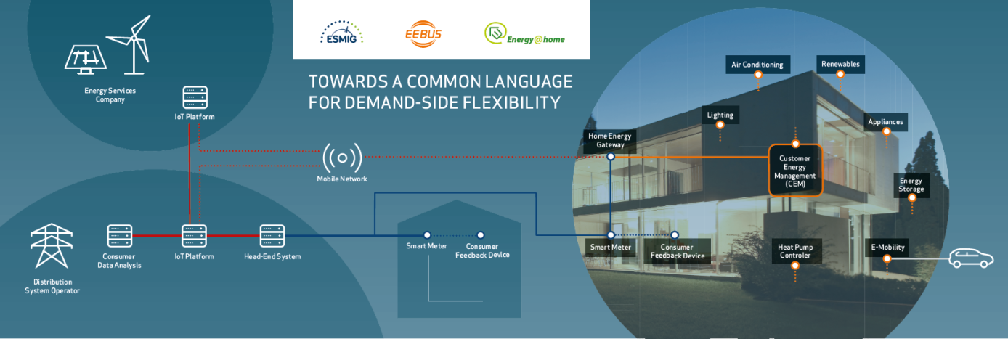
SAREF usage example :Dsf demo: saref/SAREF4ener in practice
Dataflow 1:
emergency condition in the smart grid
→ reduced production in the grid
→ need to reduce appliances consumption
SAREF
Dataflow 1
Dataflow 1
Dataflow 2
Dataflow 2
Dataflow 2: Smart meter data reporting
→ get smart meter current instant power consumption (kWatt)
→ get cumulative energy consumption (kWatt hour)

Slide 17



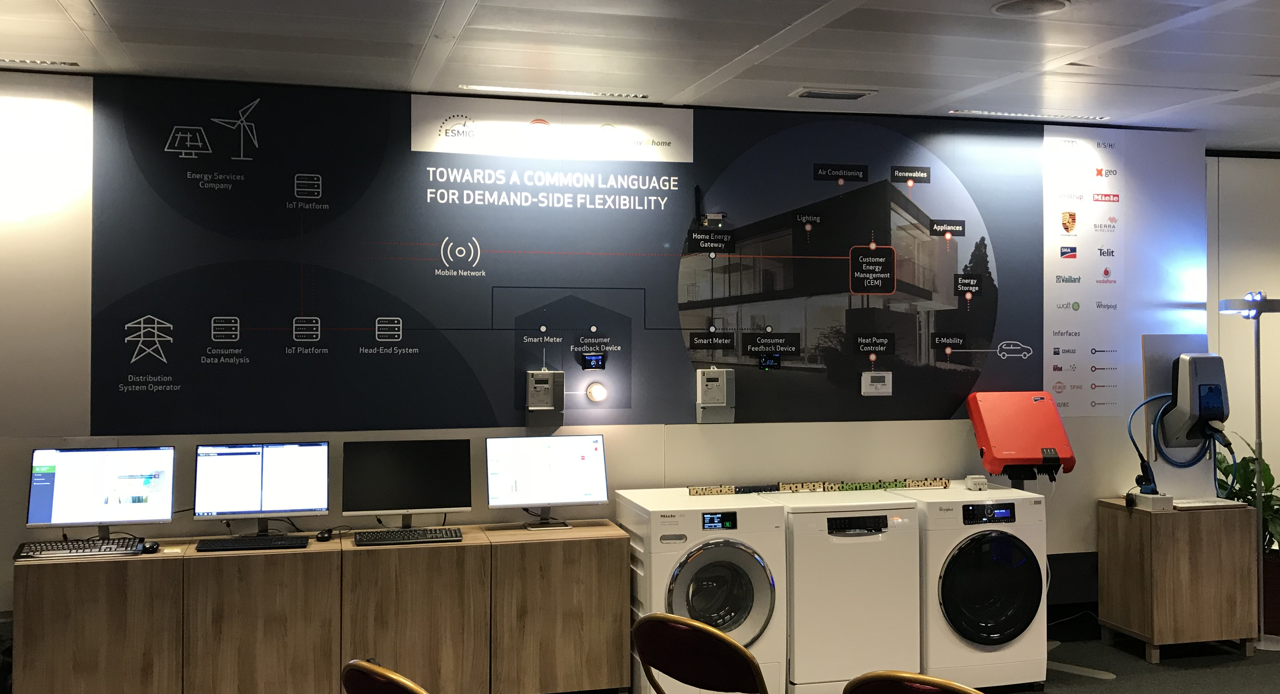

Dsf demo:
Interoperability of different standards
SPINE
for smart appliances
OpenADR
for Demand Response
SAREF
SAREF
4ENER
oneM2M
for underlying communication
COSEM for metering

Slide 18

How all of this it is reflected in implementations
Data and command elaboration
Statistics and Big data analysis
Context information aggregation and production
Control algorithms
AI intelligent elaboration
Data format adaptation
Service Control
and management on PC/tablet/phones
Human exposure
Citizen services on
PC/tablet/phones
Human exposure
Server Applications
AE
oneM2M SW client AE-ASN
oneM2M SW client AE-ASN
Server
IN-CSE
API Mca
API Mcc’
Other deployment
interworking
gateways (ADNs)
Field Technology interworking
gateways (ADNs)
API Mca
IPE
IPE
Non M2M devices
Other aggregation platforms
Field devices
Industry and proprietary solutions
(Fiware, CIM NGSI-LD; AZUR, Watson, etc)

Slide 19


Contact details
Dr. Enrico Scarrone
ETSI TC smartM2M Chairman,
oneM2M Steering Committee Chairman
M2M/IoT Standardization Manager
TIM | CTIO | Technology Communication & Standardization
enrico.scarrone@telecomitalia.it
IOT:
It is NOT about selecting a protocol… or a platform…or a cloud….
IoT is sharing the information and its meaning
between different systems, different applications,
different business sectors !
Thank you!

