Slide 2
IoT Standards and Smart Cities: Global Perspective
Smart City Standardization efforts in BIS
BIS
Mr J Roy Chowdhury
DDG (Standards P & M)
< File Name >

Slide 3
Smart City Standardization efforts in BIS
J Roy Chowdhury
DDG (Standards P & M)
Bureau of Indian Standards

Slide 4
Smart Cities
Rapid urbanization
Increasing urban population
Developing infrastructure
Providing public services
Optimum use of resources
Environmental sustainability

Slide 5
Smart Cities – the challenges
Diverse Stakeholders
Citizens,
Diverse Geographical Entities
Parking lots,
Diverse Services and Business Processes
Diverse ICT Technologies
city administration,
vendors,
streets,
buildings,
electric stations
Waste collection
Data systems
sensor technologies
software systems
networking systems
system integrators
Energy management
Transport

Slide 6
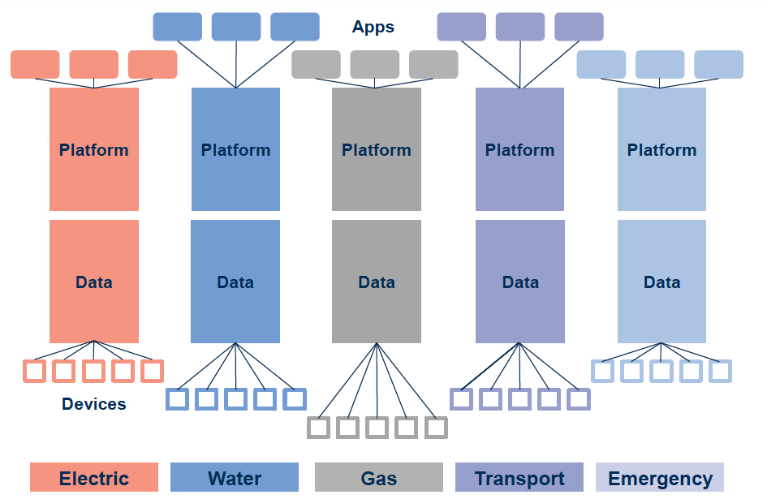
Application silos

Slide 7
Role of standards
Interoperability
Data and information exchange
Safety
Security
Privacy
Frameworks
Guidelines/best practices
Practical tools for regulatory bodies
level playing field for solution providers
Creates a globally competitive market

Slide 8
Smart city standardization ICT Aspects

Slide 9
LITD 28 Smart infrastructure Sectional Committee
Published a comprehensive set of standards for ensuring a unified, secure and sustainable digital infrastructure in our Smart cities. The Standards published covers all aspects of IT / ICT, pertaining to Smart Cities.

Slide 10
Standards developed by LITD 28
IS 18000 Unified Digital Infrastructure – ICT Reference Architecture
IS 18002-1 UDI - Data Layer Part 1 Reference Architecture
IS 18003-1 Unified Data Exchange Part 1 Architecture
IS 18003-2 Unified Data Exchange Part 2 API specifications
IS 18004-1 IoT System Part 1 Reference Architecture
IS 18006-1 Municipal Governance - Part 1 Reference Architecture
IS 18006-3-1 Municipal Governance Part 3 Property Tax Section 1 Taxonomy
IS 18008-1 Smart Cities- GIS Part 1 Reference Architecture
IS 18010-1 UDI - Unified Last Mile Communication Protocols Stack Part 1 Reference Architecture
IS 18010-2 UDI - Unified Last Mile Communication Protocols Stack - Part 5 Network Access Layer (IEEE 802.15.4) Section 1 Specification

Slide 11
IS 18000:2020
IS 18000 Unified Digital Infrastructure – ICT Reference Architecture has already been proposed as an international standard
ISO/IEC JTC 1/WG 11 Smart Cities has constituted a Ad-hoc group under it to initiate the work.

Slide 12
Standardization in other aspects of Smart Cities

Slide 13
CED 59: Smart Cities Sectional Committee
IS 17000 Sustainable Development of Habitats - Indicators
IS 17451 Smart Community Infrastructure - Best Practices for Transportation - Guidelines
IS 17456 Smart Community Infrastructure - Guidance on Smart Transportation for Allocation of Parking Lots in Cities
IS 17457 Sustainable Development of Habitats - Vocabulary

Slide 14
TED 28 Intelligent Transport Systems Sectional Committee
IS/ISO/TR 12859 Intelligent transport systems - System architecture - Privacy aspects in its standards and systems
IS/ISO/TS 13140 ( Part 1) Electronic fee collection - Evaluation of on - Board and roadside equipment (Series)
IS 16722 Radio Frequency Identification (RFID) System for Automotive Applications – Specification
IS 15754 Intelligent transport systems - Continuous air interface, long and medium range (CALM) - Infra - Red systems

Slide 15
ETD 51- Electro-technology in Mobility Sectional Committee
IS/ISO 15118 ( Part 1) Road vehicles - Vehicle to grid communication interface (Series)
IS 17017 ( Part 1) Electric Vehicle Conductive Charging System (Series)

Slide 16
Thank you!

