Slide 1
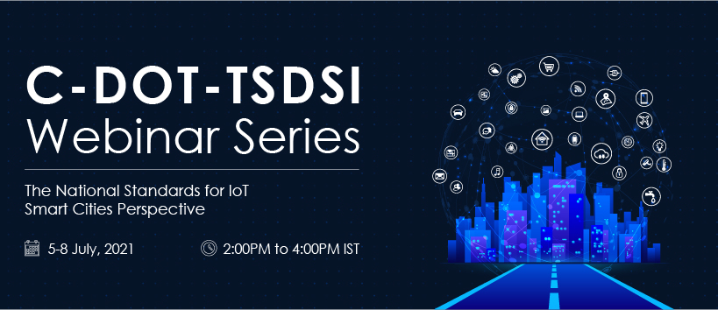

Slide 2
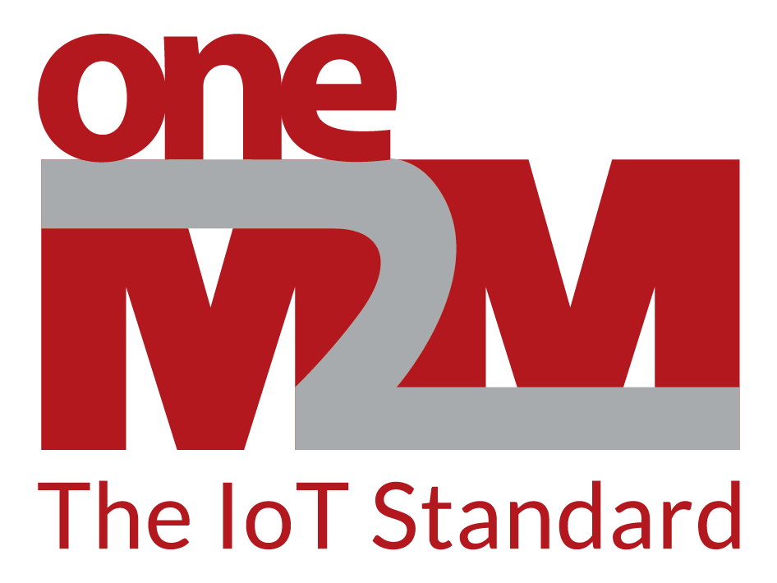
DAY 2: IoT Standards and Smart Cities: Global Perspective
oneM2M in European Smart Cities
Roland Hechwartner
Chair of the oneM2M Technical Plenary
Deutsche Telekom
20210706_TSDSI-CDOT-Webinar-oneM2M EU Smart Cities.ppx

Slide 3
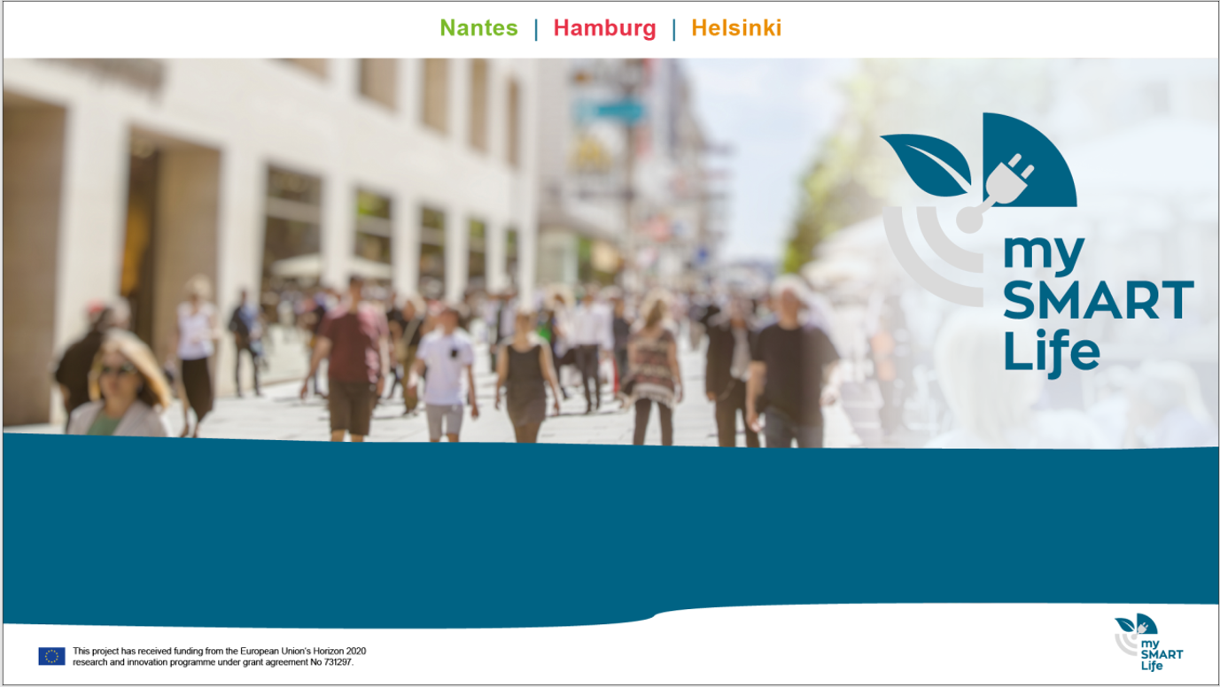
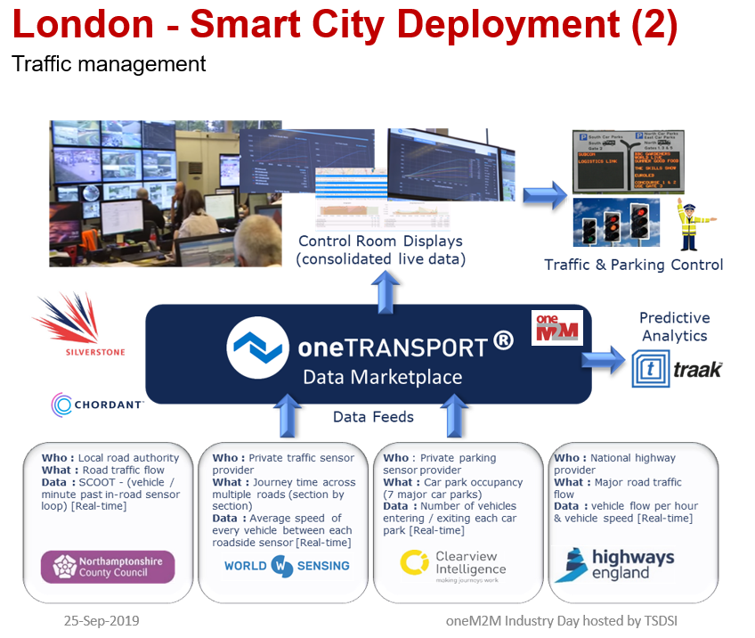
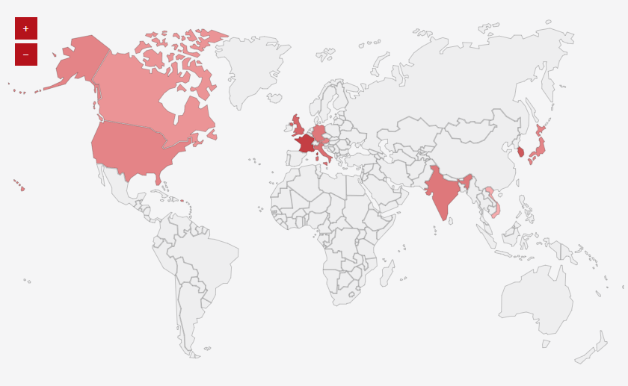

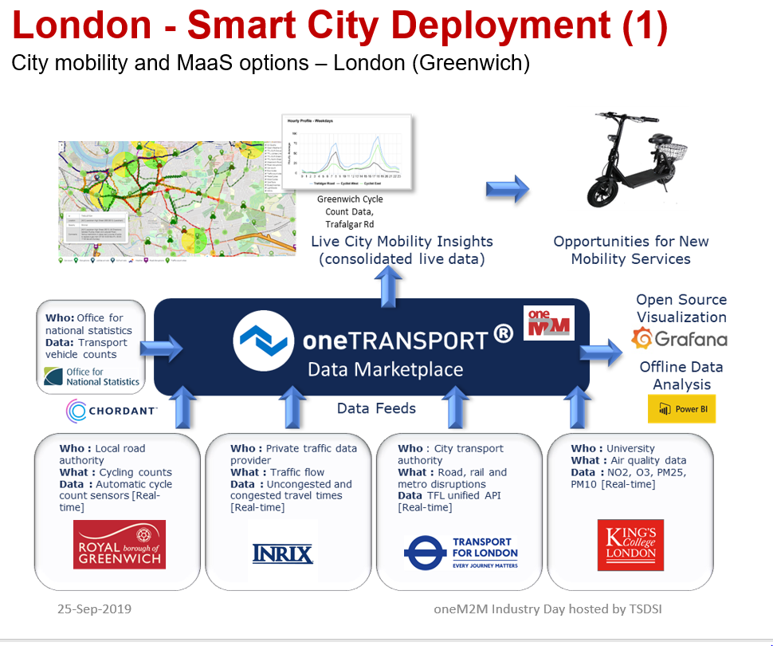
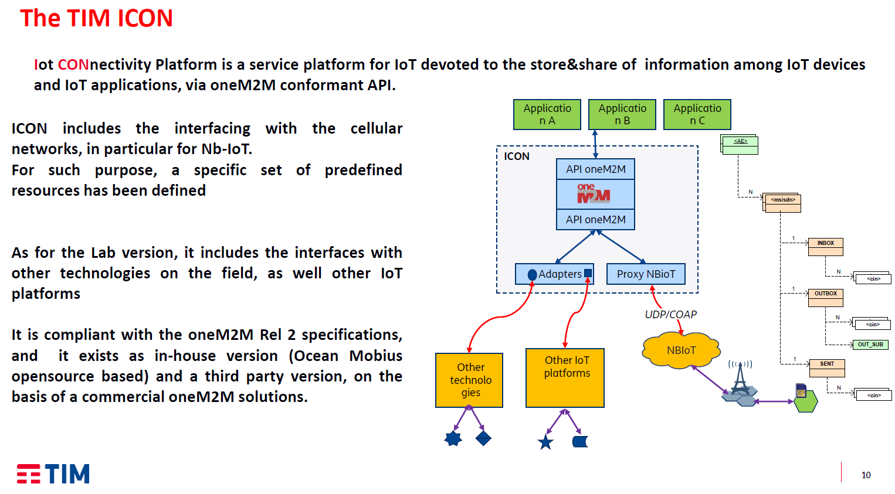
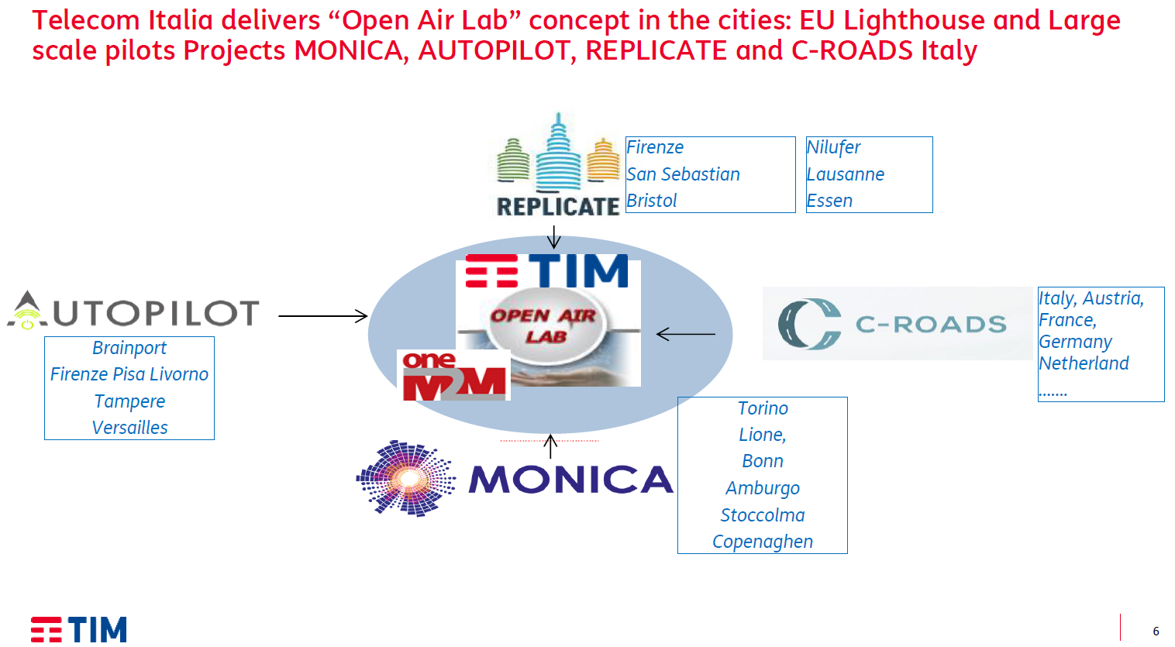
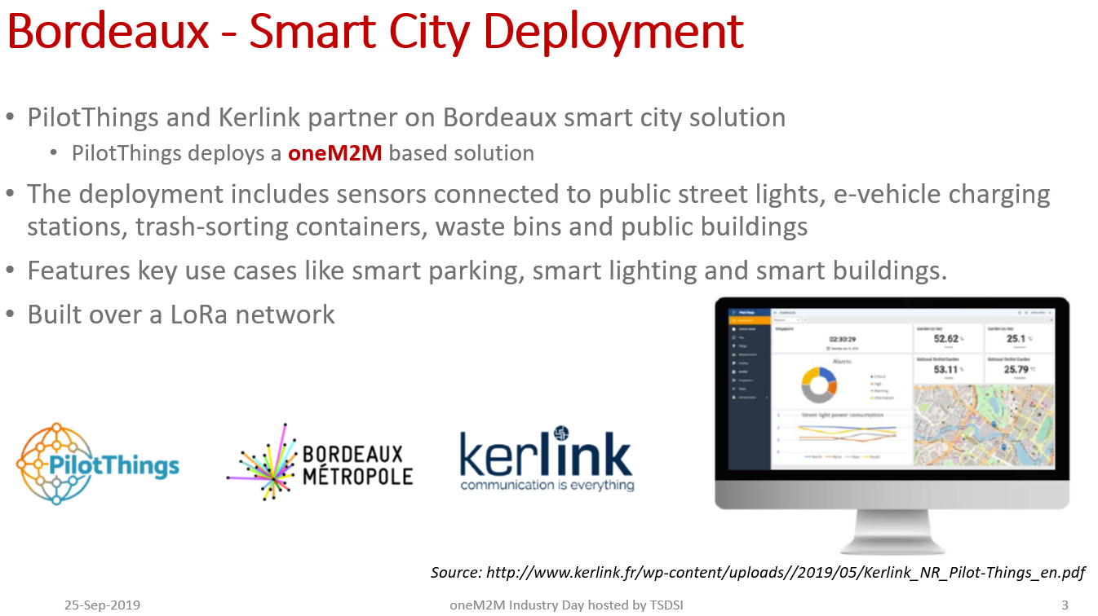
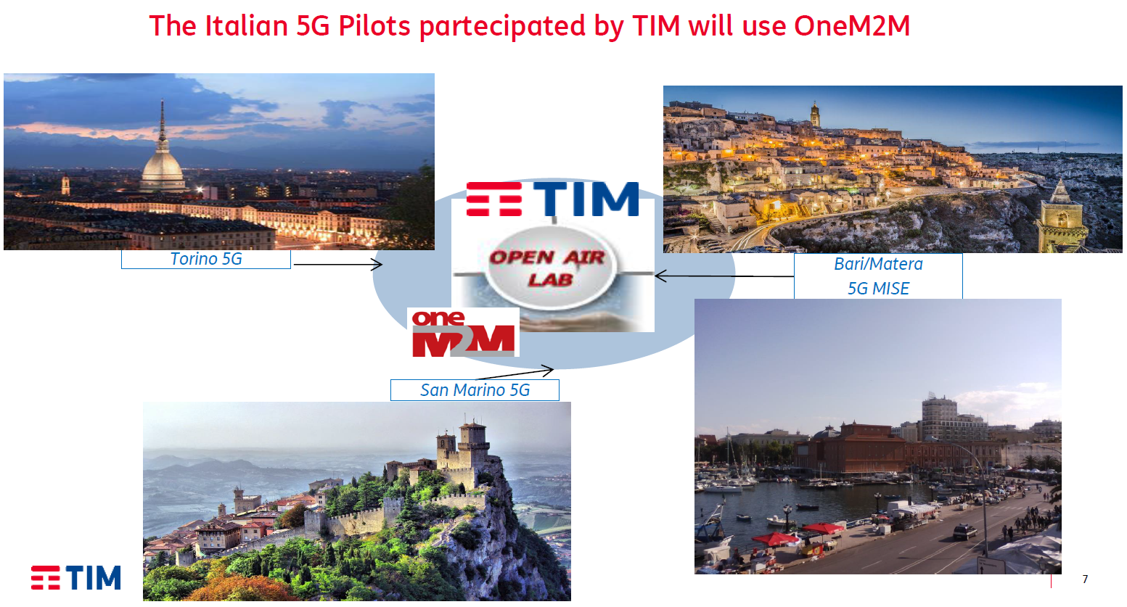
oneM2M in European Smart Cities
Source: https://www.onem2m.org/harmonization-m2m/list-of-deployments/
Source: Dr. Scarrone, TIM: Industry_Day-2018-0006-oneM2M_for_Smartcities.pdf

Slide 4


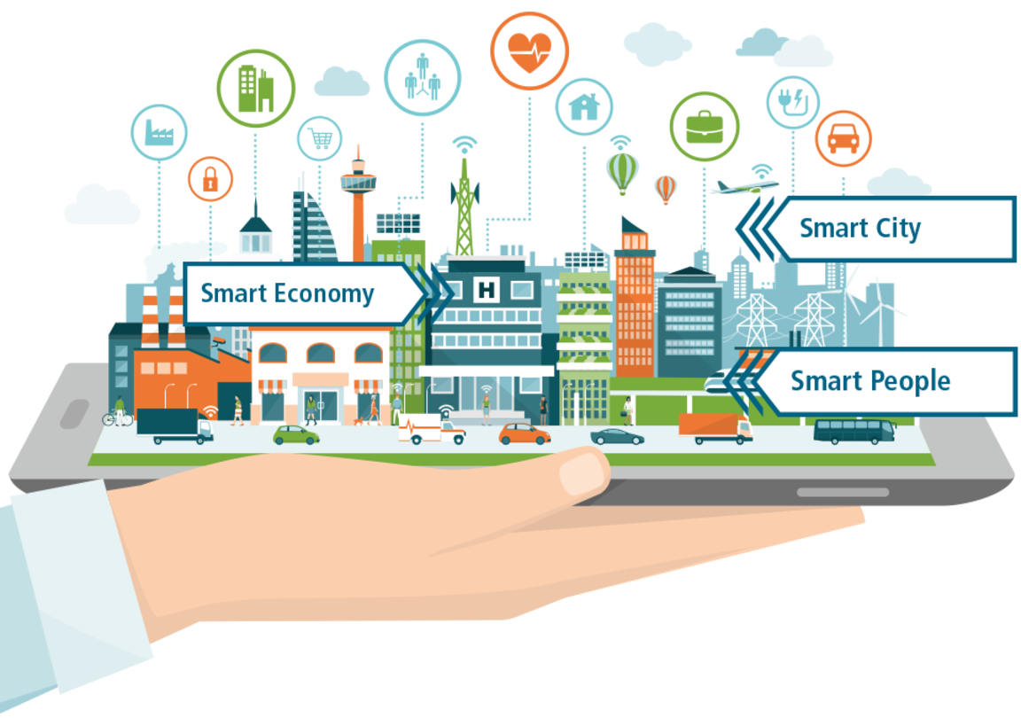
MySMARTLife
Transition of EU cities towards
a new concept of Smart Life and Economy
Lighthouse Cities
Nantes
Helsinki
Hamburg
Source: https://www.mysmartlife.eu/mysmartlife/
Notes:
What is mySMARTLife about?
The mySMARTLife project aims at making the three Lighthouse Cities of Nantes, Hamburg and Helsinki more environmentally friendly by reducing the CO₂ emissions of cities and increasing the use of renewable energy sources.
Activities are focusing on "Inclusive Cities", offering a high quality of life to residents. "Smart People" are playing a vital role in their city’s development. "Smart Economy" is an innovative and dynamic economic concept aiming at guaranteed employment and an adequate income, attracting talents and providing goods and services according to the actual requirements.
The interventions planned and carried out in the three Lighthouse Cities also include innovative technological solutions in connection with refurbishments of buildings, usage of renewable energies, clean transport and supporting ICT solutions.

Slide 5
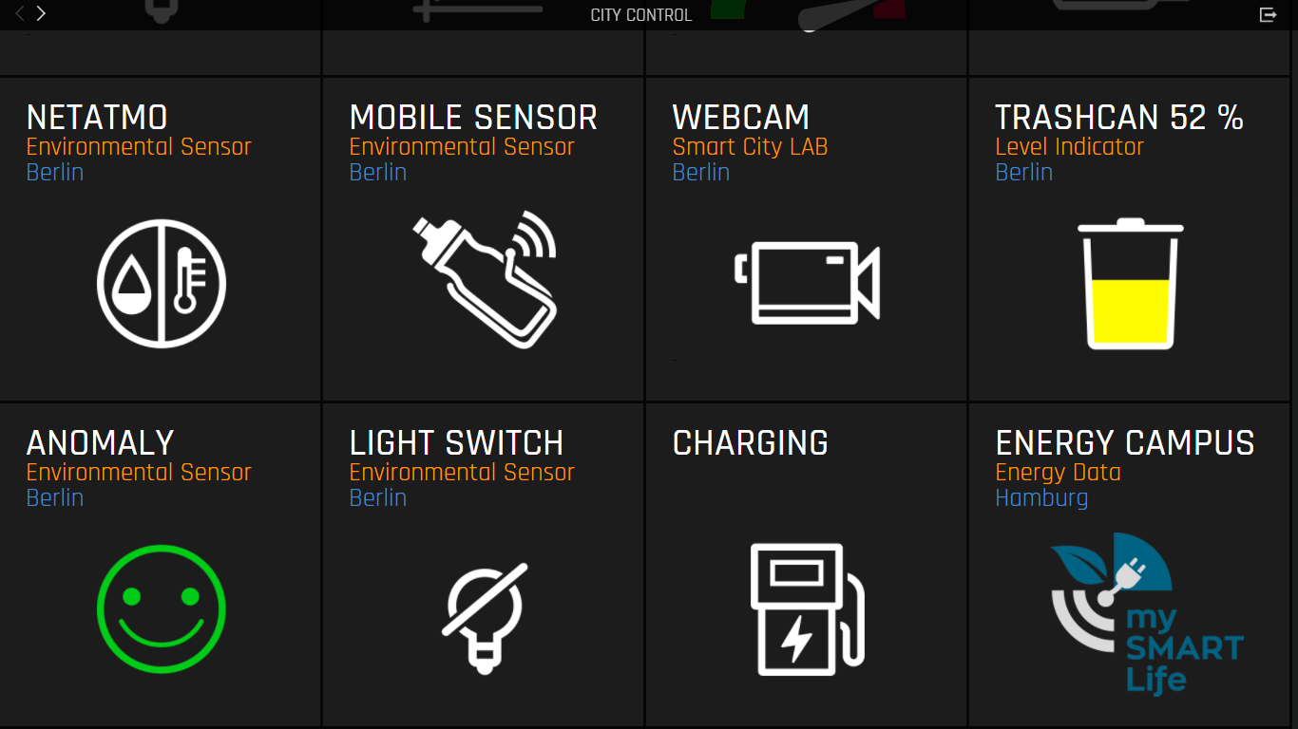
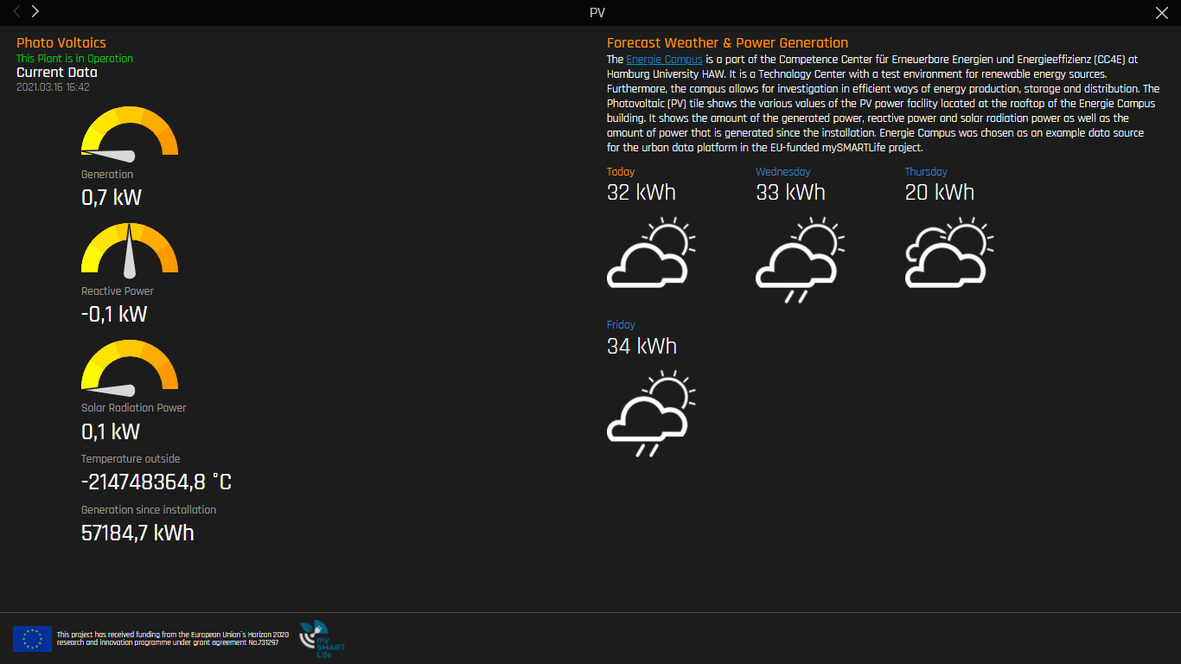
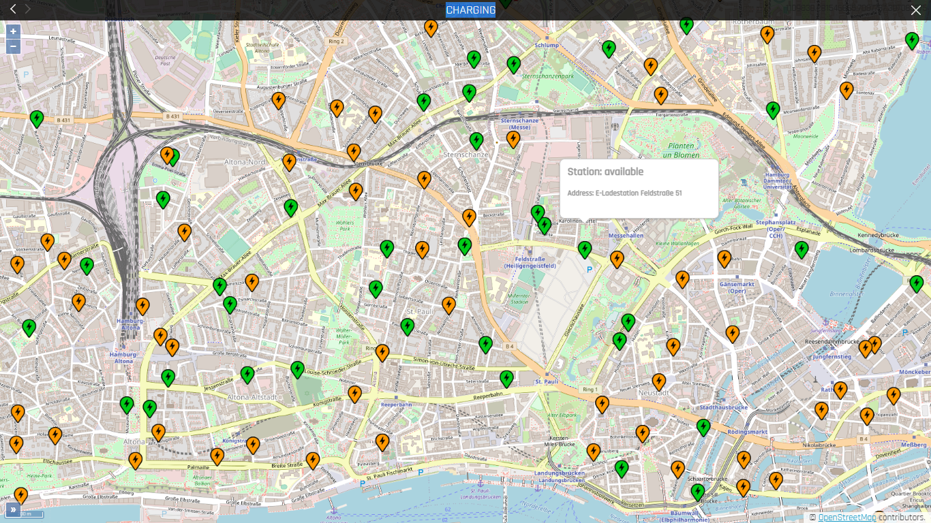
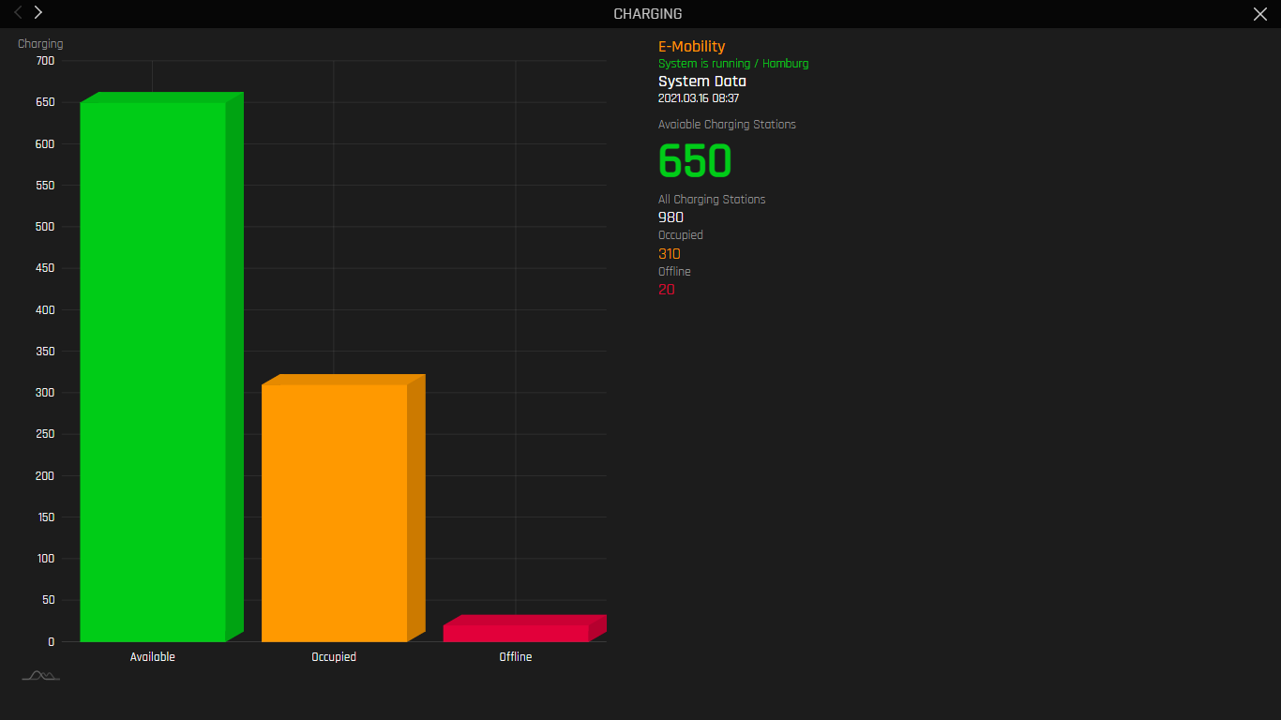
TRANSPARENCY IS KEY
City of Hamburg as a role model
City Control
photo voltaic
power generation & weather forecast
Station available
Charging Station Status
5

Slide 6






OPEN URBAN PLATFORM
A PART OF A SMART CITY ECOSYSTEM
Smart city platform ecosystem
Smart City Application
Data Intelligence
Open Urban Platform
Infrastructure Backends
IoT Connectivity
Devices (Hardware, Sensors)

Slide 7





“If you can’t have one - support them all”
Bridging OGC / STA and oneM2M standard
The MySMARTLife ICT platform for the City of Hamburg
“Our team focuses on applied innovation, so we were looking for a standardized architecture rather than developing something one-off or new”
Ingo Friese,
Deutsche Telekom
(onem2m.org)
Source: our-lighthouse-city-hamburg-deploys-onem2m-smart-city-standards-to-go-greener
TP-2019-0186-Introduction_into_OGC_SensorThings_API;
WI-100- oneM2M and SensorThings API

Slide 8
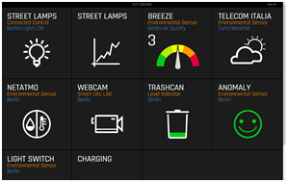




Urban Data core
ACTS AS A BRIDGE
Citizens, Authorities, Industry, Communities
Applications of 3rd parties, cities, Telekom, Streetlight vendors etc.
oneM2M API
oneM2M Standard Platform
based on Microservice Architecture
DB
oneM2M
Standard
Platform
Connectors
Owlet
Backend
Paradox Backend
Flashnet Backend
Breeze Backend
weitere Backends
Various
Backend
Systems
various
Schreder
Zumtobel
Solentis
Breeze
Source: our-lighthouse-city-hamburg-deploys-onem2m-smart-city-standards-to-go-greener

Slide 9
Thank You
www.oneM2M.org
Roland Hechwartner – roland.hechwartner@magenta.at
Notes:
9

Slide 10
Backup

Slide 11







oneM2M standards for end-to-end systems
Dashboard
Control
Connected Street Lights
Cloud
IoT Platform
Municipality Data
Source: https://onem2m.org/using-onem2m/devices-examples#architecture

Slide 12

oneM2M standards for end-to-end systems
Dashboard
Control
Non-oneM2M
Connected Street Lights
Service Layer
Cloud
IoT Platform
Municipality Data
Source: https://onem2m.org/using-onem2m/devices-examples#architecture

Slide 13

oneM2M standards for end-to-end systems
Dashboard
Control
Non-oneM2M
Connected Street Lights
Service Layer
Cloud
IoT Platform
Non-oneM2M
Analytics as a Service
Municipality Data
Source: https://onem2m.org/using-onem2m/devices-examples#architecture

Slide 14






oneM2M standards for end-to-end systems
Dashboard
Control
Non-oneM2M
Connected Street Lights
Service Layer
Cloud
IoT Platform
Non-oneM2M
Non-oneM2M
Non-oneM2M
Analytics as a Service
Municipality Data
Source: https://onem2m.org/using-onem2m/devices-examples#architecture

