Slide 1
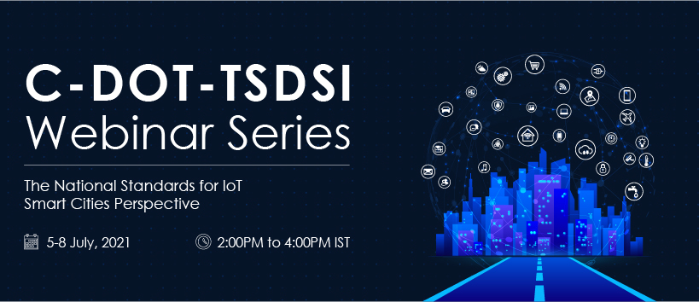

Slide 2
IoT Standards and Smart Cities: oneM2M use cases, interworking, Testing and Certifications
3GPP Interworking in oneM2M
By
Bob Flynn
Vice-chair
Test and Development Ecosystem (TDE)
oneM2M

Slide 3
Standards for Cellular Internet of Things
oneM2M
3GPP
GSMA

Slide 4


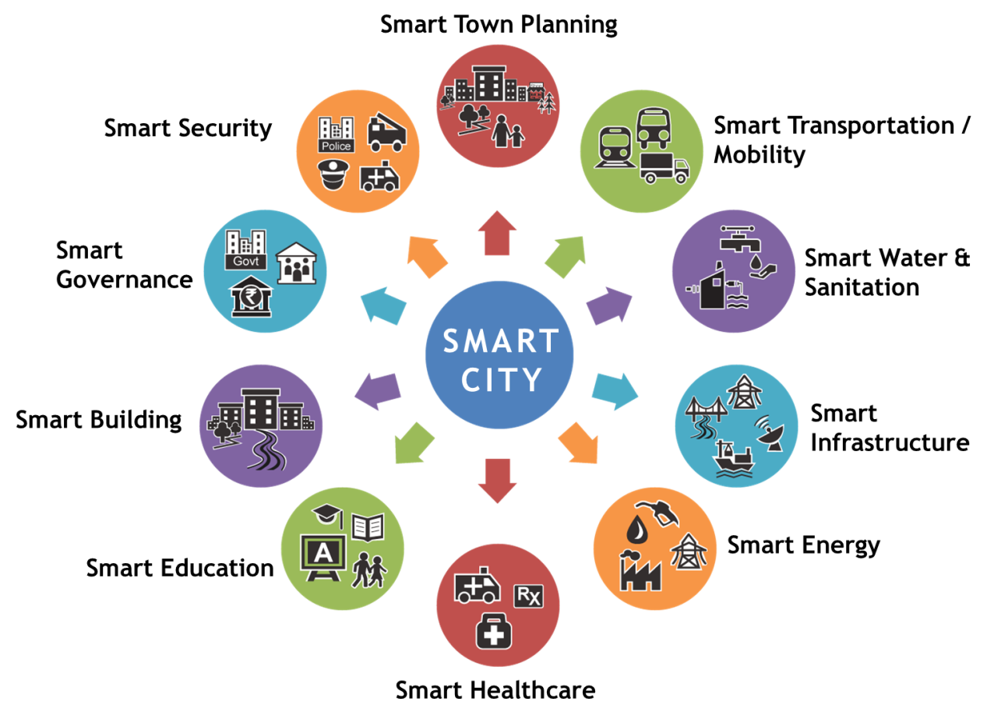
oneM2M Provides a Simpler Abstracted View
Service Layer
OCF
OPC-UA
ZigBee (dotdot)
OMA DM
BBF
LWM2M
…
OCF
OPC-UA
ZigBee (dotdot)
OMA DM
BBF
LWM2M
…
XML
JSON
CBOR
…
XML
JSON
CBOR
…
HTTP(s)
MQTT(s)
CoAP(s)
…
HTTP(s)
MQTT(s)
CoAP(s)
…
TLS/PSK
TLS/PKI
DTLS/PSK
…
TLS/PSK
TLS/PKI
DTLS/PSK
…
Cellular
Fixed
Wi-Fi
Bluetooth
NB-IoT
LoRA
Sigfox
…
Cellular
Fixed
Wi-Fi
Bluetooth
NB-IoT
LoRA
Sigfox
…
Today Smart City Stakeholders are exposed to many different technology choices. This leads to complexity and hampers interoperability.
Using oneM2M, the developer only uses the globally specified oneM2M APIs. This greatly simplifies life for Smart City Stakeholders
Notes:
Think back to the Weather analysis example.

Slide 5
Standards for Cellular Internet of Things
oneM2M
IoT Device Abstraction and Interworking
Device Management
3GPP
GSMA

Slide 6
3GPP Enhancements for MTC
-------Release 13 23.682 ------------------
Device Triggering Function
PS-only Service Provision
Core Network assisted RAN parameters tuning
UE Power Saving Mode
Group Message Delivery
Monitoring Events
  Monitoring the association of the UE and UICC and/or new IMSI-IMEI-SV association;
  UE reachability;
  Location of the UE, and change in location of the UE;
  Loss of connectivity;
  Communication failure;
  Roaming status (i.e. Roaming or No Roaming) of the UE, and change in roaming status of the UE; and
  Number of UEs present in a geographical area;
  Availability after DDN failure.
  Offline Charging
High latency communication
Support of informing about potential network issues
Resource management of background data transfer
E-UTRAN network resource optimizations based on communication patterns provided to the MME
Support of setting up an AS session with required QoS
Change the chargeable party at session set-up or during the session
Extended idle mode DRX
Non-IP Data Delivery (NIDD)
-------Release 15 23.682 ------------------
Support of PFD management via SCEF
MSISDN-less MO-SMS via T4
Enhanced Coverage Restriction Control via SCEF
MBMS user service for UEs using power saving functions
Enhancements to Location Services for CIoT
MBMS user service for NB or M UE categories
Network Parameter Configuration via SCEF
SCEF - SCS/AS API Procedures
Charging Principles

Slide 7
Standards for Cellular Internet of Things
oneM2M
IoT Device Abstraction and Interworking
Device Management
3GPP Interworking
3GPP
GSMA
Device Triggering Function
Core Network assisted RAN parameters tuning
UE Power Saving Mode
Group Message Delivery
Monitoring Events
  UE reachability;
  Location of the UE, and change in location of the UE;
  Loss of connectivity;
  Communication failure;
  Roaming status (i.e. Roaming or No Roaming) of the UE, and change in roaming status of the UE; and
High latency communication
Resource management of background data transfer
Non-IP Data Delivery (NIDD)

Slide 8


Massive IoT Device Deployment
Cellular IoT Devices
(NB-IoT, LTE-M)
IoT Service Provider
3GPP Core Network
IoT Server Application
IoT Features
IoT Service
Platform
control
Design
data
Deployment
Error scenario
8

Slide 9
GSMA TS 34 IoT Device Connection Efficiency Guidelines
IoT Service Provider
Requirements: TS.34_6
IoT Service
IoT Service Provider – The provider of IoT services working in partnership with a network operator to provide an IoT service to an end customer. The provider could also be an MNO.
IoT Service Platform
3GPP Mobile Network
3GPP Connection Efficiency
Features: TS.34_9
Mobile Network Operator – The mobile network operator(s) connecting the IoT device application to the IoT service platform.
IoT Device
IoT Device
Requirements: TS.34_3
IoT Device – The combination of both the IoT device application and the communication module.
IoT Device Application
Requirements: TS.34_4
IoT Device Application – The application software component of the IoT device that controls the communications module and interacts with an IoT service platform via the communications module.
IoT Device Application
Communication Module
Communication Module
Requirements: TS.34_5
Connection Efficiency
Requirements: TS.34.7
Communication Module – The communications component which provides wide area radio connectivity
Communications Module Firmware – The functionality within the communications module that provides an API to the IoT device application and controls the radio baseband chipset.
Communication Module Firmware
Radio Baseband Chipset – The functionality within the communications module that provides connectivity to the mobile network.
UICC – The smart card used by a mobile network to authenticate devices for connection to the mobile network and access to network services.
Radio Policy Manager
Requirements: TS.34_8
Radio
Baseband Chipset
UICC (SIM)

Slide 10
Standards for Cellular Internet of Things
oneM2M
IoT Device Abstraction and Interworking
Device Management
3GPP Interworking
CMDH
3GPP
GSMA
Device Triggering Function
Core Network assisted RAN parameters tuning
UE Power Saving Mode
Group Message Delivery
Monitoring Events
  UE reachability;
  Location of the UE, and change in location of the UE;
  Loss of connectivity;
  Communication failure;
  Roaming status (i.e. Roaming or No Roaming) of the UE, and change in roaming status of the UE; and
High latency communication
Resource management of background data transfer
Non-IP Data Delivery (NIDD)
IoT Application Requirements
IoT Device Requirements
Mobile Network Operator Requirements
IoT Service Provider Requirements

Slide 11
Standards for Cellular Internet of Things
oneM2M
IoT Device Abstraction and Interworking
Device Management
3GPP Interworking
CMDH
3GPP
GSMA
Device Triggering Function
Core Network assisted RAN parameters tuning
UE Power Saving Mode
Group Message Delivery
Monitoring Events
  UE reachability;
  Location of the UE, and change in location of the UE;
  Loss of connectivity;
  Communication failure;
  Roaming status
High latency communication
Resource management of background data transfer
Non-IP Data Delivery (NIDD)
IoT Application Requirements
IoT Device Requirements
Mobile Network Operator Requirements
IoT Service Provider Requirements
Protect the Network

Slide 12
GSMA recommends a better way
IoT Device Host
IoT Service Provider
IoT Device Application
3GPP Mobile Network
IoT Server Application
GSMA Evolved Architecture
IoT Embedded Service Layer
IoT Service Platform
Application Service Node (ASN)
Infrastructure Node (IN)
oneM2M Architecture
ASN-AE
3GPP Mobile Network
IN-AE
Mca
Mca
ASN-CSE
IN-CSE

Slide 13
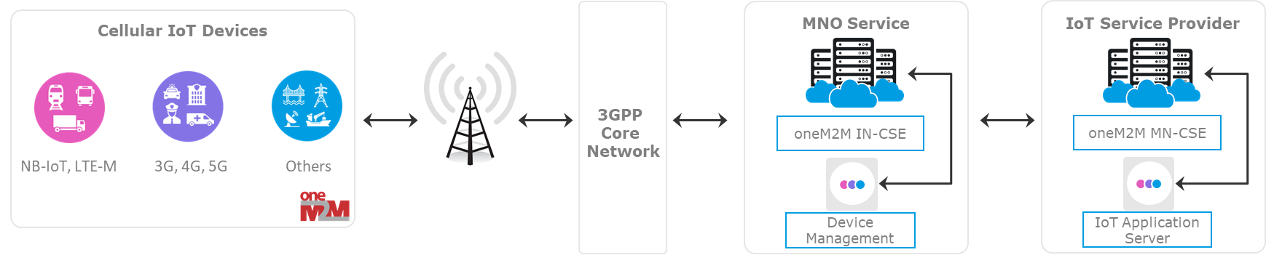
MNO Deployment
CSE notifies devices
4. Device Starts communicating according to different policies
3. Core Network identifies data congestion
SCEF notifies CSE
CMDH Policies
Mgmt Objects
1. oneM2M 3GPP device registers to MNO Service
CMDH Policies
Mgmt Objects
2. Device Starts communicating according to the policies
Normal Priority
Sensor Data
Sensor Data
Device Management Data
Mgmt Data
High Priority

Slide 14
Summary
Large scale deployments of IoT devices have the risk of negatively impacting the mobile network
GSMA created a list of recommendations to help ensure “No Harm To the Network”
oneM2M can implement the TS34 requirements in an ASN-CSE
GCF Authorized Test Labs can verify and certify devices
Fast time to market with safe and reliable solutions using open standards based on oneM2M!

Slide 15
Thank You
Notes:
15

Slide 16

About Me
Bob Flynn
Vice chair, oneM2M Test and Development Ecosystem
Founder and Principal Technology Consultant
www.exactagss.com
https://www.linkedin.com/in/bobflynniv

Slide 17

References
https://www.exactagss.com/assets/september2019--do-no-harm.pdf
https://www.chordant.io/white_papers/no-harm-to-networks-
https://www.gsma.com/iot/resources/no-harm-to-networks/
oneM2M Website: http://onem2m.org/

