Slide 1
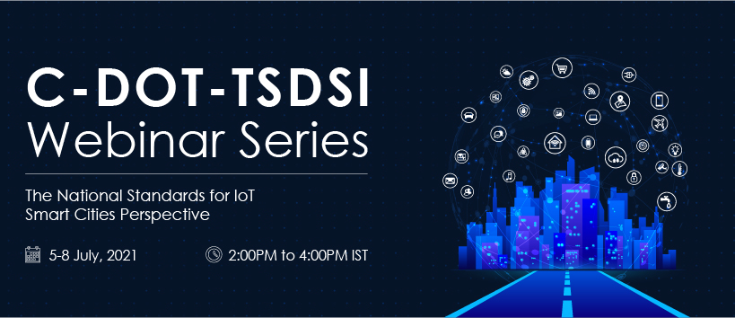

Slide 2
IoT Standards and Smart Cities: oneM2M use cases,
interworking, Testing and Certifications
Interworking framework of oneM2M
Dale Seed
oneM2M TP Vice Chair
oneM2M Sustainability Sub-Committee Convenor
Principal Engineer, InterDigital / Convida Wireless

Slide 3

oneM2M interworking framework
Application Developers
Service Providers
Data Insights Providers
Middleware Layer
IoT and Other Data Sources
Notes:
Here is how a standardized toolkit enables digital transformation

Slide 4







oneM2M interworks end-to-end systems
Dashboard
Control
Connected Street Lights
Cloud
IoT Platform
Municipality Data

Slide 5

oneM2M interworks end-to-end systems
Dashboard
Control
Non-oneM2M
Connected Street Lights
Service Layer
Cloud
IoT Platform
Municipality Data

Slide 6

oneM2M interworks end-to-end systems
Dashboard
Control
Non-oneM2M
Connected Street Lights
Service Layer
Cloud
IoT Platform
Non-oneM2M
Analytics as a Service
Municipality Data

Slide 7






oneM2M interworks end-to-end systems
Dashboard
Control
Non-oneM2M
Connected Street Lights
Service Layer
Cloud
IoT Platform
Non-oneM2M
Non-oneM2M
Non-oneM2M
Analytics as a Service
Municipality Data

Slide 8
oneM2M interworking framework
Notes:
oneM2M interworks with various IoT device technologies
E.g., 3GPP, OCF, ZWAVE, Bluetooth, ZigBee, …

Slide 9

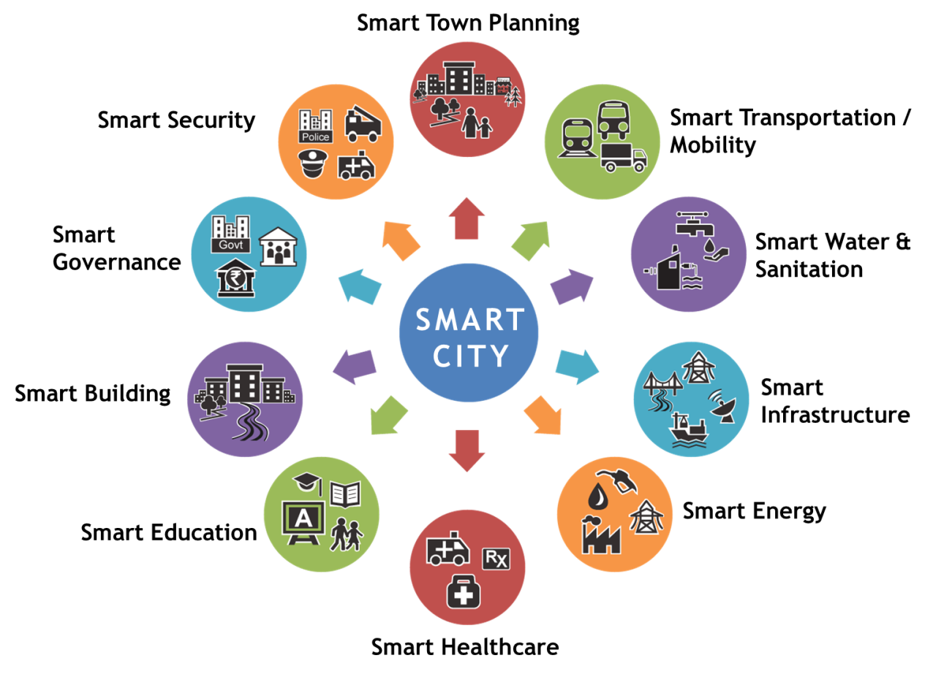
oneM2M abstraction enables simpler interworking
W3C TD
SAREF
…
OCF
OMA DM
BBF
LWM2M
…
XML
JSON
CBOR
…
HTTP(s)
CoAP(s)
MQTT(s)
…
TLS/PSK
TLS/PKI
DTLS/PSK
…
Cellular
Fixed
Wi-Fi
…
Notes:
oneM2M provides an abstracted & simplified API for applications to communicate with devices
All devices are represented as oneM2M devices regardless of the technology they use
Via standardized oneM2M API, App developers can manage devices in a simpler and uniform manner

Slide 10

oneM2M abstraction enables simpler interworking
Service Layer
W3C TD
SAREF
…
W3C TD
SAREF
…
OCF
OMA DM
BBF
LWM2M
…
OCF
OMA DM
BBF
LWM2M
…
XML
JSON
CBOR
…
Abstraction
XML
JSON
CBOR
…
HTTP(s)
CoAP(s)
MQTT(s)
…
HTTP(s)
CoAP(s)
MQTT(s)
…
TLS/PSK
TLS/PKI
DTLS/PSK
…
TLS/PSK
TLS/PKI
DTLS/PSK
…
Cellular
Fixed
Wi-Fi
…
Cellular
Fixed
Wi-Fi
…
Notes:
oneM2M provides an abstracted & simplified API for applications to communicate with devices
All devices are represented as oneM2M devices regardless of the technology they use
Via standardized oneM2M API, App developers can manage devices in a simpler and uniform manner

Slide 11

oneM2M interworking example
Single oneM2M Request to switch lights on
Service Layer
OCF
IPE
Bluetooth IPE
ZWAVE
IPE
OCF Light
Bluetooth Light
ZWAVE Light
oneM2M Light
IPE = Interworking Proxy Entity
Notes:
Once abstracted into oneM2M, App Developers can sense/control all IoT devices in a common and uniform manner
Turn switch on/off, sample sensor reading, etc.

Slide 12
oneM2M interworking example
Service Layer
oneM2M Request to switch light on
oneM2M Request to switch light on
oneM2M Request to switch light on
oneM2M Request to switch light on
OCF
IPE
Bluetooth IPE
ZWAVE
IPE
OCF Light
Bluetooth Light
ZWAVE Light
oneM2M Light
IPE = Interworking Proxy Entity

Slide 13
oneM2M interworking example
Service Layer
OCF
IPE
Bluetooth IPE
ZWAVE
IPE
OCF Request to switch light on
ZWAVE Request to switch light on
Bluetooth Request to switch light on
ZWAVE Request to switch light on
oneM2M Request to switch light on
OCF Light
Bluetooth Light
ZWAVE Light
oneM2M Light
IPE = Interworking Proxy Entity

Slide 14
oneM2M interworking example
Service Layer
OCF
IPE
Bluetooth IPE
ZWAVE
IPE
OCF Response to switch light on
ZWAVE Response to switch light on
Bluetooth Response to switch light on
ZWAVE Request to switch light on
oneM2M Response to switch light on
OCF Light
Bluetooth Light
ZWAVE Light
oneM2M Light
IPE = Interworking Proxy Entity

Slide 15
oneM2M interworking example
Service Layer
oneM2M Response to switch light on
oneM2M Response to switch light on
oneM2M Response to switch light on
oneM2M Response to switch light on
OCF
IPE
Bluetooth IPE
ZWAVE
IPE
OCF Light
Bluetooth Light
ZWAVE Light
oneM2M Light
IPE = Interworking Proxy Entity

Slide 16
oneM2M interworking example
Single oneM2M Response to switch lights on
Service Layer
OCF
IPE
Bluetooth IPE
ZWAVE
IPE
OCF Light
Bluetooth Light
ZWAVE Light
oneM2M Light
IPE = Interworking Proxy Entity

Slide 17

Takeaways
Many IoT deployments can have diverse types of IoT sub-systems and platforms including different types of devices, apps, data and services
oneM2M abstraction capabilities can reduce the complexity of interworking
oneM2M can help future proof IoT deployments by enabling different types of brownfield and greenfield technologies to interwork with one another
Service Layer
W3C TD
SAREF
…
OCF
OMA DM
BBF
LWM2M
…
Abstraction
XML
JSON
CBOR
…
HTTP(s)
CoAP(s)
MQTT(s)
…
TLS/PSK
TLS/PKI
DTLS/PSK
…
Cellular
Fixed
Wi-Fi
…
17

Slide 18

Thank You
Dale Seed
oneM2M TP Vice Chair
oneM2M Sustainability Sub-Committee Convenor
Principal Engineer, InterDigital / Convida Wireless
dale.seed@interdigital.com
Notes:
18

Slide 19
Backup
Notes:
19

Slide 20

Underlying Network Abstraction
oneM2M interworks with underlying network technologies to help manage connectivity and communication to IoT devices on behalf of the apps
  Scheduling and buffering of messages based on device reachability
  Selection of underlying network connectivity options for device communication
  Triggering of devices to establish a network connection based on when apps need to communicate with devices
  QoS configuration based on app’s needs
Service Layer
Cellular
Fixed
Wi-Fi
…
* oneM2M is closely working with 3GPP on
interworking via SCEF API
20

Slide 21
IoT Device Security Abstraction
oneM2M hides the different security frameworks of each IoT device technology from the App Developer.
A Developer’s app can establish a security association with the oneM2M service layer and via this security association, communicate securely with IoT devices
The oneM2M service layer establishes and manages the security association with each of the IoT devices on behalf of the app
  Enrolment, credential bootstrap/management, authentication, integrity, privacy, and authorization network connectivity of the devices from the app developer.
Service Layer
TLS/PSK
TLS/PKI
DTLS/PSK
…
Cellular
Fixed
Wi-Fi
…

Slide 22
Transport Protocol Abstraction
oneM2M hides the different transport protocols used by the devices from the App Developer.
Applications can use different transport protocols than the one or more different devices they choose to communicate with
  E.g. HTTP(s), CoAP(s), MQTT(s), WebSockets
oneM2M will handle converting the transport protocol so the App Developer does not need to
Service Layer
HTTP(s)
CoAP(s)
MQTT(s)
…
TLS/PSK
TLS/PKI
DTLS/PSK
…
Cellular
Fixed
Wi-Fi
…

Slide 23

Content Serialization Abstraction
oneM2M hides the different content serializations used by the devices from the App Developer.
Applications can use different types of content serialization formats than the one or more devices they choose to communicate with
  E.g. XML, JSON, CBOR, Plain-Text
oneM2M will convert the content serialization format so the App Developer does not have to
Service Layer
XML
JSON
CBOR
…
HTTP(s)
CoAP(s)
MQTT(s)
…
TLS/PSK
TLS/PKI
DTLS/PSK
…
Cellular
Fixed
Wi-Fi
…

Slide 24
IoT Services and Device Management Abstraction
oneM2M interworks with various IoT device service enablement and device management technologies
  E.g. LWM2M, OCF, OMA DM, BBF TR-069, …
  All devices are presented to the App via oneM2M API
  Via standardized oneM2M API, App developers can use device services and manage devices
Once the data model is abstracted into oneM2M, App Developers can access all devices in a common manner and make use of oneM2M value-add capabilities such as
  Resource Discovery
  Generating Events via subscriptions and notifications
  Grouping
  Access Controls
Service Layer
OCF
OMA DM
BBF
LWM2M
…
XML
JSON
CBOR
…
HTTP(s)
CoAP(s)
MQTT(s)
…
TLS/PSK
TLS/PKI
DTLS/PSK
…
Cellular
Fixed
Wi-Fi
…

Slide 25
IoT Semantics Abstraction
oneM2M supports a semantic framework
This framework supports semantic ontology interworking
  Ontologies defined by other organizations can be used in the oneM2M framework to describe oneM2M resources in a semantic manner
The framework supports semantic ontology abstraction
  oneM2M defines its own technology that can be used to describe oneM2M resources in a semantic manner
  Semantic descriptions expressed in terms of other ontologies can be interworked to oneM2M’s Base Ontology to provide abstraction
Service Layer
W3C TD
SAREF
…
OCF
OMA DM
BBF
LWM2M
…
XML
JSON
CBOR
…
HTTP(s)
CoAP(s)
MQTT(s)
…
TLS/PSK
TLS/PKI
DTLS/PSK
…
Cellular
Fixed
Wi-Fi
…

