Slide 2
IoT Standards and Smart Cities: oneM2M use cases, interworking,
Testing and Certifications
Testing and Certification of IoT Ecosystem in India
By
Prasanth Ponugoti., ITS
DDG (MRA),TEC

Slide 3
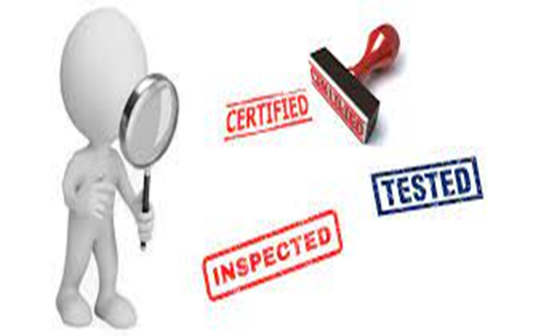
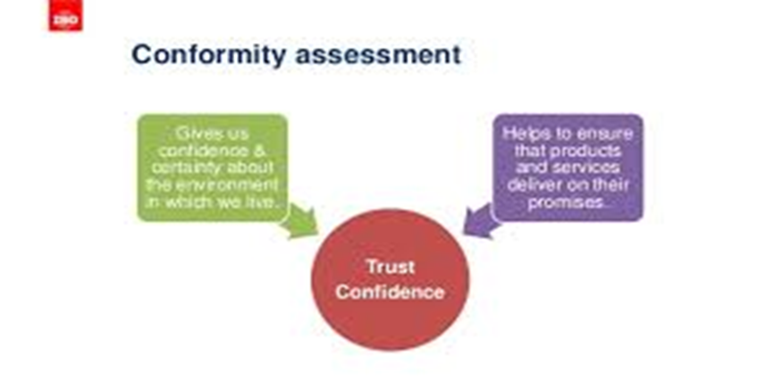
WHY DO WE NEED TESTING AND CERTIFICATION CONFIRMITY ASSESMENT AND CERTIFICATION-EMPHASIS
Conformity assessment is the comprehensive term for procedures by which products and processes are evaluated and determined to conform to particular standards…
Gives confidence certainty of environment in which we deploy, helps to ensure product are delivered as per promise
As a public policy professionals our focus is on protecting and providing the services and goods to last man with out discrimination
Complications in testing IOT technologies
China Tepai Experience
In today’s Homo Economicus society, telecommunication technology has become cardinal thread in the ambitiously emerging civilisations
Nudging public policy in an emerging new great civilisations is not possible without data acquisition through IOT and telecom technologies…
Telecom technologies are changing civilisation from homo economicus to Homo socio economicus by connecting people and things intelligently ..
How can we sustain such societies with out standardisation and conformity assessment..

Slide 4
METAMORHISIS OF TESTIGN AND CERTIFICATION Emerging technologies are re-defining the testing as a process of continuum- NATIONAL STRATEGY .
To dream for 5 trillion dollar Indian economy, telecom is pivotal sector The Conformity Assessment and certification shall be cardinal thread to accelerate such growth in any sector
Virtualisation and softwareisation are biggest challenges in testing
To Meet such demand in the industry TEC has started an ambitious scheme called Conformity Assessment Bodies Designation scheme and Mutual Recognition Agreement (MRAs)
Where is the compliance eco- system to realise such big dream ? ONLY PPP is the way !!!!
CAB designation scheme is the answer

Slide 5
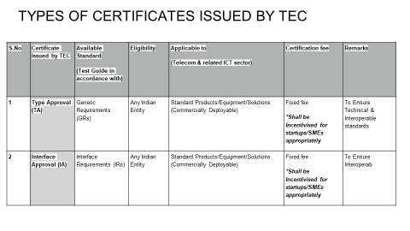
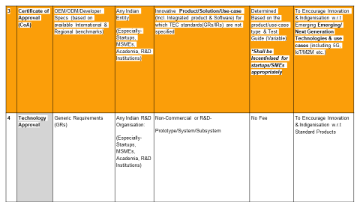
TEC National strategy - Social justice vs markets various certifications that TEC awards apart from Mandatory AN INNOVATIVE PUBLIC POLICY TOMEET ASPIRATION OF GOVT

Slide 6
Following Essential Requirements are published by TEC as on date
IOT Gate Way
Smart Watch
Smart Electric meters
Feed back devices
Tracking devices

Slide 7
Iot gateway smart watch feed back devices

Slide 8
Thank You
can reach me at :
ddgc.tec@gov.in
Praasanth.ponugoti@gov.in
delhiprasanth@gmail.com
9868136446
Notes:
8

