Slide 1
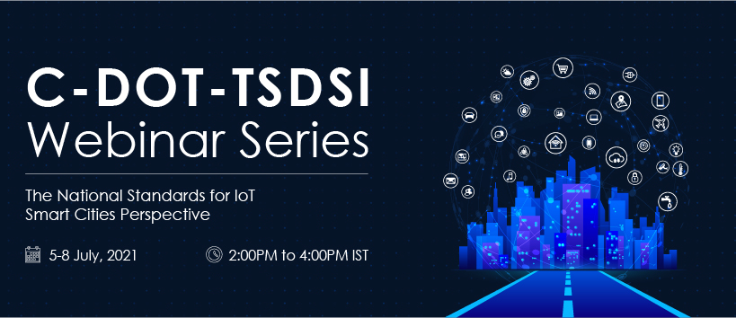

Slide 2
< Session Name>
oneM2M based use cases in Smart City Living Lab
Deepak Gangadharan
Assistant Professor, IIIT Hyderabad

Slide 3
Smart City Living Lab – Introduction
Smart Campus
Power & Distribution
Smart Rooms
Water
Air Quality
Smart Street Lamp
Crowd Monitoring
Structural Health
Weather
Solar
IoT deployments for nine application verticals
Notes:
Living Lab, an open-innovation ecosystem has been set up at IIITH, in collaboration with the technology partners EBTC and LAAS-CNRS and support from the MEITY, Smart City mission and Government of Telangana.
As part of the Living Lab, we have deployed various IOT sensor nodes across the campus to monitor air quality, water quality, weather, energy parameters, and more, and post to a OneM2M server via 4g, Lorawan etc. for data processing and predictive control.

Slide 4


Smart City Living Lab – General Architecture
Database
(~3TB data to store One year data)
20+25
10+40
Water Sensor Node (10 mins, 1 min)
Air Quality
Sensor Node (15 secs)
2
WiFi
Dashboard
WiFi/4G
Weather Sensor Node (1 min)
IIIT-H
IN-CSE
100
LoRaWAN
Energy Monitoring Sensor Node
Crowd Monitoring Sensor Node
GPU for Algorithm processing
6
WiFi
Solar Sensor Node (1 min)
Smart room Node (1 min)
7
16+100+14

Slide 5









Data Flow Architecture
Different vertical parameters monitored by respective nodes deployed at various locations in IIIT-H campus
Data sensed is pushed to the OM2M platform, an open-source implementation of oneM2M standard
A data warehouse to store historical data integrated with OM2M using subscription
An API layer for seamless data exchange between IIIT-H data monitoring system and data consumers using IUDX interface
Data Warehouse
API Layer
IIIT-H Monitoring Node
Application

Slide 6
Data Flow Architecture
iudx-rs-onem2m.iiit.ac.in
API layer
onem2m.iiit.ac.in
Subs_Mgmt
Client
latest-data
resource id validation, TIP
Data
Insertion
Historical
Data Retrieval
IUDX catalogue
IIIT-H Monitoring Node
Db
db-onem2m.iiit.ac.in

Slide 7
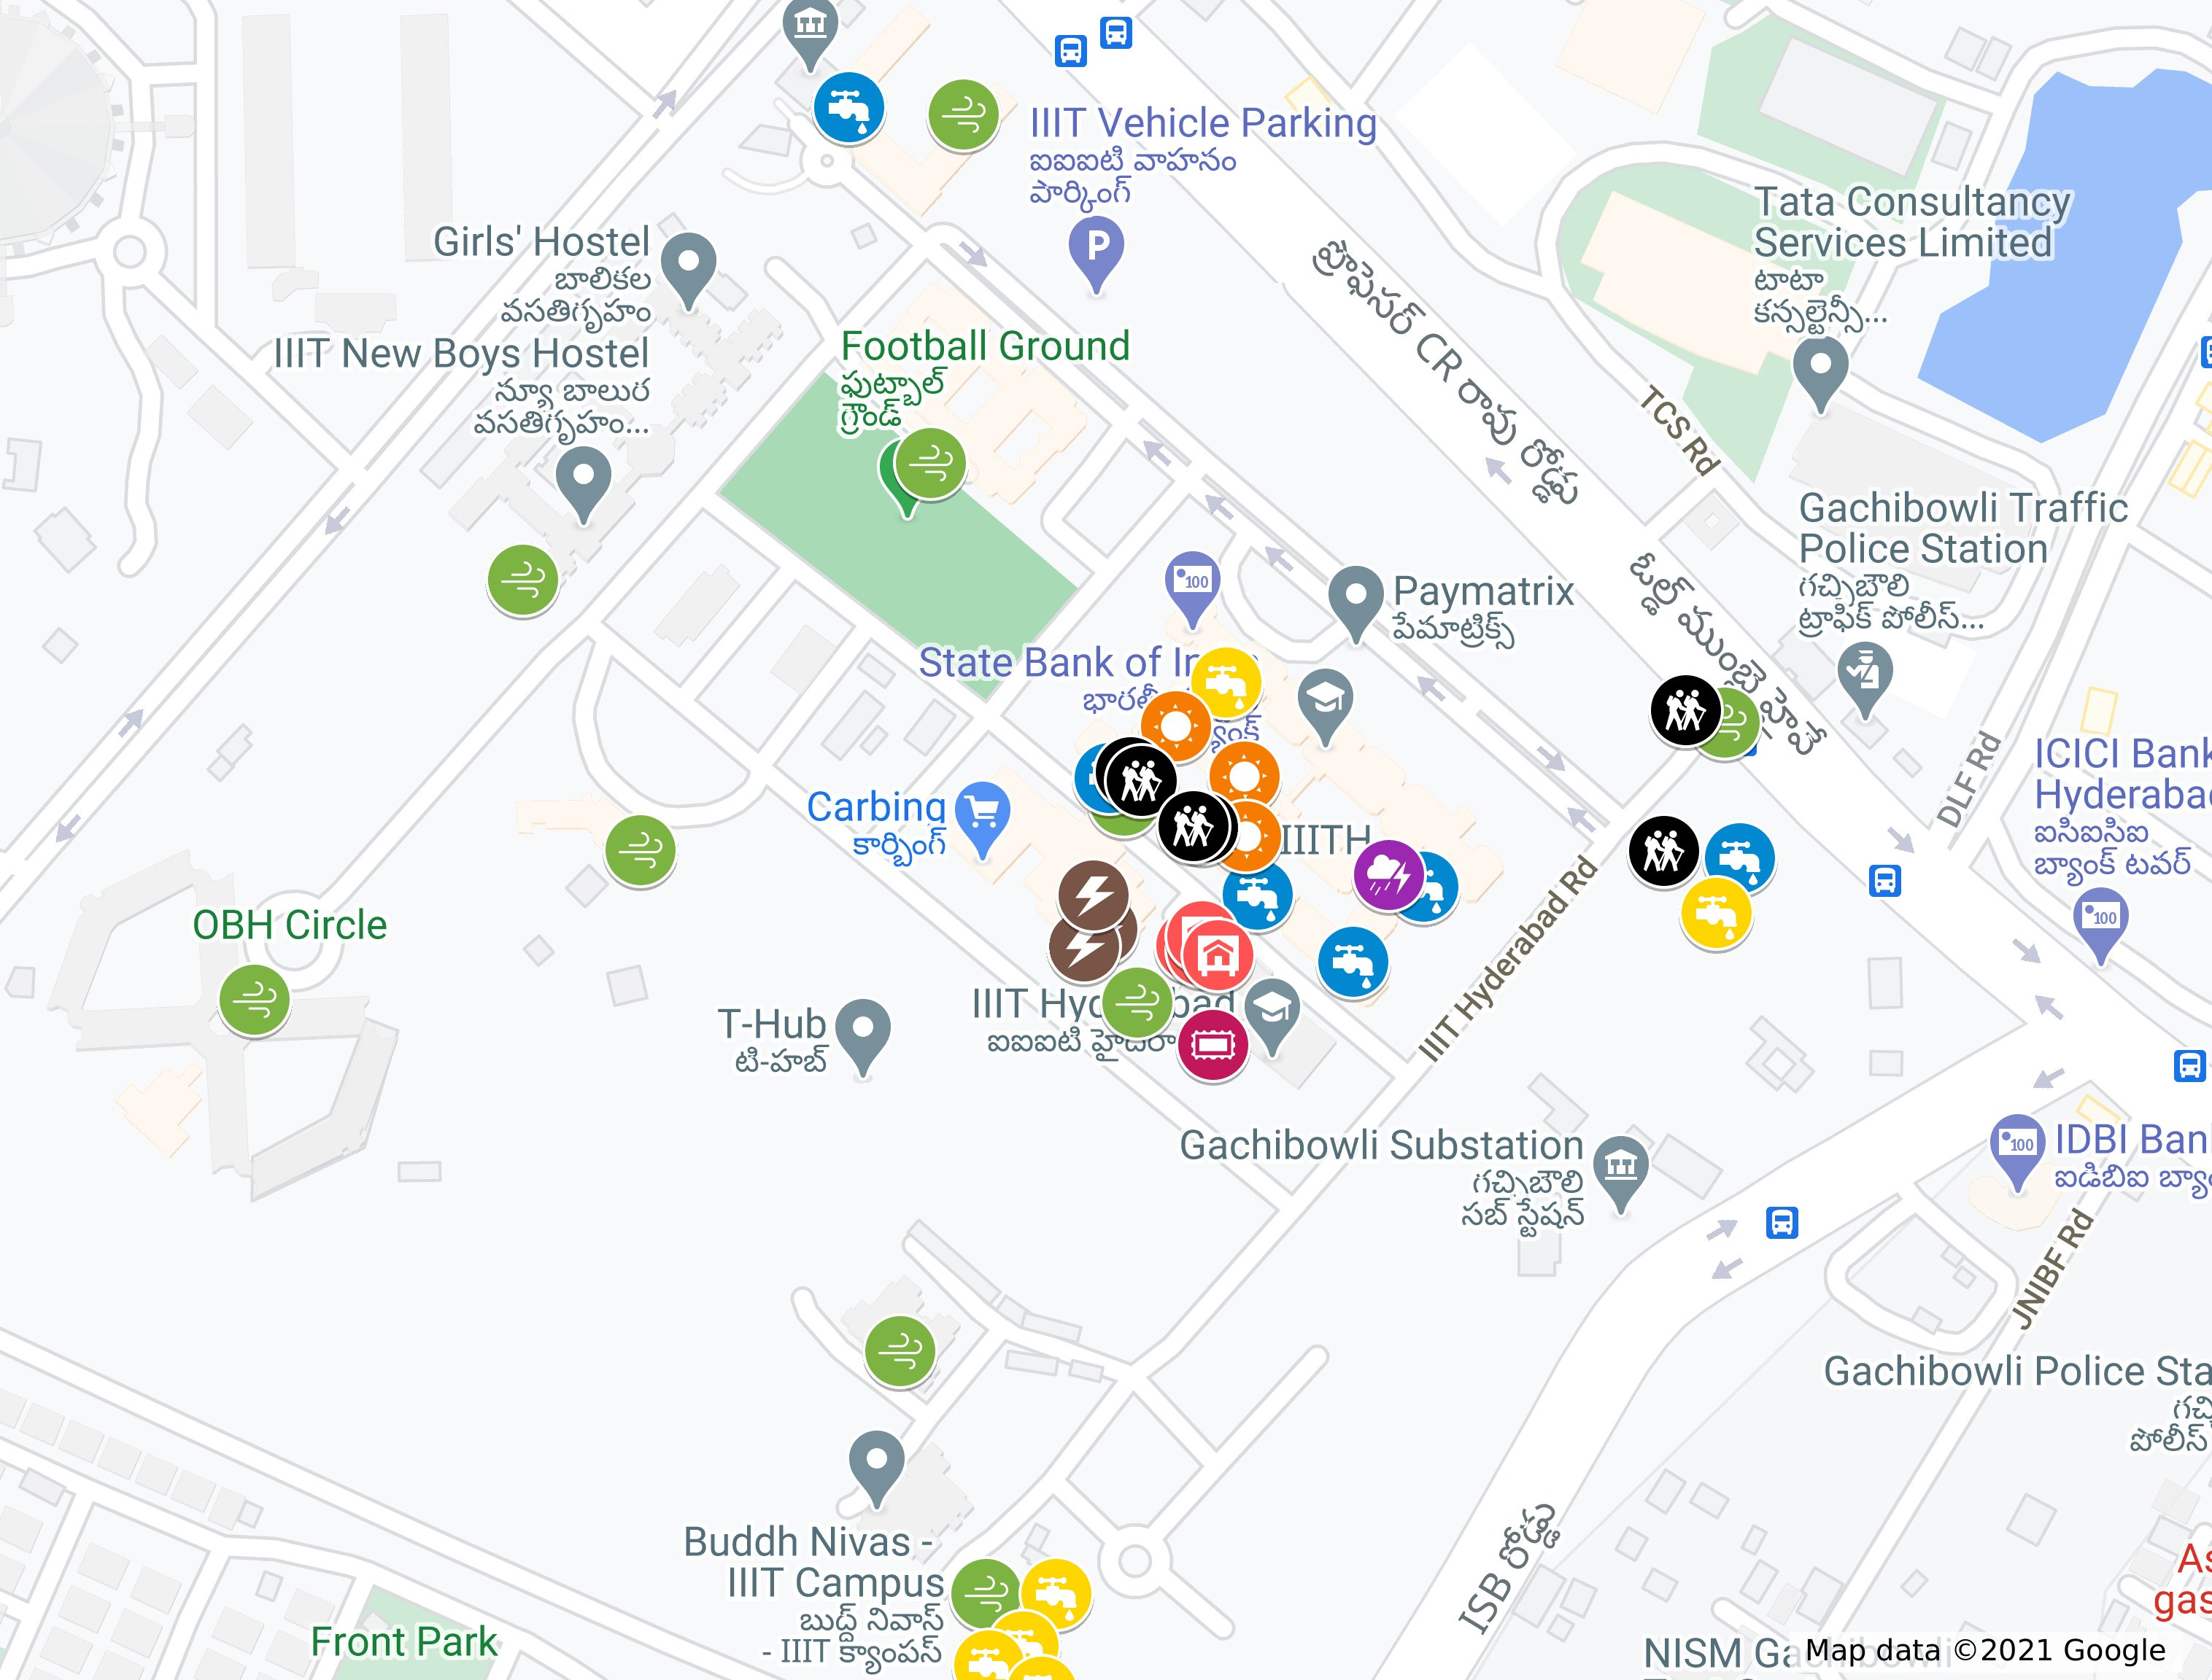









Present Deployment
Air Quality Monitoring
Water Distribution Monitoring
Smart Room Air Quality Monitoring
Water Flow Monitoring
Solar
Weather
Energy
Crowd Monitoring
Smart Room AC

Slide 8
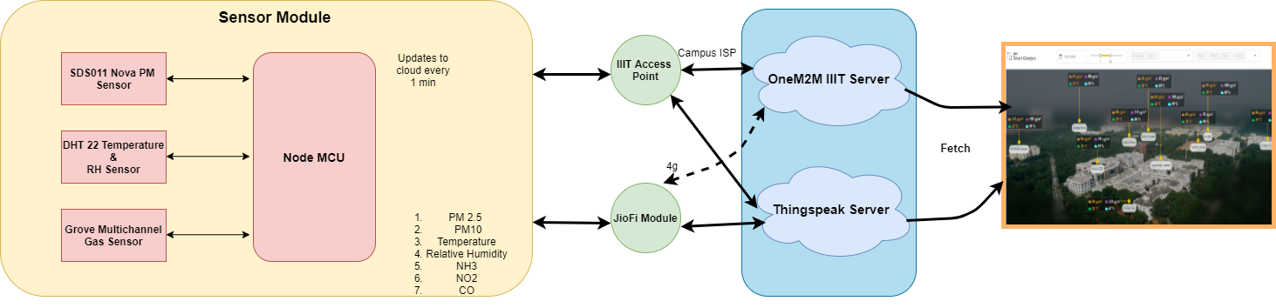
Air Quality
Notes:
The Air Quality Model is having Node MCU as controller which is collecting data at every 15 second about particulate matter, gases like CO, NO2, NH3 and environmental parameters like temperature and Relative humidity. ​
Data get updated on Thingspeak and OneM2M server in string format :{time_stamp, pm25, pm10, temp, rh, co, no2, nh3, aqi, aql, aqlmp, 15sec data/ 10 min data} at every 1 minute through Jio-Fi or IIIT access point from where the data got fetched to dashboard.​

Slide 9
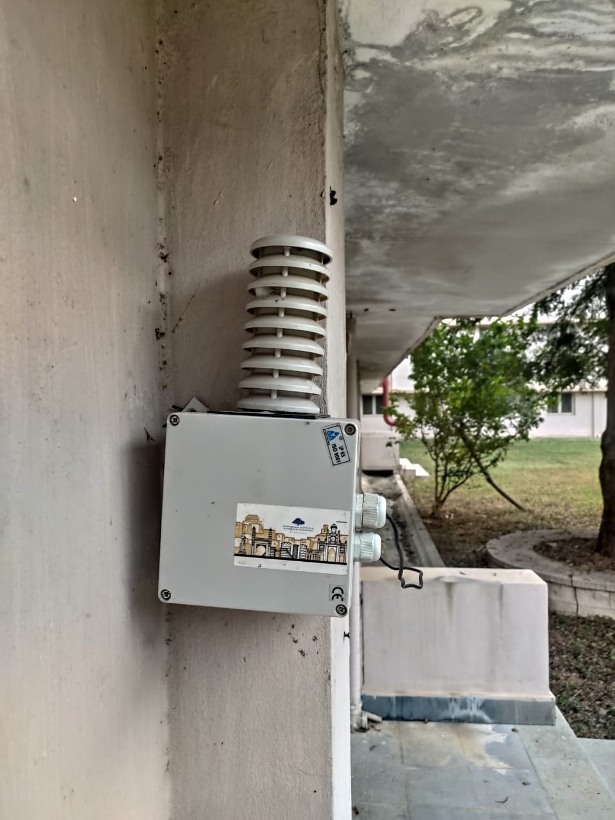
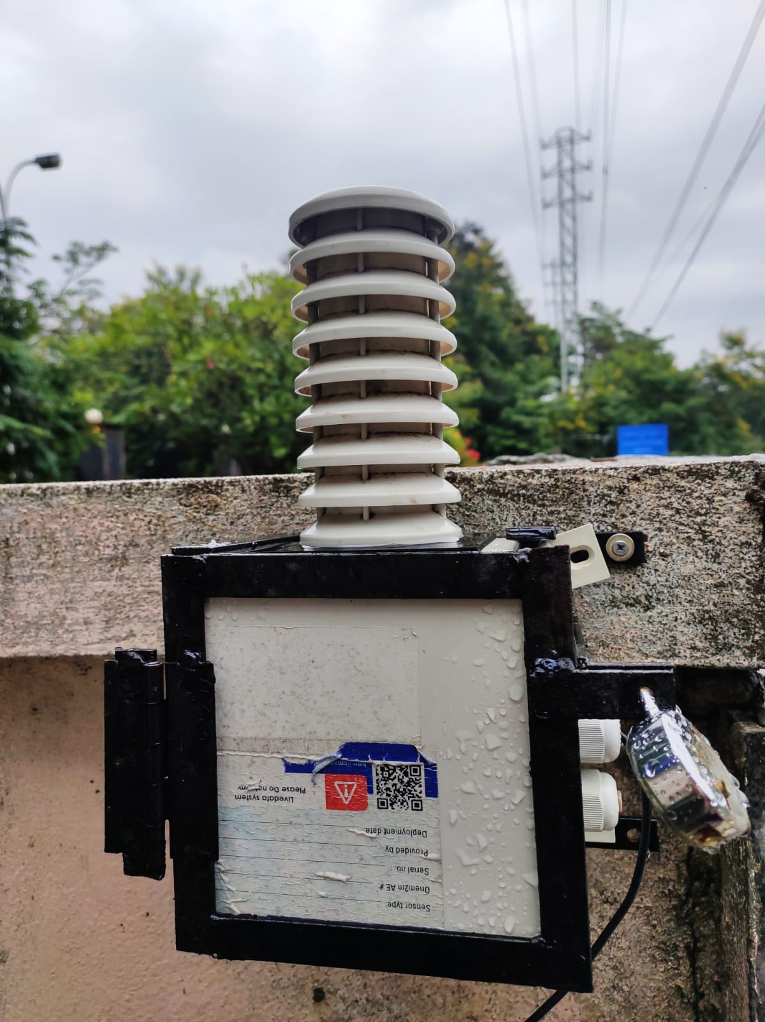
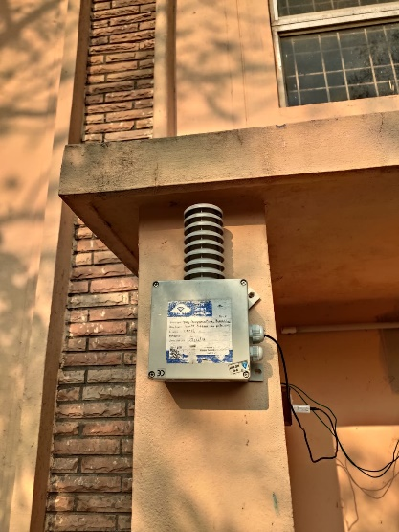
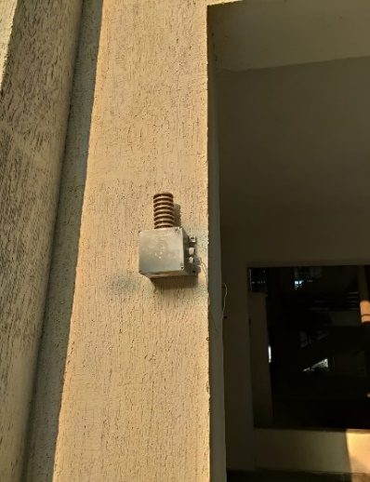
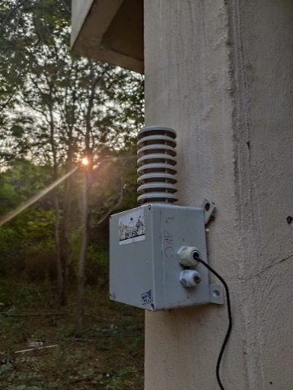
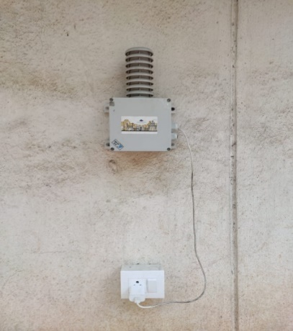
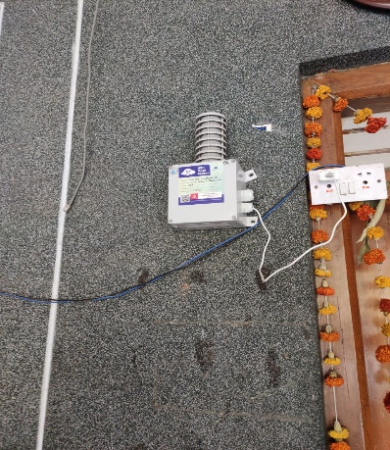
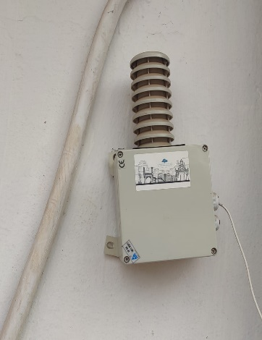
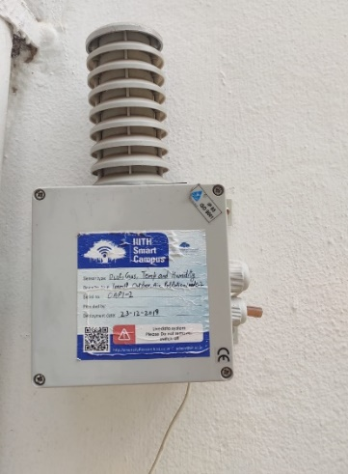
Deployed Nodes
AQ-BN00-00
AQ-MG00-00
AQ-KN00-00
AQ-KH00-00
AQ-PH03-00
AQ-SN00-00
AQ-PL00-00
AQ-FG00-00
AQ-FG00-00

Slide 10
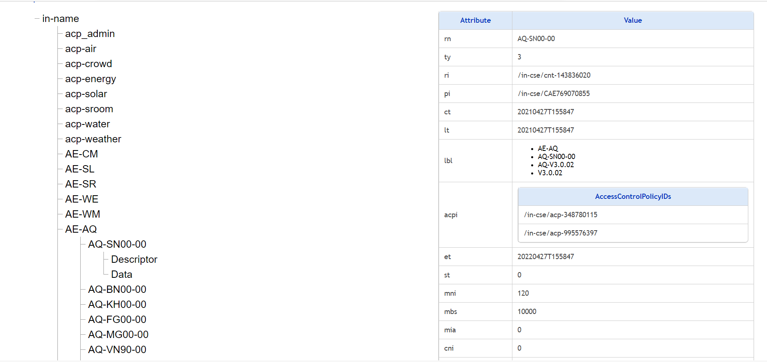
OM2M Resource Tree – Air Quality

Slide 11
OM2M Node Descriptor – Air Quality
Attribute | Value
Node ID | AQ-MG00-00
Location | Latitude: 17.44599, Longitude: 78.35142
Device Model | Controller - ESP8266; Sensors - [(PM2.5, PM10 = SDS011); (Temperature, Relative Humidity = DHT22); (CO, NO2, NH3 Concentration = Groove Multichannel Gas Sensor);]
Version History [Version, Start Date Time, End Date Time] | [V1, 19-08-2020 10:00:00, 99-99-9999 99:99:99];
Data String Parameters | Time Stamp, PM2.5, PM10, Temperature, Relative Humidity, CO Concentration, NO2 Concentration, NH3 Concentration, AQI, AQL, AQI-MP, Data Interval
Measurement Sensor Parameters Description | Data Description, [Units], [Resolution], [Accuracy]
Timestamp | The number of seconds that have elapsed since Thursday, 1970 Jan 1 00:00:00 UTC
PM2.5 | Instantaneous value of PM2.5 (0 ug/m3 to 999.9 ug/m3),ug/m3, particle resolution 0.um and Mass Measurement resolution 0.1 ug/m3, maximum of +-15% of reading and +-10ug/m3
PM10 | Instantaneous value of PM10, ug/m3, particle resolution 0.um and Mass Measurement resolution 0.1 u/m3, maximum of +-15% of reading and +-10ug/m3, minimum value is 0 ug/m3 and maximum value is 999.9 ug/m3
Temperature | Instantaneous value of Temperature, [°C], [0.1 °C], [+-0.5 °C], minimum value is -40 °C and maximum value is 80 °C
Relative Humidity | Instantaneous value of Relative Humidity, [%], [0.1 %], [+-2 %rh], minimum value is 0 and maximum value is 100
CO Concentration | Instantaneous value of CO concentration, ppm, 0.01 ppm, minimum value is 1 ppm and maximum value is 1000 ppm
NO2 Concentration | Instantaneous value of NO2 concentration, 0.01 ppm, minimum value is 0.05 ppm and maximum value is 10 ppm
NH3 Concentration | Instantaneous value of NH3 concentration, 0.01 ppm, minimum value is 1 ppm and maximum value is 500 ppm
Air Quality Information | Description
Air Quality Index (AQI) | Overall Air Quality Index (AQI)
Air Quality Level (AQL) | Air Quality Category Indication. Qualitative level defined according to the local health agencies. For example, 'GOOD', 'MODERATE', 'POOR', 'UNHEALTHY', 'SEVERE', 'HAZARDOUS' etc.
AQI Major Pollutant (AQI-MP) | Major pollutant in the Air Quality Index (AQI). For example 0 - 'PM2.5' and 1 - 'PM10'
Data Interval | Data Interval Indicating 15 seconds or 10 mins data. For example 0 - 15 sec Data and 1 - 10 min data

Slide 12
Response
Output:
{
"m2m:cin": {
"rn": "cin_424155371",
"ty": 4,
"ri": "/in-cse/cin-424155371",
"pi": "/in-cse/cnt-394010075",
"ct": "20211120T082952",
"lt": "20211120T082952",
"lbl": [‘AE-AQ', 'AQ-SN00- 00', ‘V3.0.02' ,'AQ-V3.0.02''],
"st": 0,
"cnf": "text/plain:0",
"cs": 72,
"con": "[1605860957,9.30,25.70,30.30, 49.80,3.23, nan,8.05,nan,9.00,25.70,0,1,0]"
}
}

Slide 13
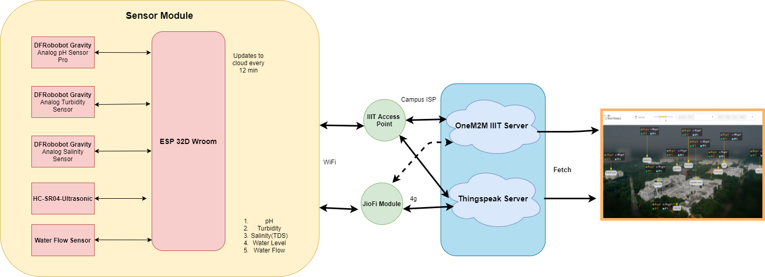
Water
Notes:
Apart from air quality , water quality should also be managed in smart city. In this vertical Water quality is analyzed, various parameters like TDS, Turbidity, Temperature and pH have to be considered. Hence different sensors are used to measure these individual parameters. The ESP32 controller collects the data from the sensors. ​Data get updated on Thingspeak and OneM2M server in string format :{Time Stamp, Turbidity, pH, Water Level} at every 5 minute through IIIT access point from where the data got fetched to dashboard

Slide 14
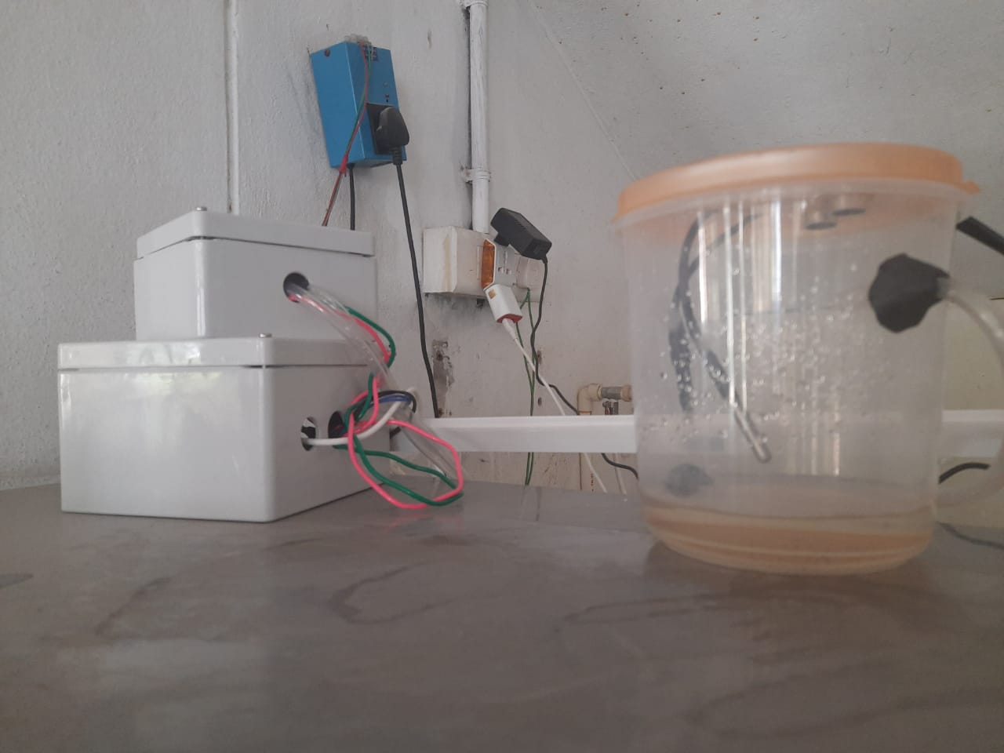
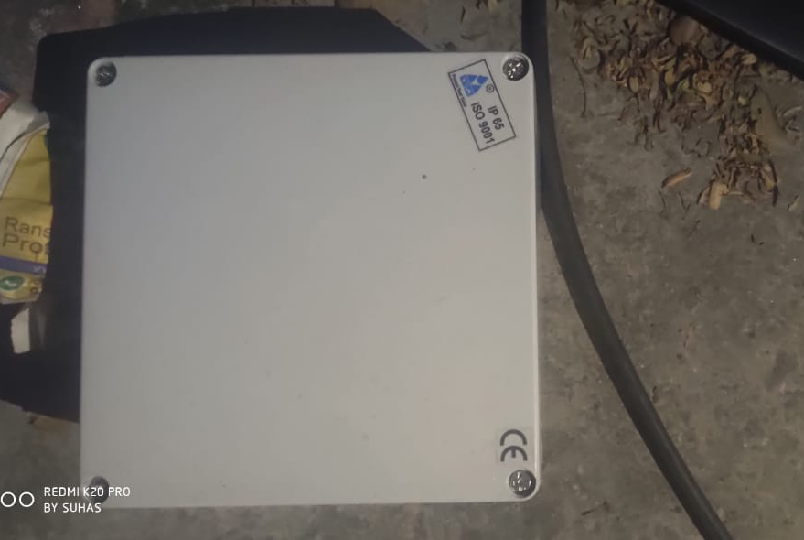
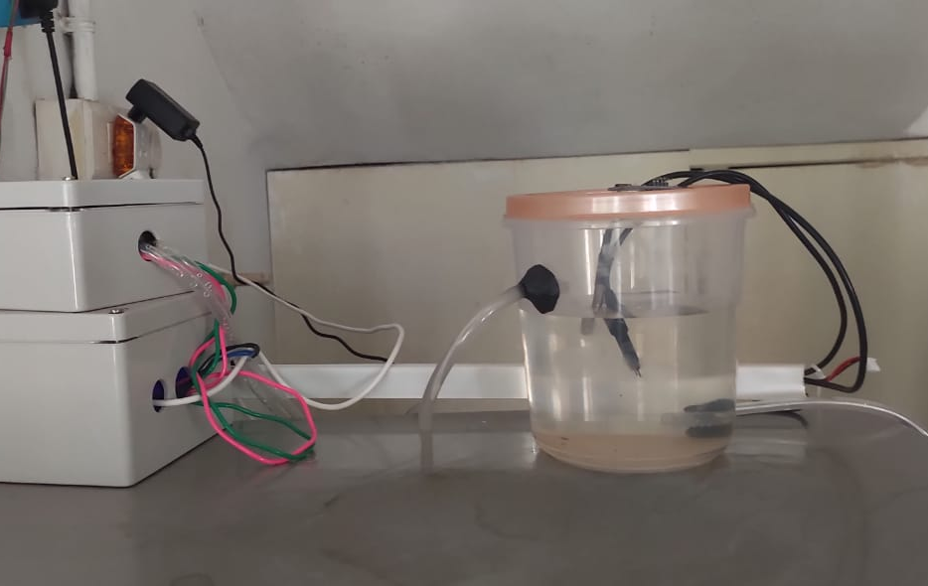
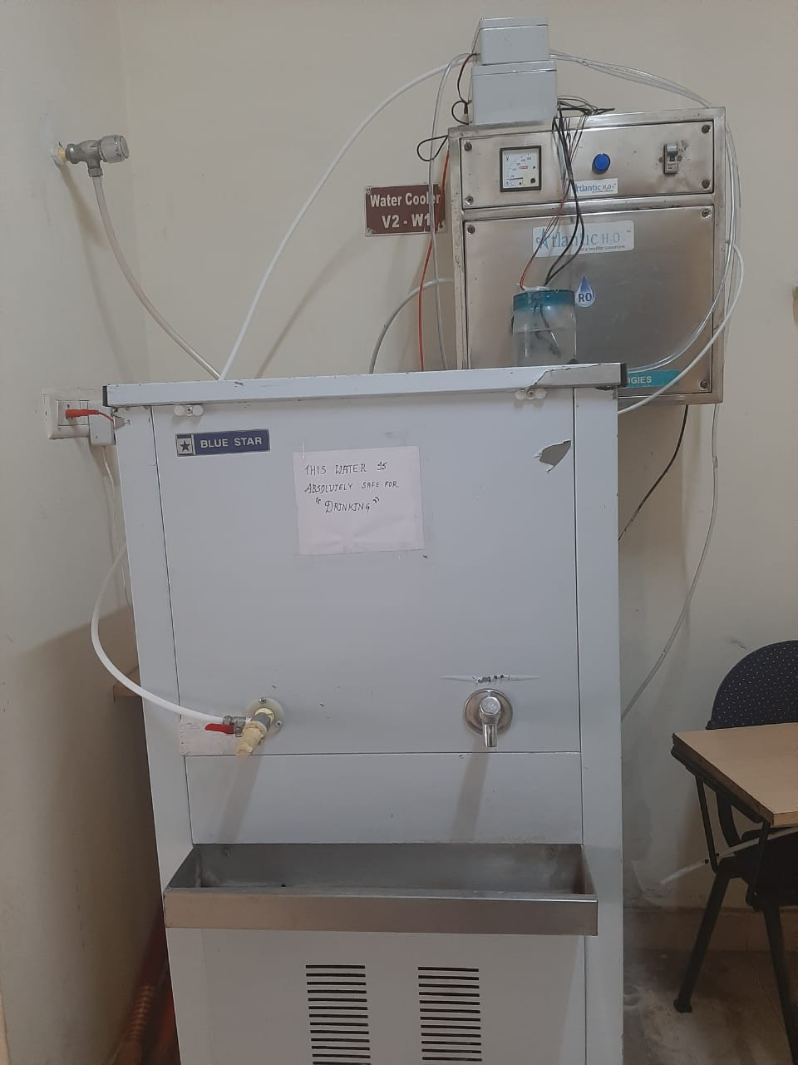
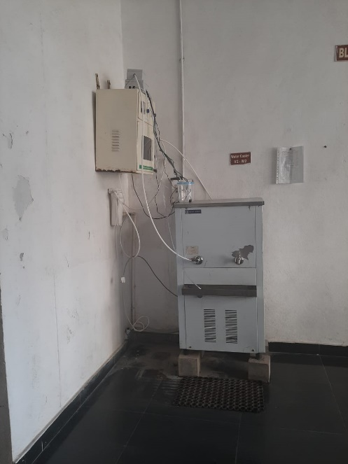
Deployed Nodes

Slide 15
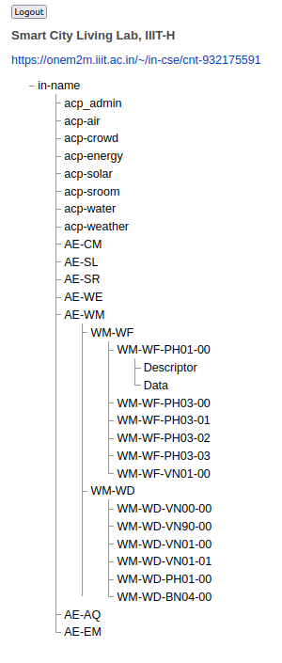
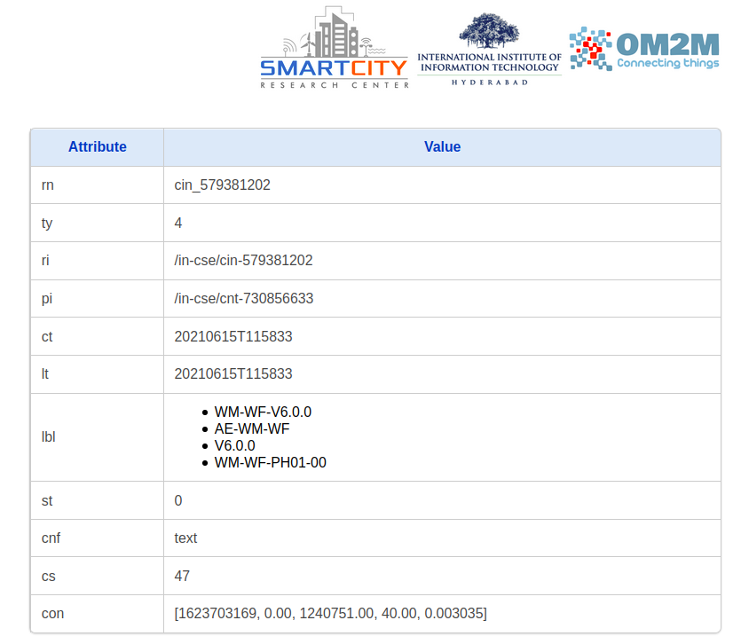
OM2M Resource Tree – Water Distribution

Slide 16
OM2M Node Descriptor – Water Distribution
Attribute | Value
Node ID | WM-WD-VN00-00
Water Distribution Node Location | Latitude: ,Longitude:
Device Model | Controller - ESP32, Sensors - [(Temperature= DFRobot Gravity Temperature Sensor );(TDS= DFRobot gravity: Analog TDS Sensor/meter for Arduino) ; ]
Version History [Version name, Start Date, Start Time, End Time] | [V1, dd-mm-yyyy, hr:min:sec, 9999]; [V2, dd-mm-yyyy, 99999, XXXXXX]
Data String Parameters | Time Stamp, TDS
Measurement Sensor Parameters Description | Data Description, Units, Resolution, Accuracy
Time Stamp | The number of seconds that have elapsed since Thursday, 1970 Jan 1 00:00:00 UTC
Temperature | Instantaneous value of Temperature, °C, 0.1 °C, +-0.5 °C, minimum of -55°C and maximum of 125°C
Salinity (TDS) | Instantaneous value of TDS, ppm (mg/L), 1 ppm, +-10%, minimum value of 0 ppm and maximum of 1000 ppm
Water Level | Instantaneous Water Level , cm , 0.1 cm , +-0.3cm, minimum of 3 cms and maximum of 400 cms

Slide 17

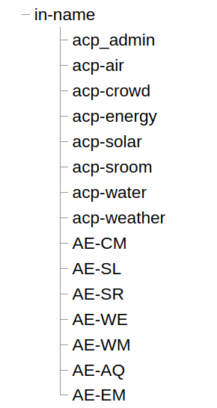
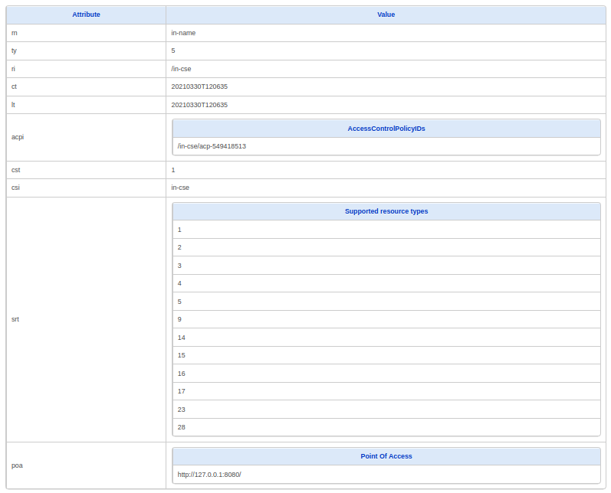
OM2M: IN-CSE Implementation
IN-CSE

Slide 18
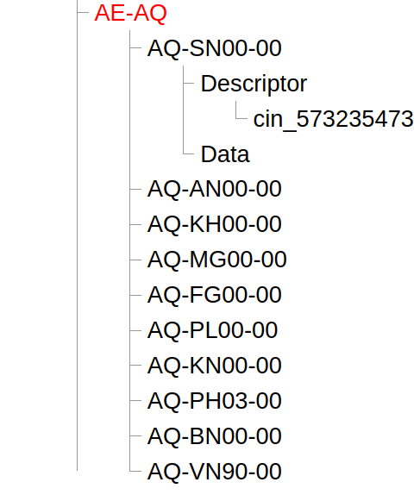
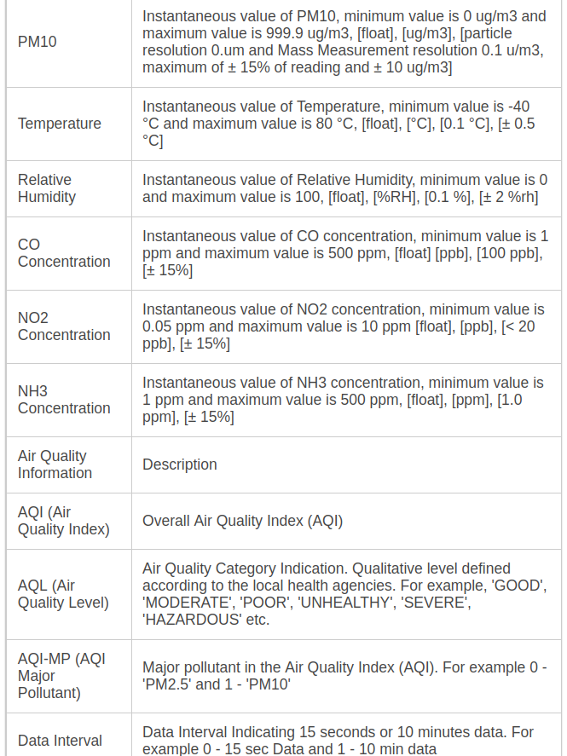
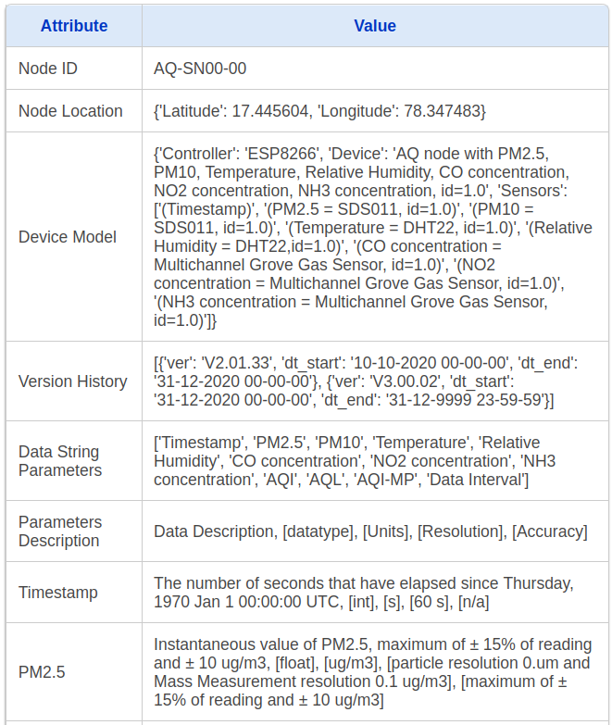
Content Instance - Description

Slide 19
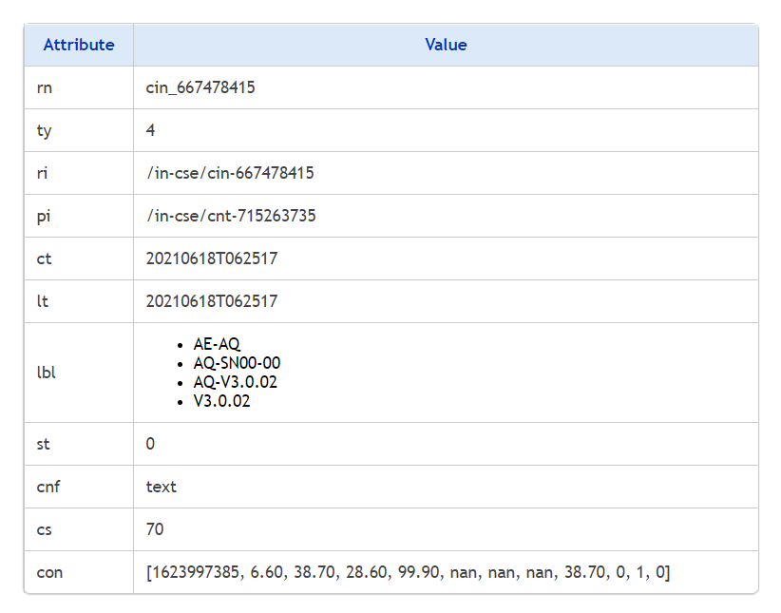
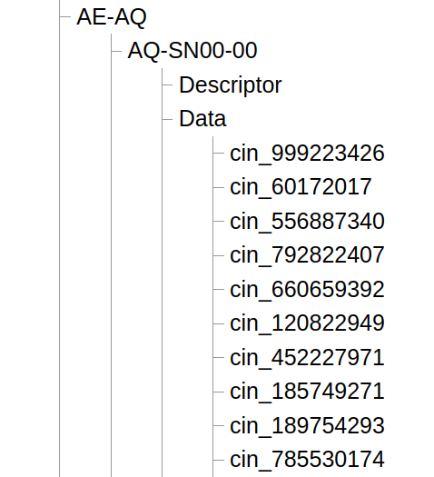
Content Instance - Data

Slide 20
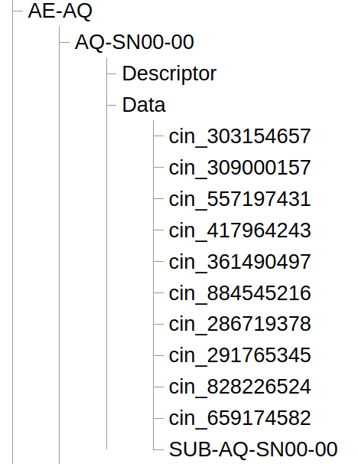
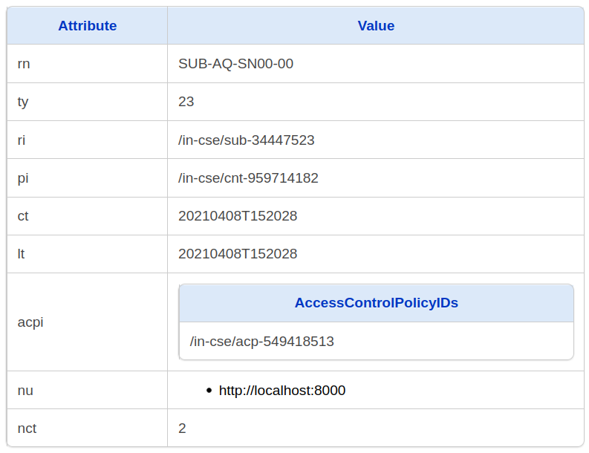
Subscription

Slide 21
Future Challenges
Performance Issues
Improve data retrieval times of latest data from multiple verticals
OM2M evolution
  current version is based on oneM2M release 2

Slide 22
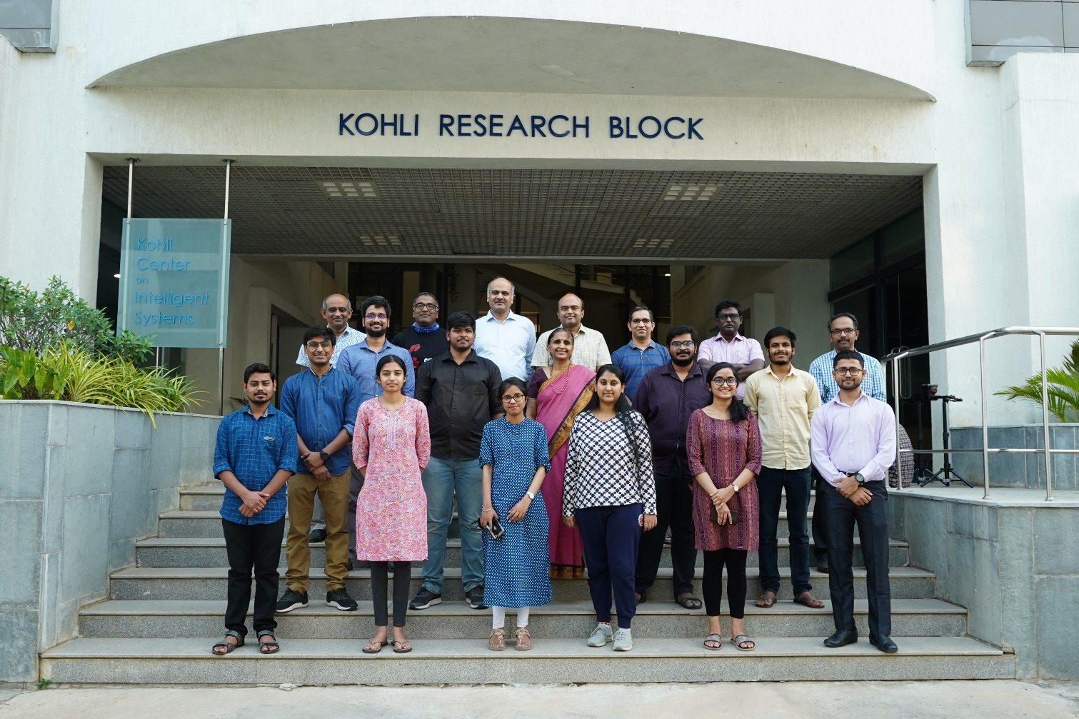
Leadership Team
Mr.Ramesh LogaNathan
Dr.Vishal Garg
Dr.Sachin Choudhuri
Dr.Aftab Hussain
Dr.Deepak Gangadharan
Mr.Y.V.Prakash
Mrs.Anuradha Vattem
Team in Action
Mr.Siddharth Prakash
Mr.Ayu Pamar
Ms.Usha
Mr.CGS Ganesh
Mr Suhas V
Ms. Anuriha Kodali
Mr.Shubham
Mr.Ayush
Mr.Nilesh
Mr.Rhishi Bose
Mr. Akash Bathini
Ms. Ihita Gangavarapu
Mr Ruthwik Muppala

Slide 23
Thank You
Email: deepak.g@iiit.ac.in or smartcityresearch@iiit.ac.in
Notes:
23

